Slide 1
Redundancy and Emergency Interconnectivity Study Water Transmission Grid Study
For the Coosa North Georgia Region
April 22, 2015
Presented by: Michelle Vincent, Jacobs and Tanya Kinnard, Amec Foster Wheeler

Slide 2
Introduction
Background
Redundancy and Emergency Interconnectivity Study
Service Areas
Existing interconnections
Emergency scenarios and reliability targets for focus area
Additional interconnection projects and costs
Next steps and recommendations
Water Transmission Grid Study
Methods and priorities
Conceptual grid development
Potential sources
Recommendations and costs
Future Activities

Slide 3
Background
Studies were commissioned by the Coosa North Georgia Regional Water Planning Council (“Council”) to support Regional Water Plan implementation efforts
The Council:
Established by Georgia's State Water Plan in 2008
Sets direction, goals, and policy for water planning in the region
Works closely with Georgia Environmental Protection Division to produce Regional Water Plans and support implementation
Meets semi-annually to quarterly
The North Georgia Water Partnership (“Partnership”) serves as the technical advisory body for the Council, in addition to implementing goals for water planning and service for the region.
The Partnership:
Formed in 2003
Provides proactive regional water-based planning, technical assistance and education
Meets monthly and assists with implementation process

Slide 4
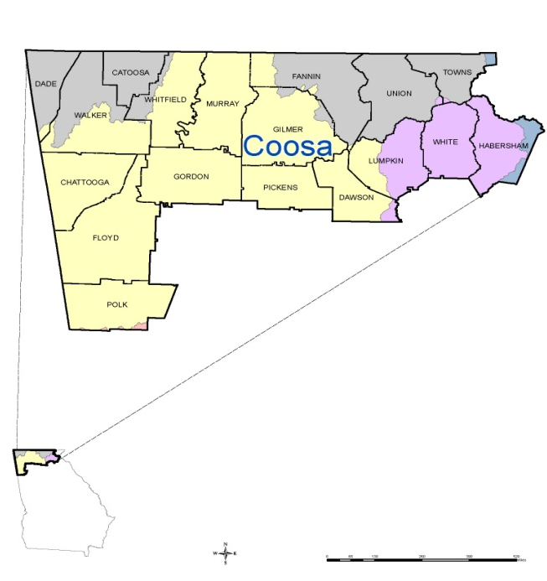
Background
Coosa North Georgia Water Planning Region
River basins: Tennessee, Coosa, Chattahoochee, Savannah

Slide 5
Redundancy and Emergency Interconnectivity
Major tasks of Study:
Data collection
Determine Service Areas - entire region
Analyze and map existing interconnections – focus area
Evaluate emergency scenarios and reliability targets for focus area
Propose additional interconnection projects
Next steps and recommendations

Slide 6
Redundancy and Emergency Interconnectivity
Public Water Service Areas
Notes:
Determined and mapped service areas for region

Slide 7
Redundancy and Emergency Interconnectivity
Modeled after study commissioned by GEFA for the Metro Atlanta area
Goal is to eventually cover entire Coosa Region and incorporate appropriate findings and targets into Regional Plan
Initial Focus Areas
Chatsworth
Dalton
Rome (Floyd County)
Calhoun
Focus area prioritized due to:
High levels of existing interconnections,
Known availability of GIS data
Centralized location.

Slide 8
Redundancy and Emergency Interconnectivity
Data collection
Analysed and mapped existing interconnections
Focus Areas already interconnected
Notes:
Collected data, pipes, water mains, water treatment plan capacities, permit limits, water availability. Demand – current (2010) and 2050 – from Regional Water Plan
Red dots are existing; orange are proposed.

Slide 9
Redundancy and Emergency Interconnectivity
Meeting existing and future demand
Compared existing and future (2050) demand of Annual Average Day demand with water availability
Calhoun’s current supplies would not meet 2050 demand
Focus Area results:
System | Annual Average Day – 2010 Demand | Annual Average Day – 2050 Demand
Chatsworth |  | 
Dalton |  | 
Rome |  | 
Calhoun |  | X
Notes:
For purposes of interconnection plan, we assume that Calhoun will expand or build new water treatment facility to meet demand.

Slide 10
Redundancy and Emergency Interconnectivity
Reliability Targets and Emergency Scenarios
Emergency Scenarios:
Failure of largest treatment facility within a Partnership member’s system
Short-term catastrophic failure of distribution system
Short-term contamination of a water supply system
Short-term contamination of a raw water source
Reliability Targets
100% Annual Average Day Demand
65% Annual Average Day Demand
35% Annual Average Day Demand

Slide 11
Redundancy and Emergency Interconnectivity
Reliability Targets and Emergency Scenarios
Maximum Deficit, for evaluated emergency planning scenarios:
System | 65% of Immediate Demand | 35 % of Immediate Demand | 65% of 2050 Demand | 35% of 2050 Demand
Chatsworth |  |  |  | 
Dalton |  |  | 2.0 MGD | 
Rome |  |  | 2.5 MGD | 
Calhoun |  |  |  | 
Dalton and Rome: Failure of largest water treatment facility or short-term failure of water distribution system.

Slide 12
Redundancy and Emergency Interconnectivity
Proposed additional interconnection projects
Notes:
Red dots are existing; orange are proposed.

Slide 13
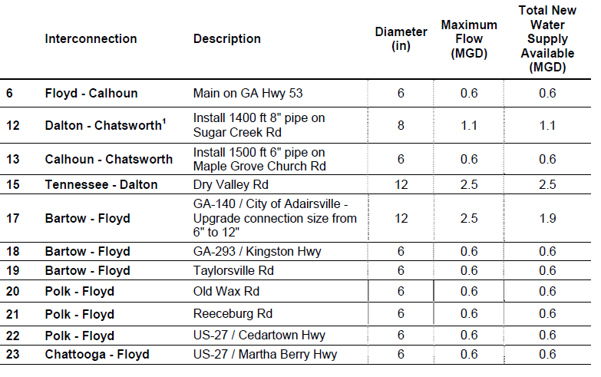
Redundancy and Emergency Interconnectivity
Range of cost ~$10,000 to $230,000 based on length
Notes:
Proposed projects and estimated costs

Slide 14
Redundancy and Emergency Interconnectivity
Next steps and Future Activities:
Phase 1 (current Project): Rome/Floyd, Chatsworth, Dalton, Calhoun [Completed]
Phase 2: Dade, Walker, Catoosa, Chattooga, Polk, (Tennessee) (2016)
Phase 3: Gilmer, Murray, Pickens, Dawson, (Big Canoe), (Tennessee),(connections with Cherokee Co and Metro Influence) (2017)
Phase 4: Fannin, Union, Lumpkin, (Tennessee) (2018)
Phase 5: Towns, White, Habersham (2019)
Phase 6: Compile entire region (2020)
Notes:
Each phase take about 6-9 months, but could be delayed due to budget concerns. Coucld also accelerate timeframe by combining phases.

Slide 15
Water Transmission Grid Study

Slide 16
Water Transmission Grid
Methods and priorities
Worked with Partnership to determine potential water supply sources
Collected regional data
Evaluated
raw vs. finished water
open and/or natural channels vs closed (pipes) channels
Proposed Beyond 2050 Conceptual Grid system
Long term planning approach
hybrid system – majority finished water.
Features (5) “service” zones

Slide 17
Grid Concept Development
Envisioned as one continuous raw or finished pipeline available for anyone to tap
Refined to (4) service zones in GA and (1) service zone in TN
Reality of these endeavors is beyond 2050 as water supply projected needs are minimal through 2050 for the region
Planning for 3rd generation

Slide 18
Conceptual Water Transmission Grid
(Zone 1) - North Blue Ridge
(Zone 2) -Shoal Creek-Upper Chattahoochee
(Zone 3) - Carters Lake-Coosawattee
(Zone 4) - Tennessee Finished Water
(Zone 5) - West Georgia Interconnect

Slide 19
Conceptual Water Transmission Grid

Slide 20
Potential Water Supply Sources
Tennessee Water Systems
Interconnections already exist (Tennessee American Water and Eastside Utility)
Several GA municipalities and communities currently purchase water from TN
Use of finished water avoids controversy

Slide 21
Potential Water Supply Sources
Rome/Dalton/Calhoun
Surplus water available now and near future
As part of Redundancy and Emergency Interconnectivity Study this focus area is identified as an example for the region and possible the state
Highly interconnected already

Slide 22
Potential Water Supply Sources
Regal Springs
A well and surface water spring system
Benefits include requiring minimal treatment
and conveniently located to west side of region

Slide 23
Potential Water Supply Sources
Lake Blue Ridge
Blue Ridge was chosen over Nottley or Chattuge due to proximity to future water needs
Conceptual grid envisions future connection to other lakes in the area

Slide 24
Potential Water Supply Sources
Proposed Reservoir on Dry Creek
Identified in “Preliminary Water Supply Study Technical Memorandum” by Partnership in 2008
Projected yield ~ 12.2 MGD
Located between Catoosa and Whitfield counties
One of highest rated potential reservoirs

Slide 25
Potential Water Supply Sources
Shoal Creek Reservoir
Potential yield 100 MGD
Proximity to southern and eastern Coosa region
Eliminates moving water through difficult terrain

Slide 26
Recommendations and Costs
Closed pipelines to transport water
Break region into interconnected zones
Move water through path of least resistance
Costs for these types of project pipeline scenarios range from $17M to $58M per zone or on average at $11M per pipeline length
Similar projects around the world range from $100s of millions to $1 billion

Slide 27
Operation of Grid
Grid Operation
Proposed “Chain Memorandum of Understanding” (MOU)
Allows existing agreement to remain and additional agreements to be added later
Agreements clarify how water will be transported throughout a zone

Slide 28
Water Transmission Grid
Future Activities:
Incorporate additional interconnection areas
Collect additional data: utilities corridors.
Identify future regional water supply projects
Establish regional goals
Target emergency redundancy rates 35% and 65%?
Local and regional systems work to achieve goals.

Slide 29
Comments, Questions and Discussion
Michelle Vincent, Jacobs and Tanya Kinnard, Amec Foster Wheeler

