Slide 1
North Georgia Agricultural Water Use Study
North Georgia Water Resources Educational Seminar
Erin Lincoln, PH
April 22, 2015

Slide 2
Introduction

Slide 3
Introduction
Determine existing permitted and non-permitted water use information available
Determine water use needs for specific agricultural products
Crops (corn, apple orchards, etc.)
Poultry
Livestock (beef, dairy, swine, etc.)
Determine gaps in existing data and plan to fill the gaps

Slide 4
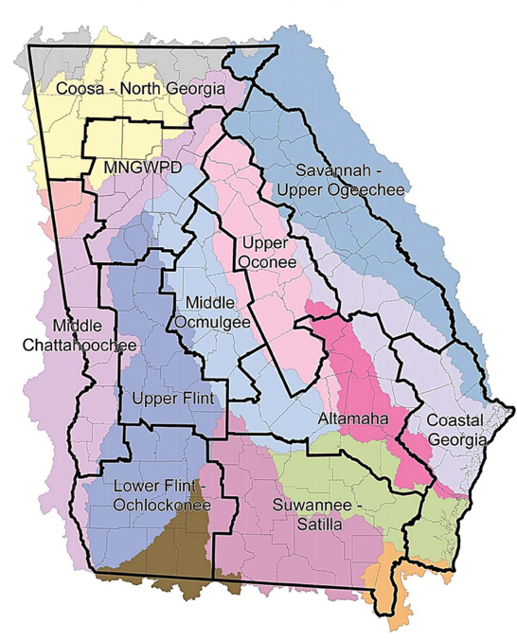
Introduction
North Georgia Water Resources Partnership
Northwest Georgia Regional Commission
Coosa-North Georgia Water Planning Region
18 Counties
Chattahoochee, Coosa, and Tennessee Watersheds
Blue Ridge, Ridge and Valley, Piedmont Eco-Regions
Notes:
Surface Water
Several major rivers
Numerous small streams and tributaries
Farm ponds and small impoundments
Groundwater
Water in fracture and bedding plains
Unreliable sources of water

Slide 5
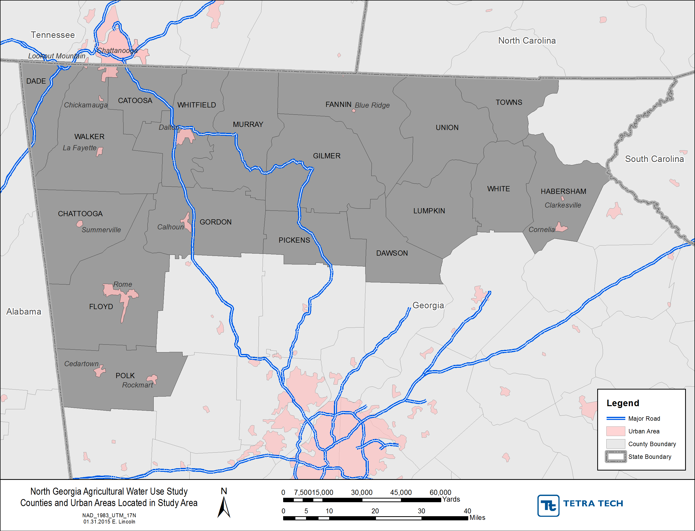
Introduction

Slide 6
North Georgia Physiographic Provinces

Slide 7
North Georgia Crop Acreage

Slide 8
North Georgia Crop Acreage
2008 Georgia Land Use Trend (GLUT)
Natural Resources Spatial Analyst Laboratory (NARSAL)
LANDSAT data
2014 Farm Gate Value Report
College of Education and Agricultural Sciences
County Extension Agents

Slide 9
North Georgia Crop Acreage

Slide 10
North Georgia Crop Acreage

Slide 11
Estimated Irrigated Acreage
Agricultural Permitting Unit of GAEPD
Permit required for withdrawals of 100,000 GPD
Small farms typically don’t need a permit
National Environmentally Sound Production Agriculture Laboratory (NESPAL)
Agricultural Permitting Unit of GAEPD
Agricultural and Water Conservation and Metering Program (GSWCC)
GIS Imagery

Slide 12
GAEPD Permits
182 Agricultural Irrigation Permits
176 surface water withdrawals
6 groundwater withdrawals
Withdrawal permits for 13,852 acres of crops
22% to 36% of total row crop acreage

Slide 13
Estimated Crop Irrigation Requirements

Slide 14
Estimated Crop Irrigation Requirements
Over 40 Crop Studies/Papers Reviewed
North Georgia crop water requirements
North Carolina Irrigation Guide (NRCS)
University of Georgia (CAES)
Extension agents/researchers
UGA Research Farms
Agricultural Water Demand Report (NESPAL)
Crop water usage models
Cooperative extension service irrigation surveys

Slide 15
Estimated Crop Irrigation Requirements
Groundwater Use Act (OCGA § 12-5-90)
All new agricultural withdrawal permits or amended permits issued after July 1, 2003 be metered
Farmers must install meters themselves
GSWCC collects water use data
6% of Withdrawals in NGWRP Metered
Annual irrigation depth
No information on irrigated acreage, crop type, or monthly usage

Slide 16
Estimated Crop Irrigation Requirements
Irrigation amounts extremely variable between farmers
Desired yields/personal preference
Soil/topography
Irrigation system efficiency rates
On average, crops typically need 1 in/week
Fruit, vegetables, and ornamentals need more
1.1 to 1.3 in/week due to irrigation efficiencies
No irrigation during wet years

Slide 17
Average Monthly Precipitation

Slide 18
Estimated Crop Irrigation Requirements

Slide 19
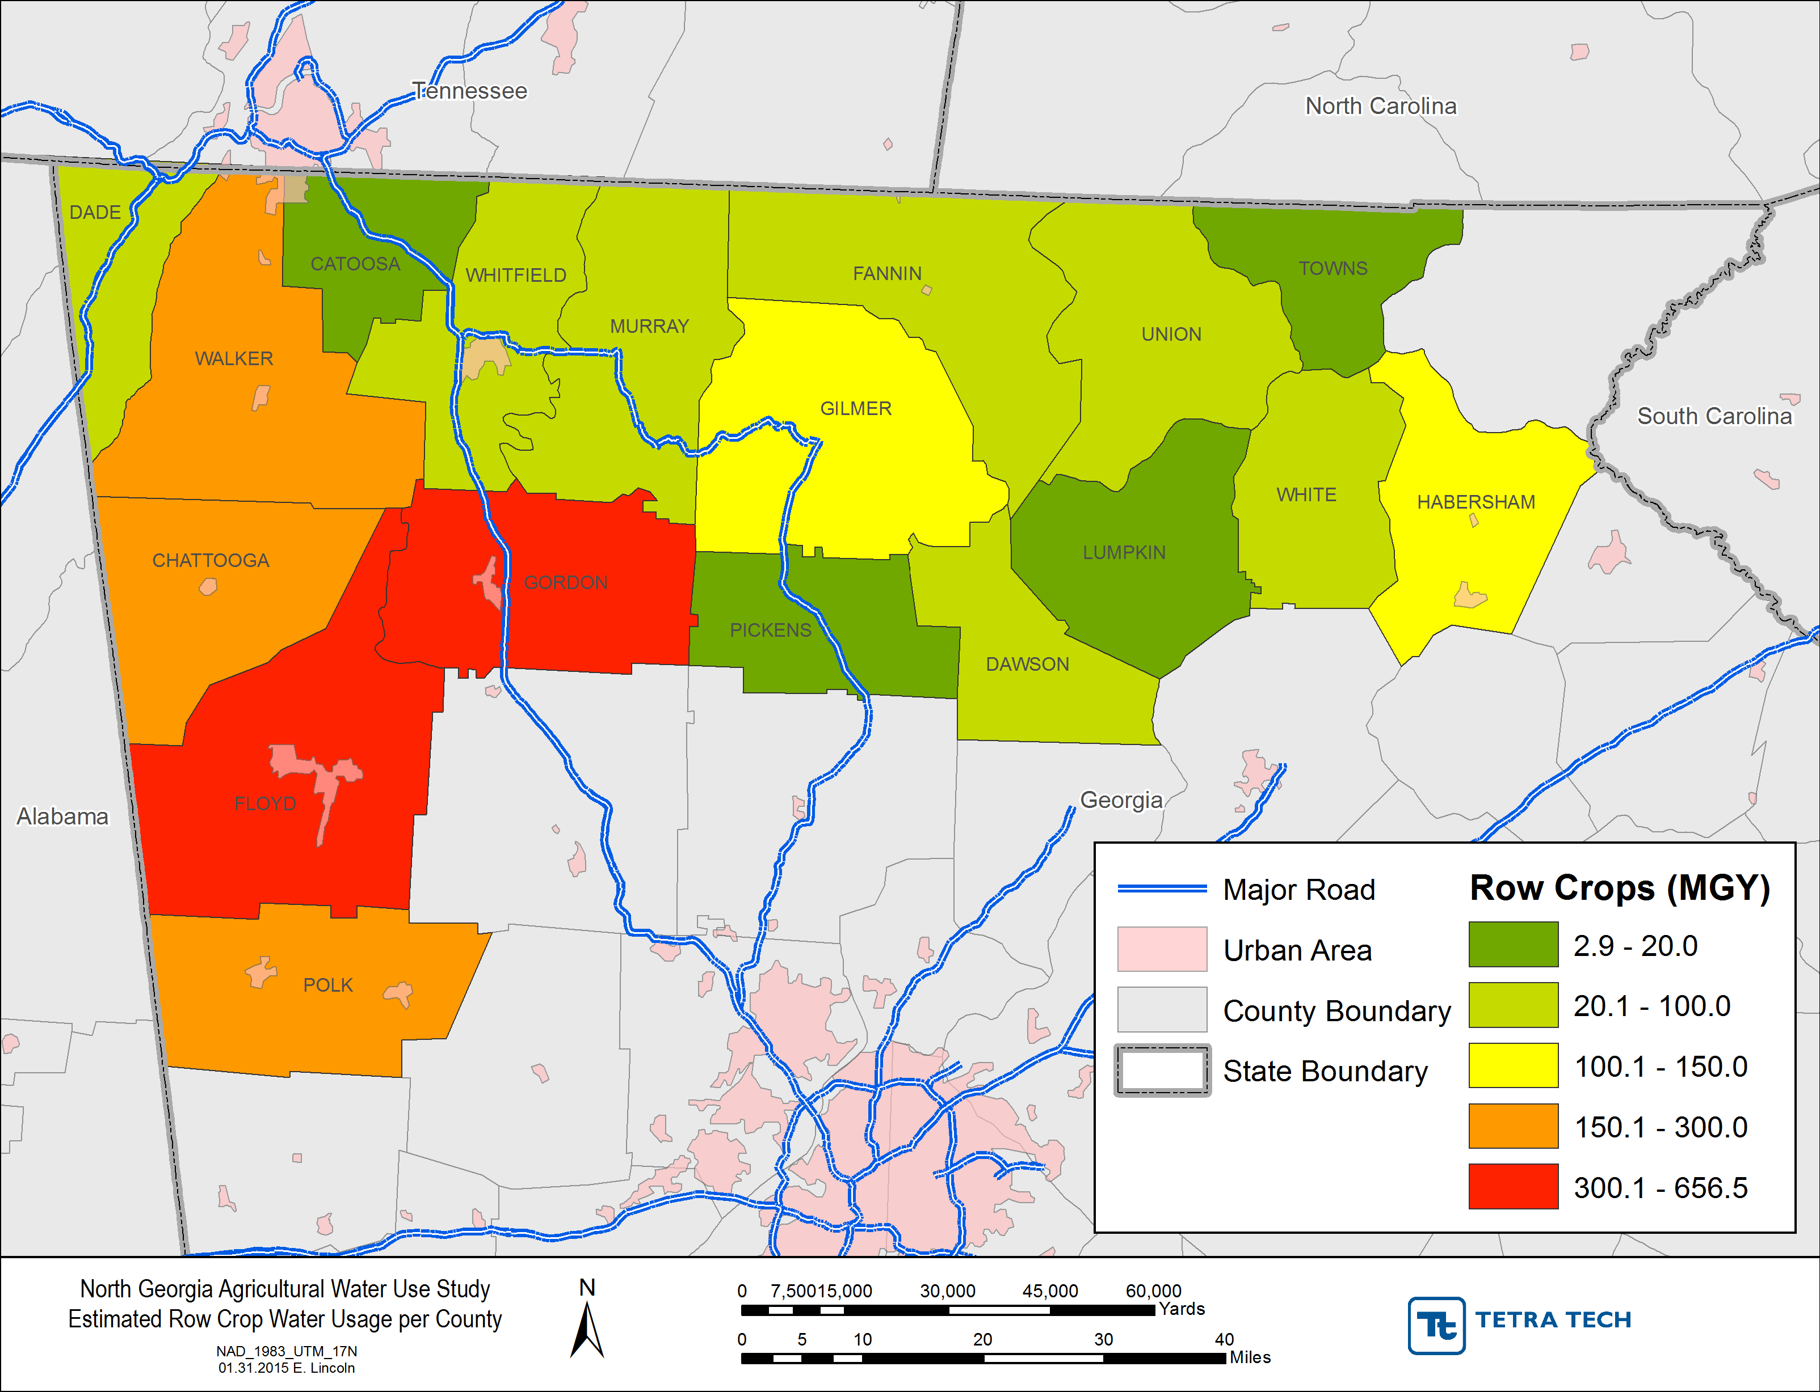
Estimated Row Crop Water Use

Slide 20
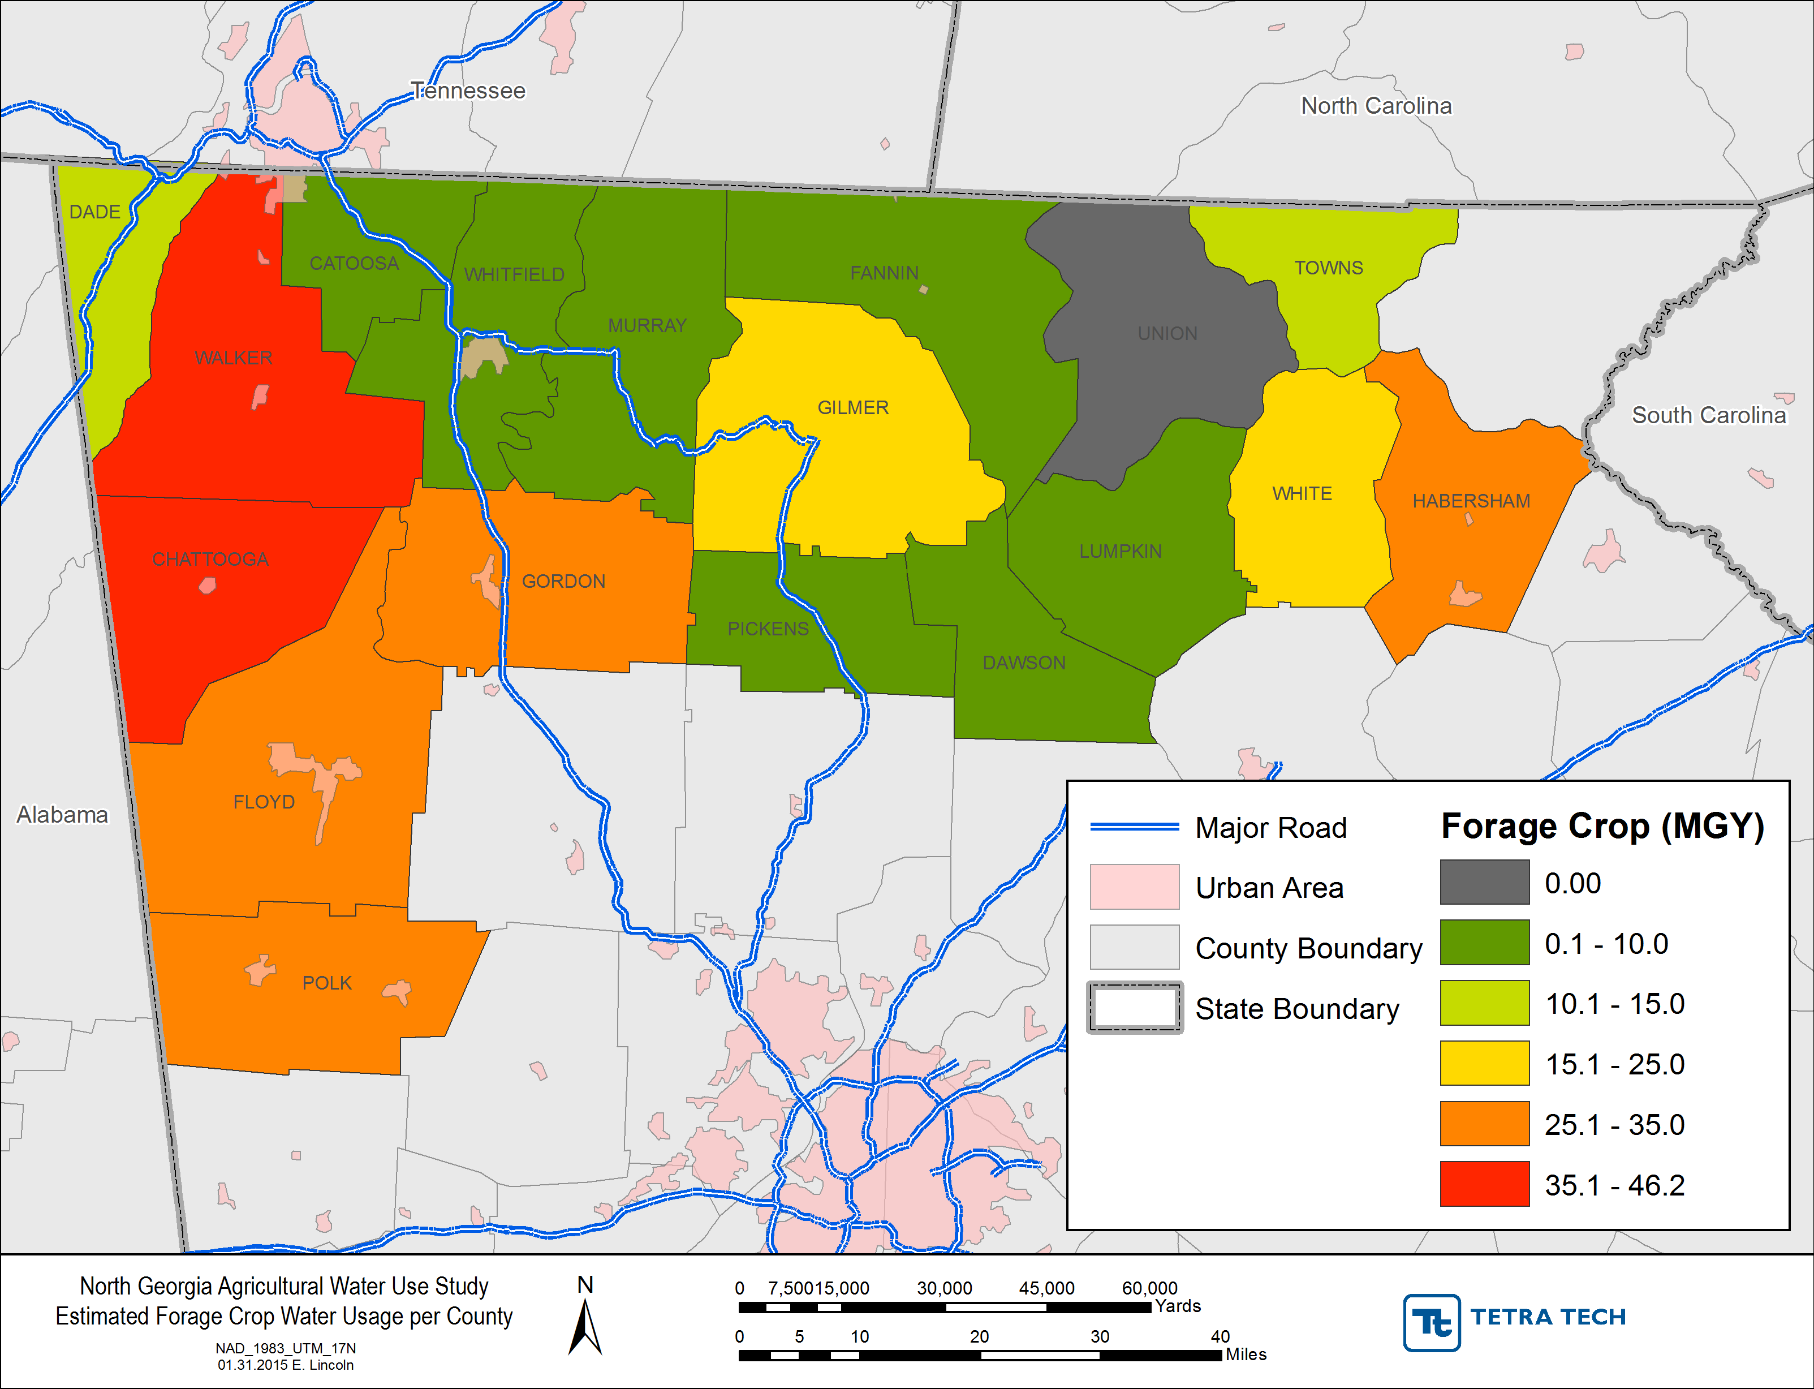
Estimated Forage Crop Water Use

Slide 21
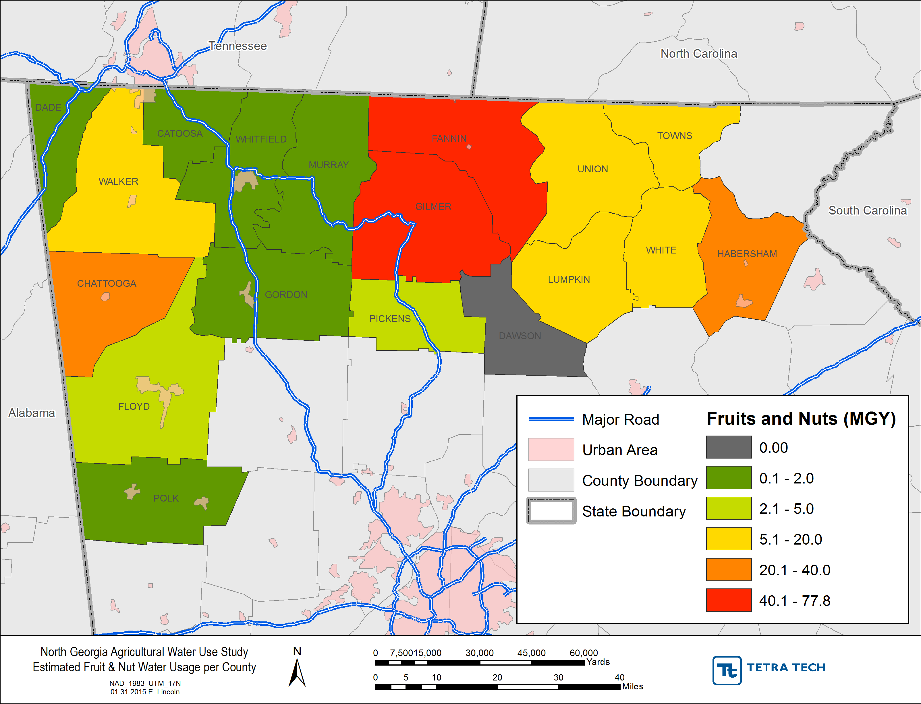
Estimated Fruit & Nut Water Usage

Slide 22
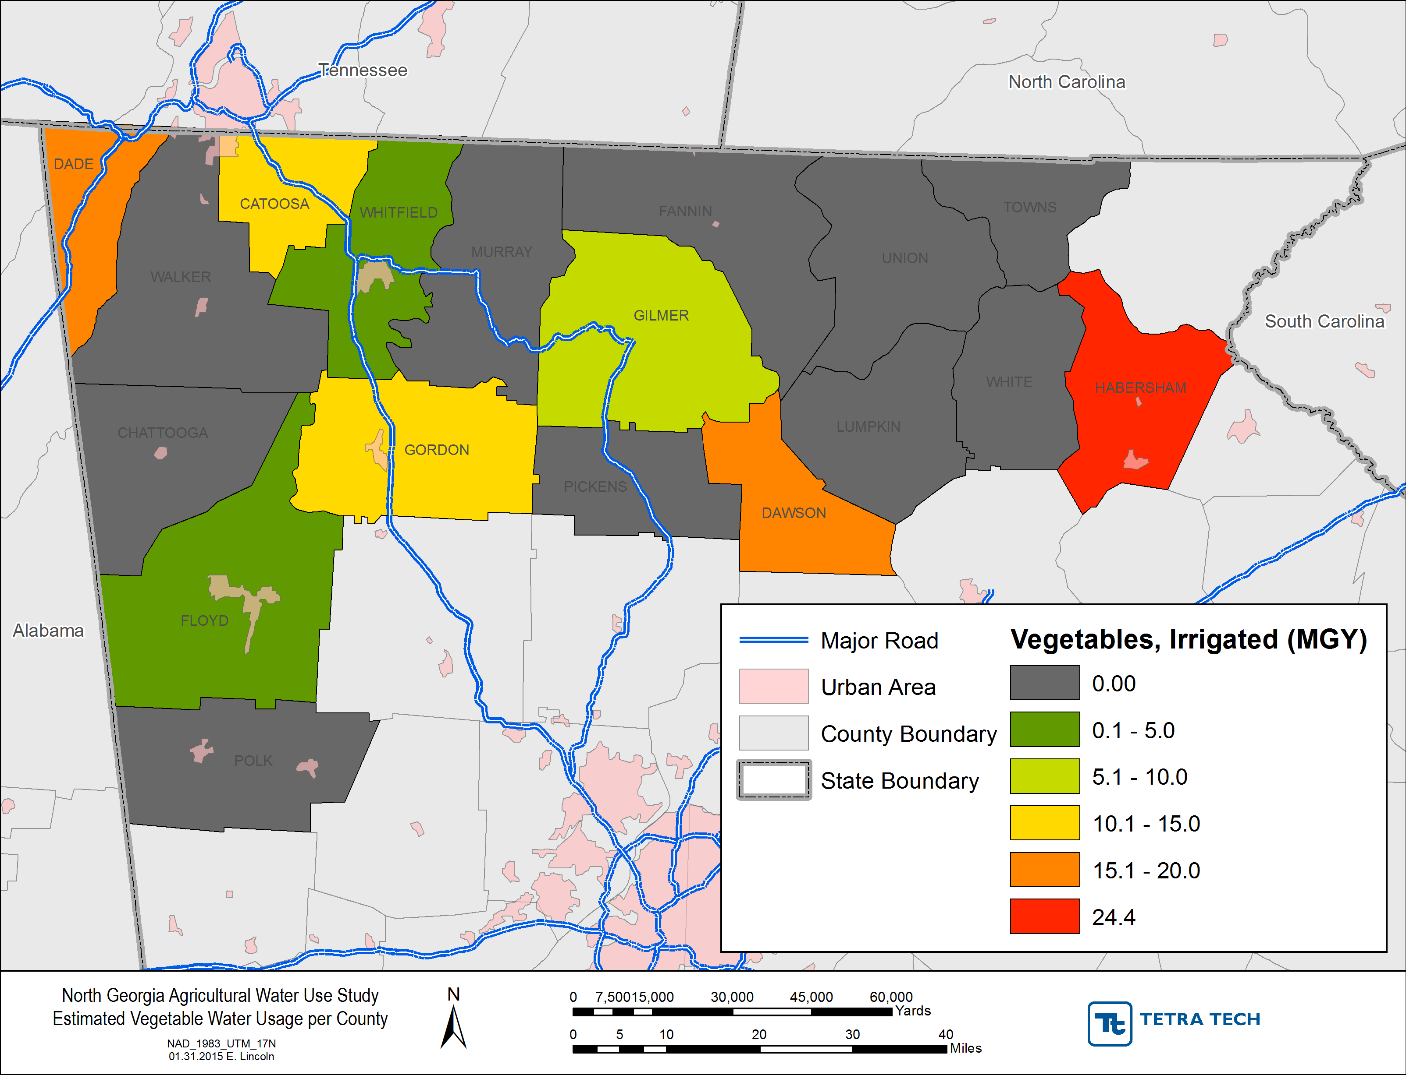
Estimated Vegetable Water Use

Slide 23
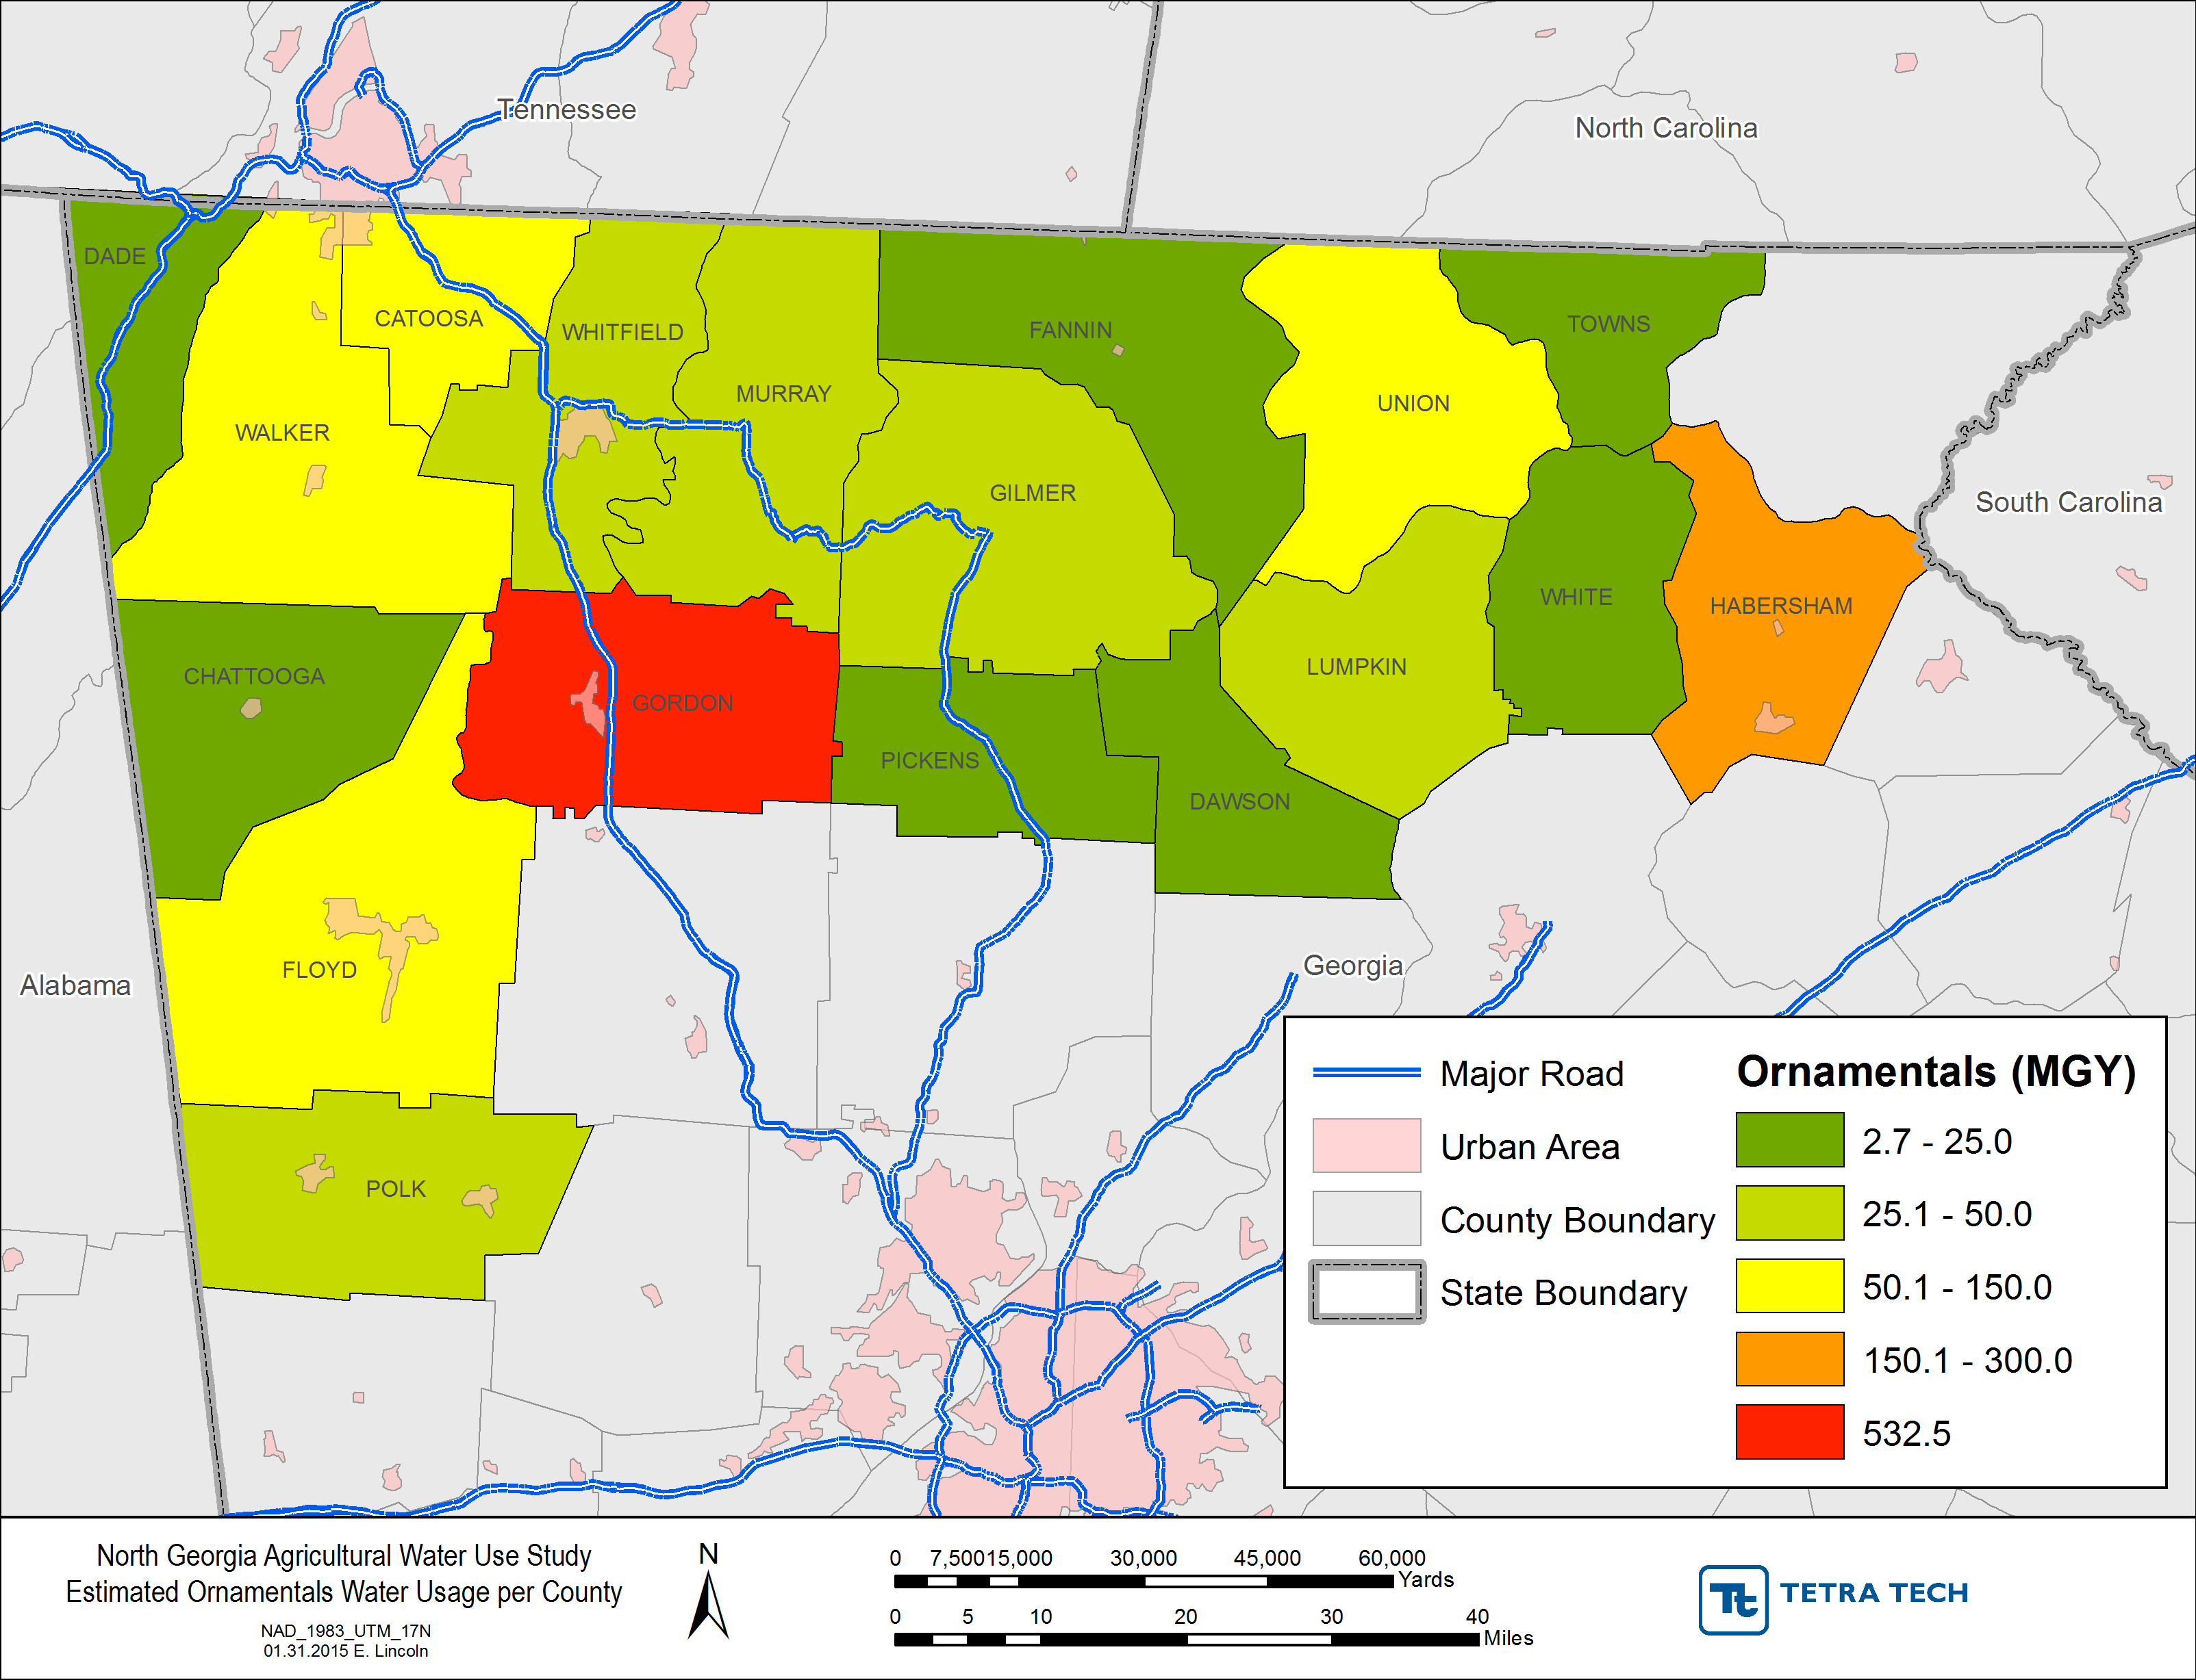
Estimated Ornamental Water Use

Slide 24
Estimated Poultry & Livestock Water Usage

Slide 25
Estimated Poultry & Livestock Water Usage
19 withdrawal permits for poultry & livestock
Total number of animals and water usage sources
2014 Farm Gate Value Report
GA Poultry Federation
University of Georgia (CAES)
Agricultural Water Demand Report (NESPAL)
Water usage depends on animal type and season
Animal size and lifespan
Consumption and evaporative cooling

Slide 26
Estimated Poultry Water Usage

Slide 27
Estimated Livestock Water Usage

Slide 28
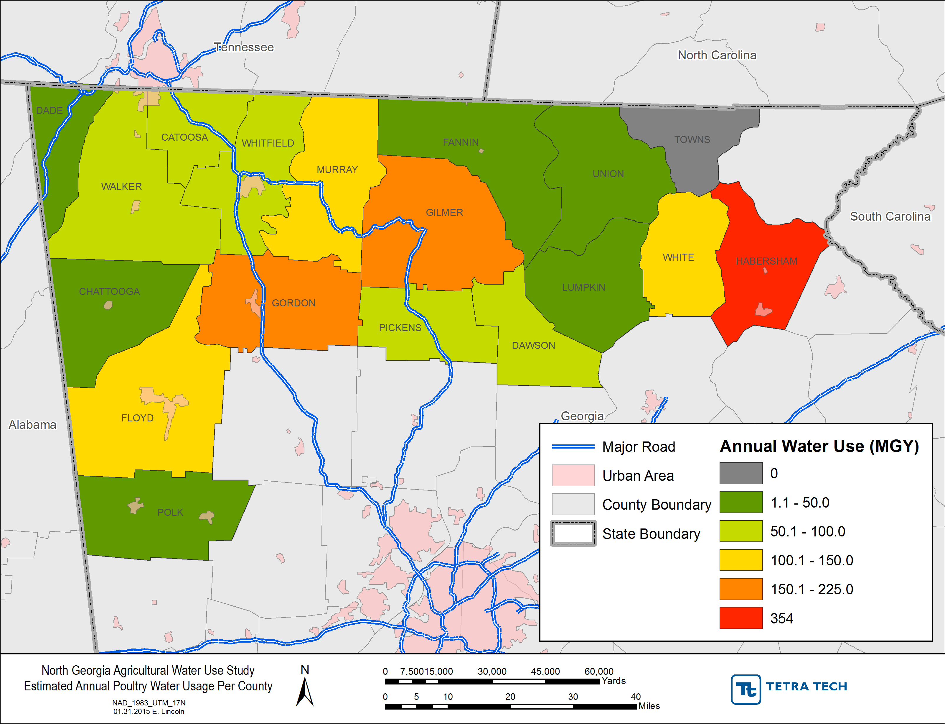
Estimated Poultry Water Usage

Slide 29
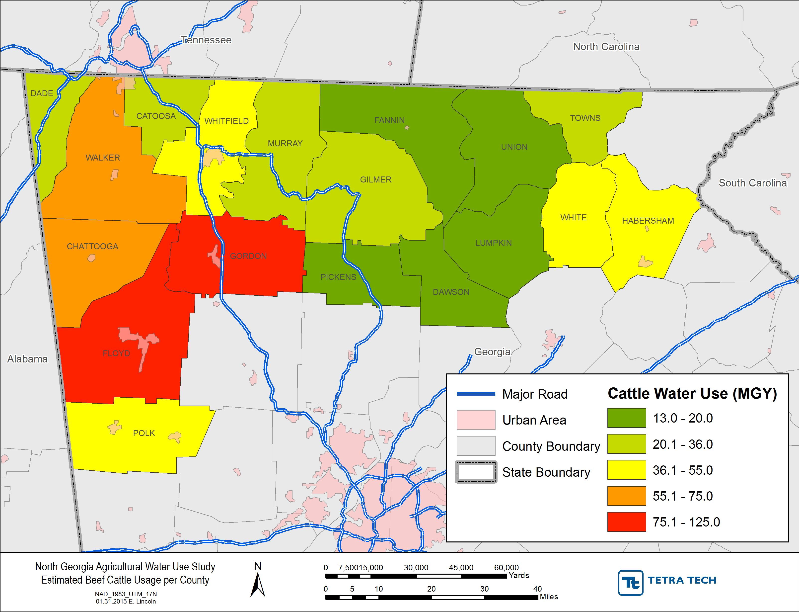
Estimated Beef Cattle Water Usage

Slide 30
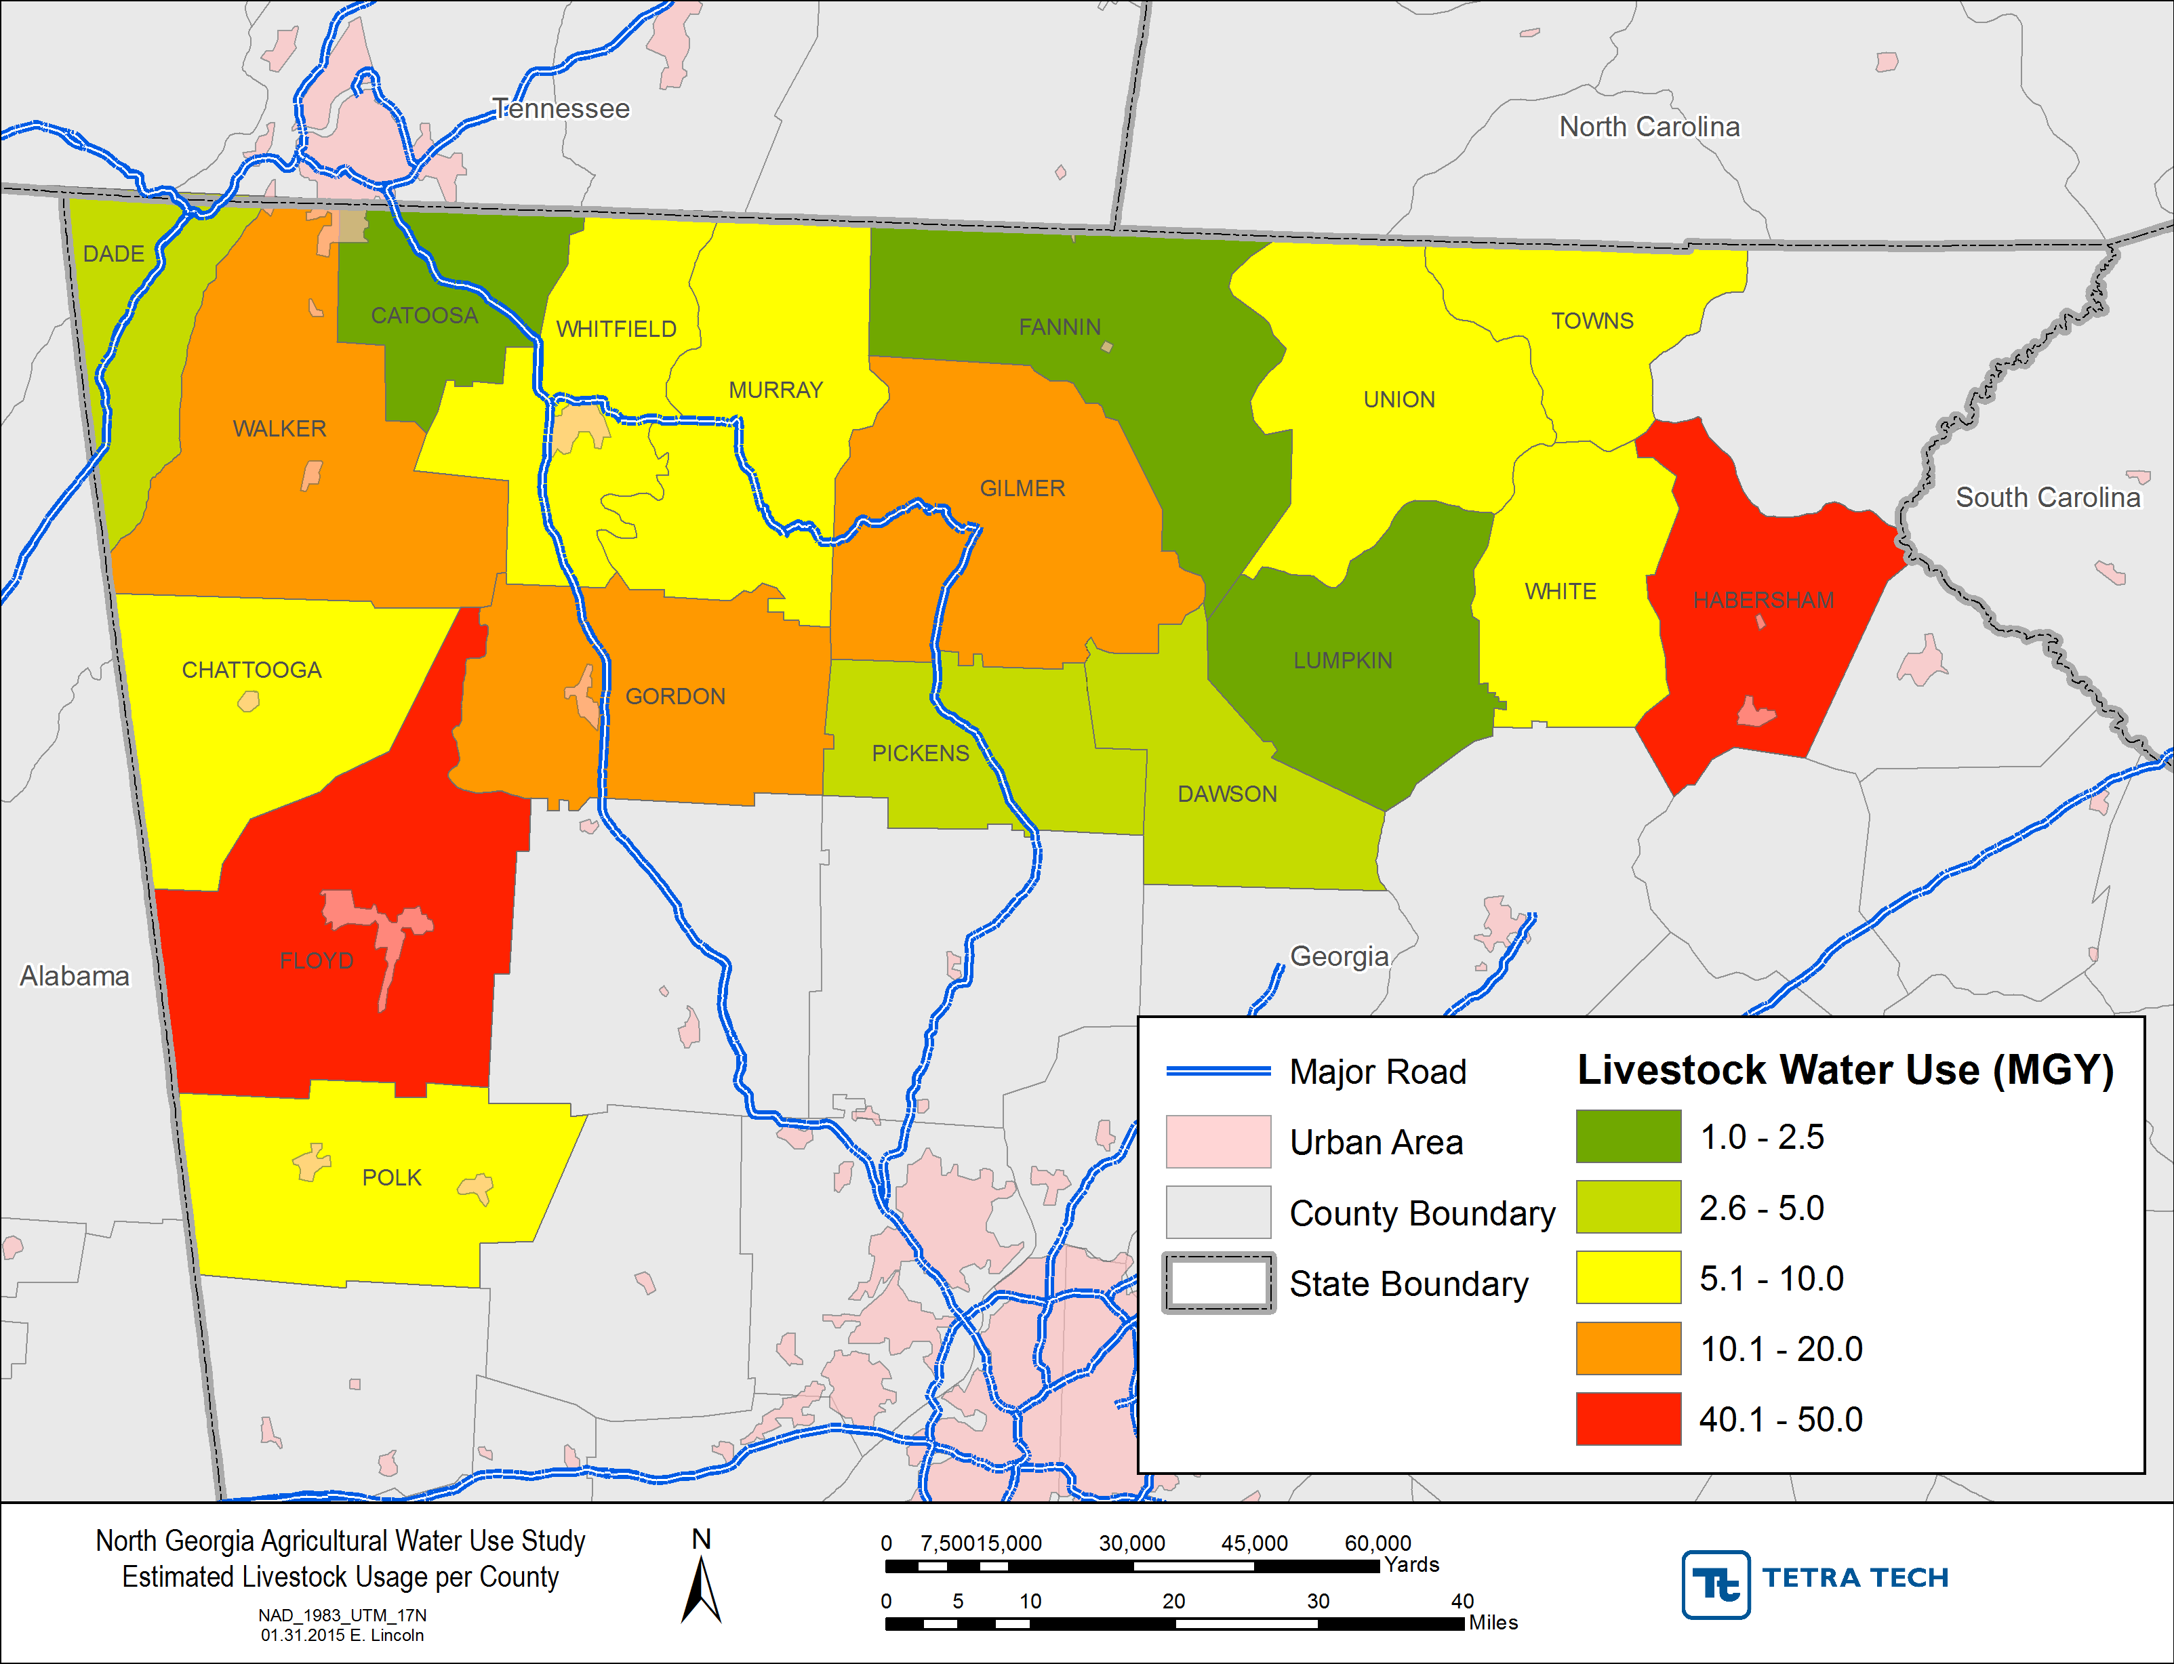
Estimated Other Livestock Water Usage

Slide 31
Estimated Region-Wide Water Usage

Slide 32
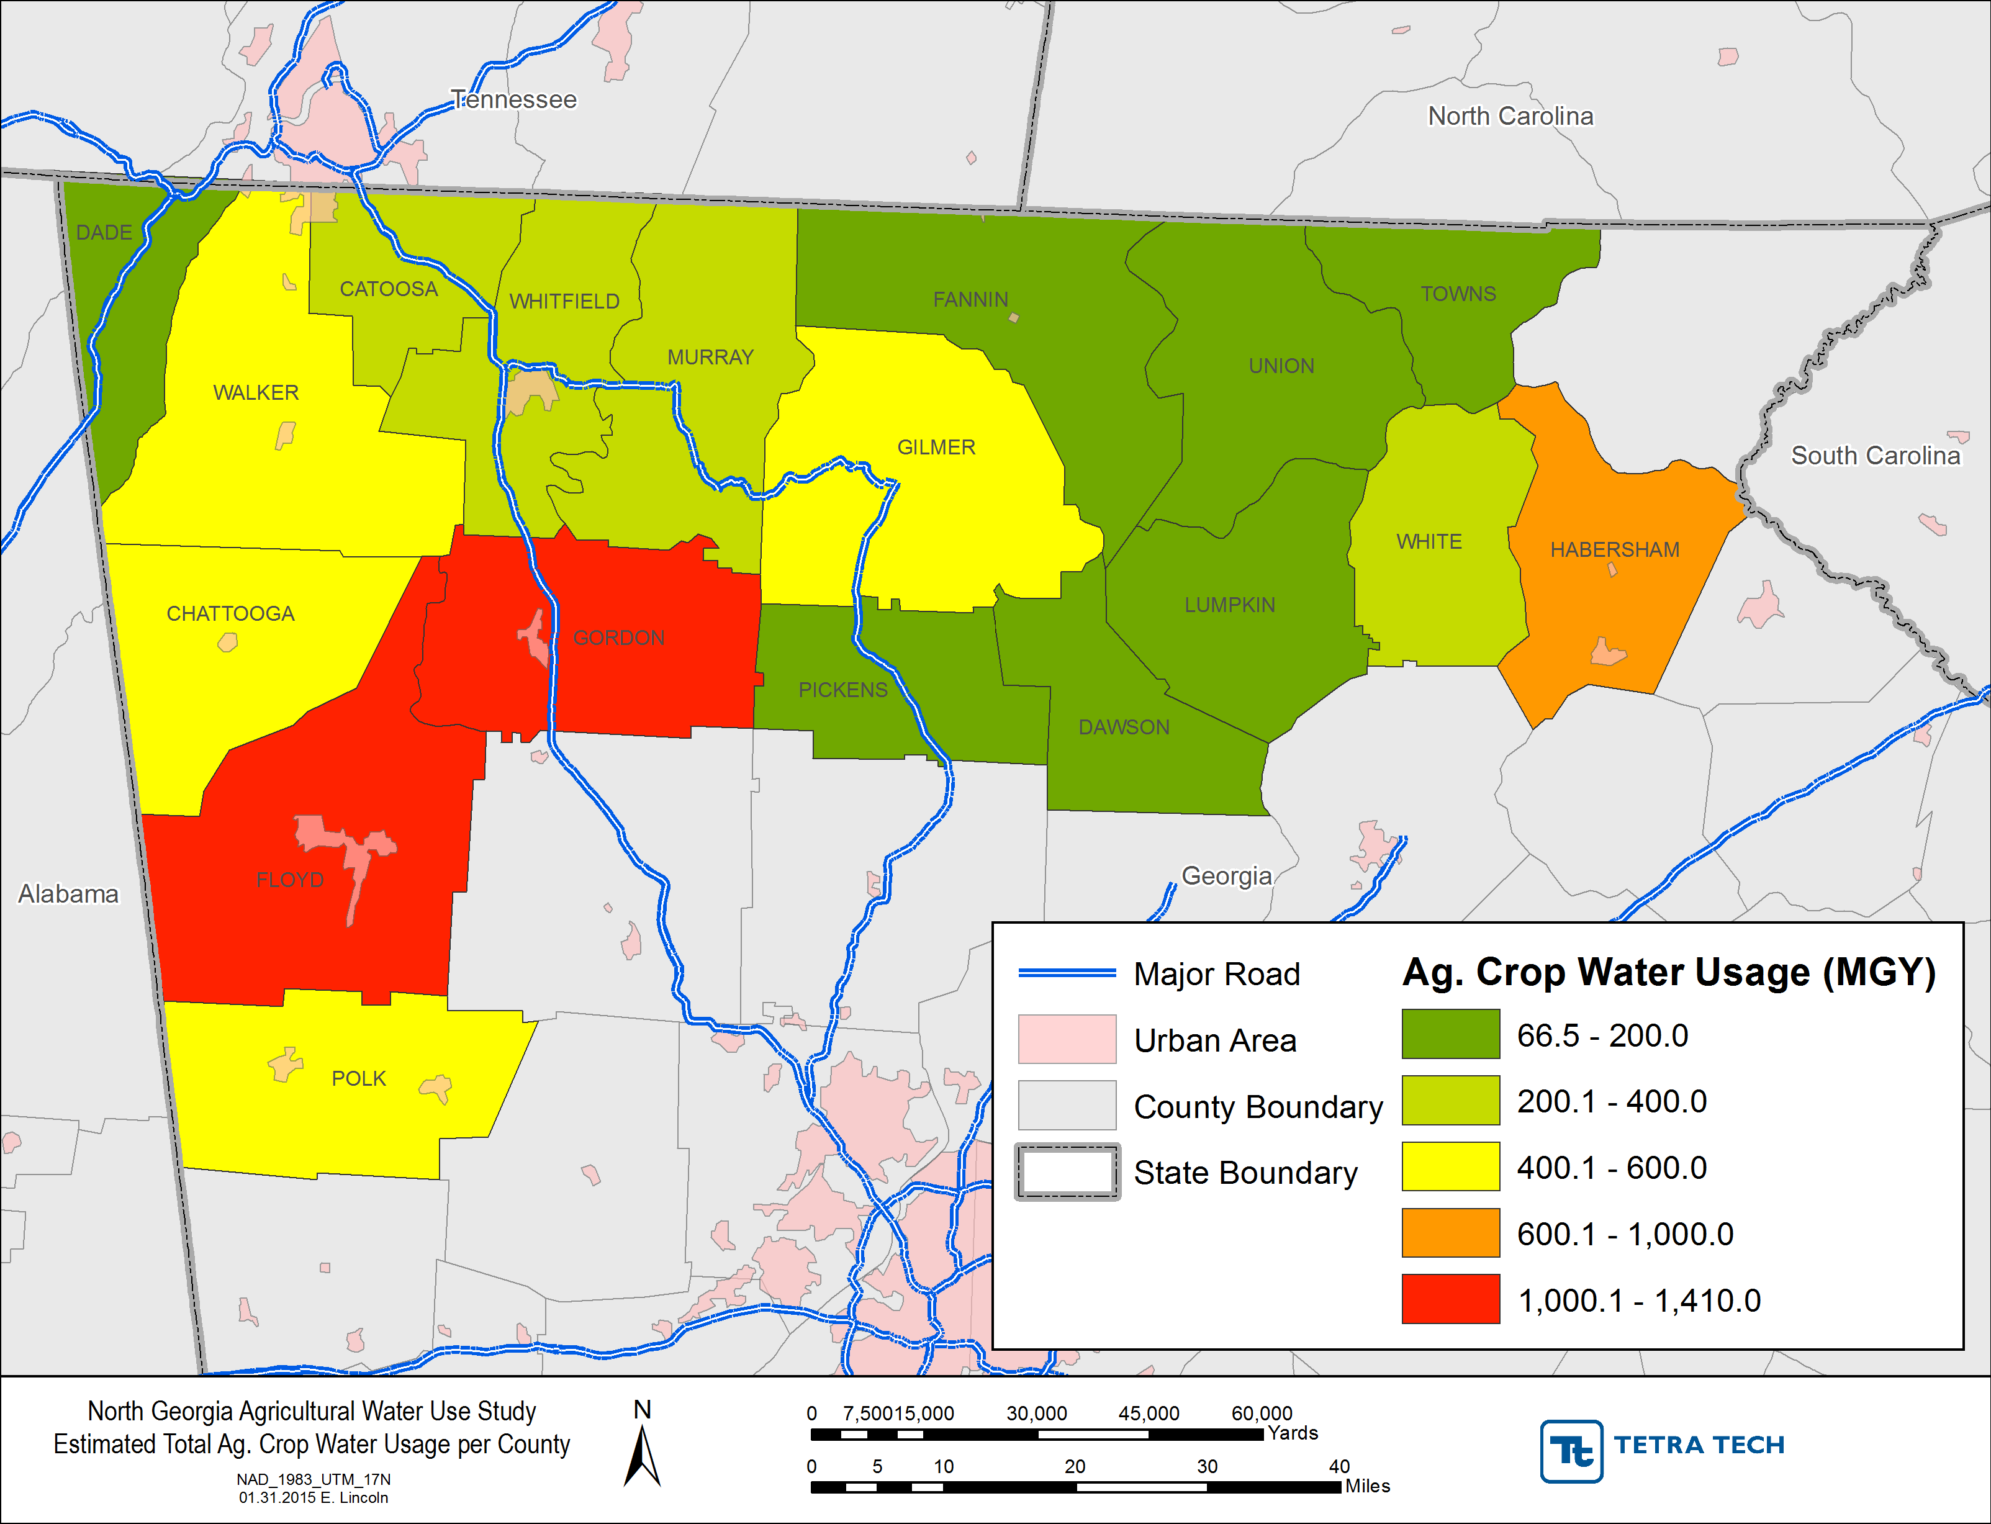
Estimated Region-Wide Water Usage

Slide 33
Estimated Region-Wide Water Usage

Slide 34
Estimated Gordon County Water Usage

Slide 35
Estimated Floyd County Water Usage

Slide 36
Estimated Habersham County Water Usage

Slide 37
Estimated Region-Wide Water Usage
7,402 MGY annually in NGWRP Region
Gordon, Floyd, and Habersham County use 3,388 MGY annually
Row crop irrigation has the estimated highest water usage
Poultry and ornamentals have the second and third highest usage

Slide 38
Next Steps
Confidence in estimated poultry and livestock water use
Reduce uncertainty in crop irrigation usage
Actual irrigated acreage unknown
Irrigation depths change annually
Focus on Floyd and Gordon Counties
GIS crop acreage confirmation and validation
Expand metering program
Targeted irrigation surveys

Slide 39
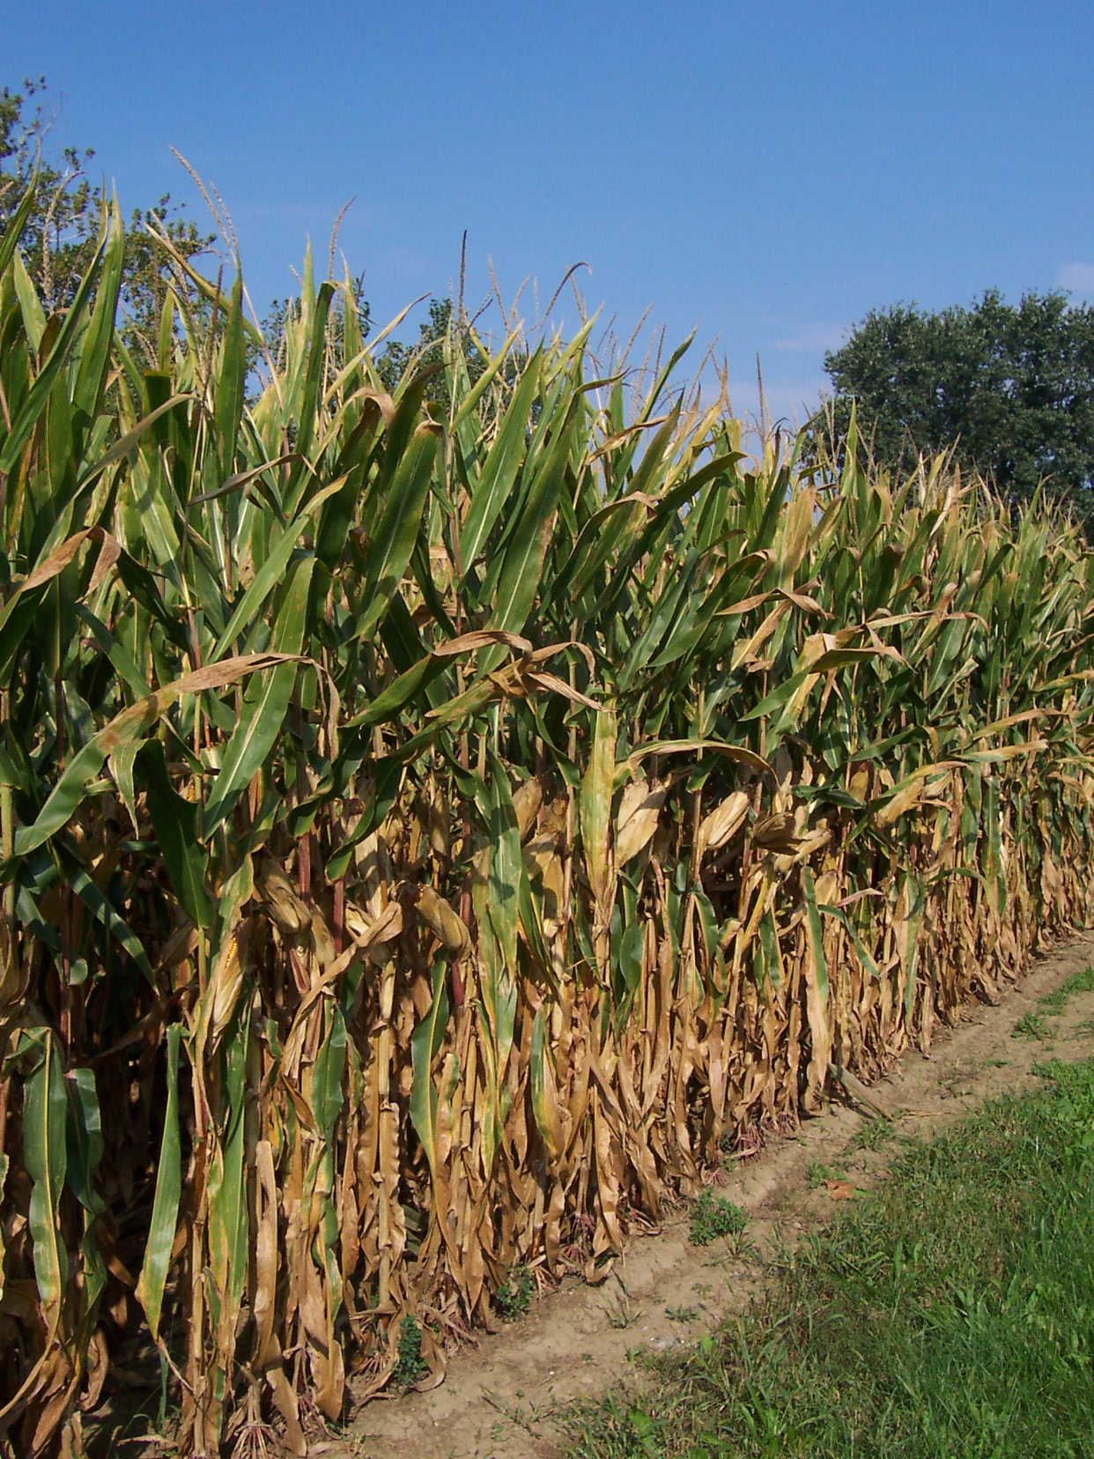
QUESTIONS?
Erin Lincoln, PH
Tetra Tech
erin.lincoln@tetratech.com
770.738.6040
Special Thanks To:
NGWRP
NGRC
GAEPD
GA Poultry Federation
UGA CAES
GSWCC

