Slide 1

2020 Census
Local Update of Census Addresses Operation
(LUCA)
Training
Introduction
Notes:
Thank you for attending this training today to introduce you to the 2020 Census Local Update of Census Addresses Operation, also known as LUCA.

Slide 2
Agenda
The Decennial Census.
Census Bureau terminology.
Preparation for 2020 LUCA participation.
The 2020 LUCA materials and operational instructions are subject to change between the LUCA Training timeframe and the time you receive your materials for review in the spring of 2018; therefore, the examples shown in the various training modules may differ from the official materials.
Notes:
During today’s introductory presentation, we will discuss, at a high level, the 2020 Census and 2020 LUCA, Census terminology, and preparing to participate.
The 2020 LUCA materials and operational instructions are subject to change between the LUCA Training timeframe and the time you receive your materials for review in the spring of 2018; therefore, the examples shown in the various training modules may differ from the official materials.

Slide 3
The Decennial Census
The purpose is to conduct a census of population and housing and disseminate results to the President, the States, and the American People.
Uses of Census data:
  Apportioning representation among states as mandated by Article 1, Section 2 of the US Constitution.
  Drawing congressional and state legislative districts, school districts and voting precincts.
  Enforcing voting rights and civil rights legislation.
  Distributing federal dollars.
  Informing planning decisions of tribal, federal, state and local government and organizational decisions (e.g., where to locate, size of market, etc.) of businesses and non-profits.
Notes:
The purpose of the Decennial Census (also known as the 2020 Census for this decade) is to conduct a census of population and housing and disseminate the results to the President, the States, and the American people. The United States Constitution mandates an actual count of every person residing in the United States every 10 years. The Census Bureau counts individuals within households and typically collects information about the housing structure and the housing unit.
The primary use of Decennial Census data is apportioning representation among states as mandated by Article 1, Section 2 of the United States Constitution, but additional data uses include:
Drawing congressional and state legislative districts, school districts and voting precincts by tribal, state and local governments.
Enforcing voting rights and civil rights legislation by the Department of Justice.
Distributing hundreds of billions of dollars in federal funding, EACH YEAR, to tribal, state, and local governments. Missing a housing unit, and the associated population, during the decennial census may result in a missed opportunity for governments to benefit, which perpetuates until the next decennial census.
Lastly, census data plays a role in informing the decisions of governments, businesses and non-profits regarding numerous topics such as community and regional development, education, agriculture, energy, and environmental programs, as well as other community improvements and enhancements.
To conduct the decennial census, the Census Bureau utilizes its census address list. A review and update of the census address list is the focus of LUCA.

Slide 4
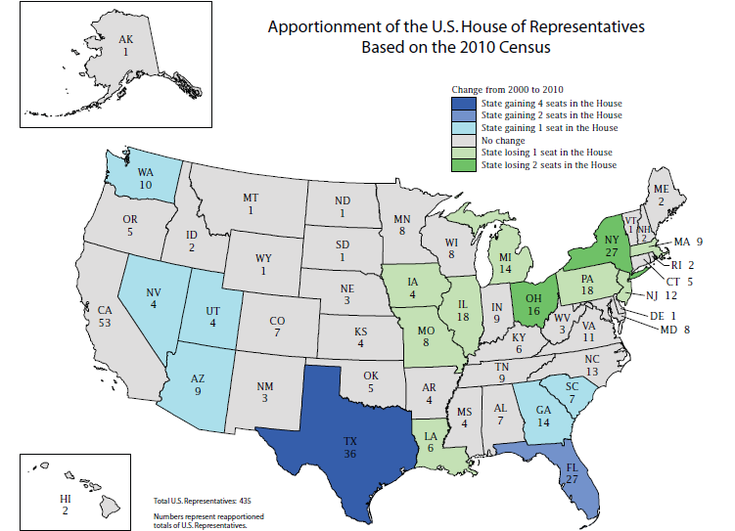

Slide 5
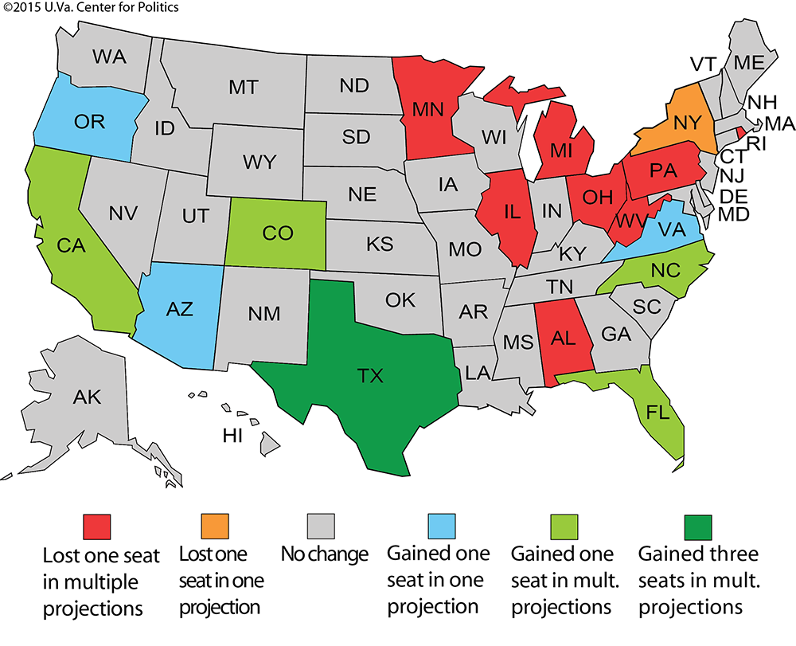
Notes:
These are not Census projections; this map is from the University of Virginia Center for Politics based on multiple projections by Election Data Services in their “2016 Reapportionment Analysis”.
These are mid-decade projections - very preliminary and subject to change. But, it is important to note that the foundation for these projections is based on the population counts from the 2010 Decennial. So, a question to ask is, how accurate do you feel the population counts were for your city or county in 2010? The next question to ask is, how many of the counties and cities represented here today participated in LUCA in 2010?
While multiple projections suggest Alabama may lose a seat – the margin is very, very close and an accurate population count is crucial…Which brings us to LUCA and why it is so important to start with a solid address list.

Slide 6
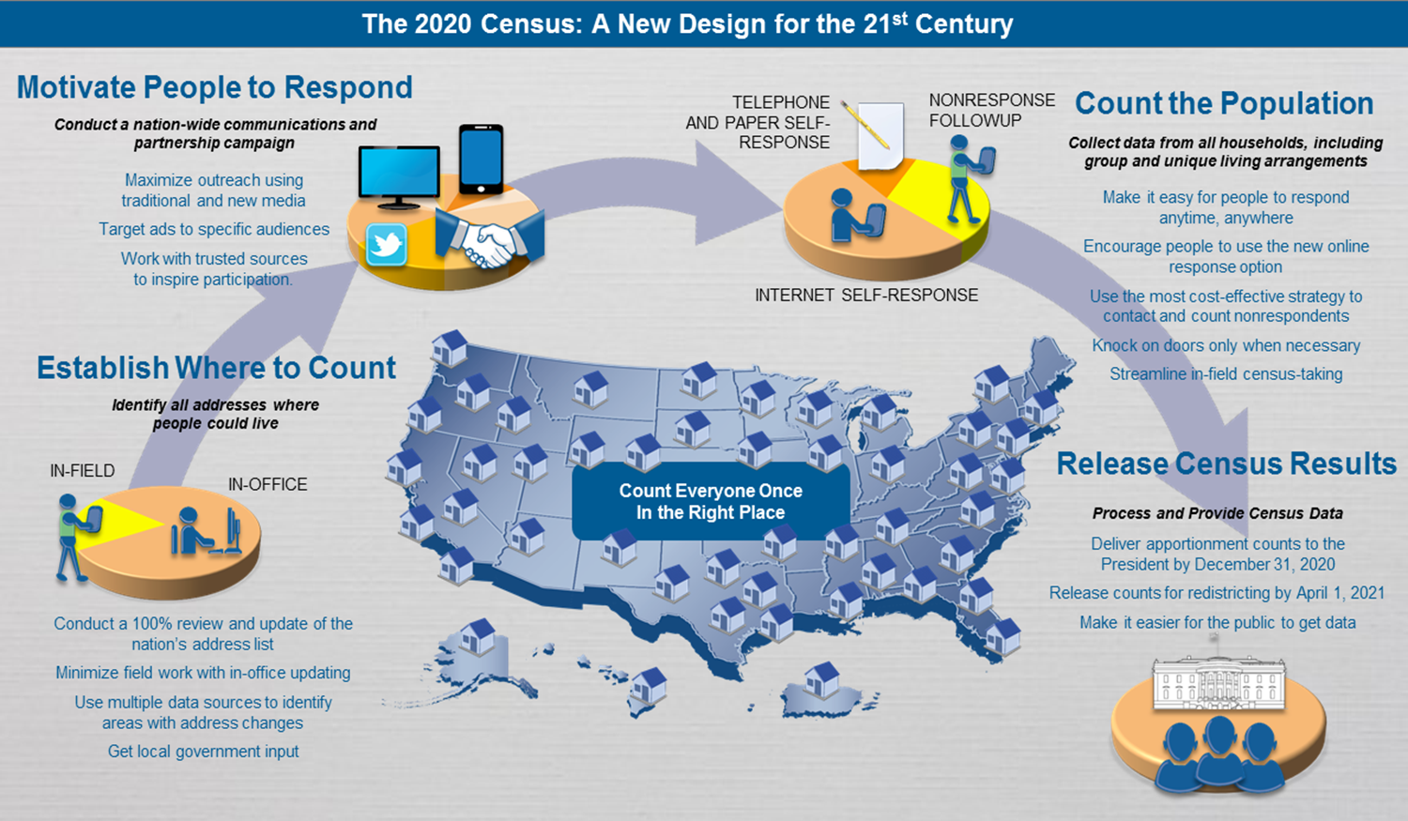
2020 Census Design
Notes:
This graphic illustrates the 2020 Census Design process and why building a strong geographic foundation is so important.
Starting at the bottom left of the slide, the Census Bureau must Establish Where to Count by identifying all the addresses where people could live. The census address list contains the residential addresses that form the “where to count”.
Moving up from the bottom left to the top left, the Census Bureau must Motivate People to Respond by conducting a nationwide communication and partnership campaign. This campaign utilizes the census address list to send materials that invite and encourage households to respond.
Moving across to the top right corner of the graphic, the Census Bureau must Count the Population by collecting data from all households, including group quarters and unique living arrangements. The Census Bureau uses the address list and maps to send enumerators to collect interview data from nonresponding households.
Finally, moving down from counting the population, the Census Bureau must Release Census Results by using the address list and geographic boundaries to process, tabulate, and disseminate apportionment counts to the President by December 31, 2020, redistricting data to the States by April 1, 2021, and high quality data to the public.
In this presentation and others you may receive throughout this year, the Census Bureau provides examples regarding the importance of LUCA participation and a successful 2020 Census that result AFTER the “Release Census Results” section of this slide. While the examples on the previous slide are all valid reasons for participating in LUCA, this graphic illustrates why your LUCA participation is so fundamentally important.
LUCA offers eligible entities the opportunity to provide their input into the address list that serves as the foundation of the entire 2020 Census Design process. Participants in the 2020 LUCA operation have a direct influence on the quality and completeness of the census address list.

Slide 7
Who Can Participate
Federally recognized tribes with a reservation and/or off-reservation trust land.
States and Counties.
Incorporated places.
  Cities, towns, boroughs, villages.
Notes:
The Census Bureau’s LUCA participants are comprised of active, functioning, legal governments including:
Federally recognized tribes with a reservation and/or off reservation trust lands.
States and Counties.
Incorporated Places (cities, towns, boroughs, villages).
Townships (Minor Civil Divisions).

Slide 8
Title 13 U.S.C. – Confidentiality and Security
Information provided to/from LUCA is covered under Title 13 of the United States Code which:
  Requires the Census Bureau to ensure confidential treatment of census-related information, including individual addresses and map structure points.
  Requires the Census Bureau maintain the confidentiality of all information it collects.
LUCA operation requires all liaisons, reviewers, and anyone with access to Title 13 materials abide by Confidentiality and Security Guidelines and requires all LUCA participants sign the Confidentiality Agreement Form (D-2005).
Notes:
Title 13 of the U.S. Code covers information provided to and from LUCA. Title 13 requires the Census Bureau ensure the confidential treatment of census related information, including individual addresses and map structure points, and maintain the confidentiality of all information it collects. The LUCA operation requires all liaisons, reviewers and anyone with access to the Title 13 materials abide by the Confidentiality and Security Guidelines and requires all LUCA participants (liaison and reviewers) sign the Confidentiality Agreement Form.
The census address list (both paper and digital formats) and PDF small format block maps are Title 13 material and require protection. The guidelines document that accompanied the LUCA invitation/registration materials is included as Appendix A of the Respondent Guide. If changes occur to staff that have access to the Title 13 materials, the jurisdiction must provide updated Confidentiality Forms as the changes occur, throughout the LUCA operation timeframe.

Slide 9
2020 LUCA Schedule
Timeframe | Activity
January 2017 | Advance Notice mailing mailed to Highest Elected Officials (HEOs), Tribal Chairs (TCs), Governors and other potential 2020 LUCA contacts.
March 2017 | 2020 LUCA Promotional presentations began.
July 2017 | 2020 LUCA invitation and registration materials mailed to HEOs, TCs and Governors.
October 2017 | 2020 LUCA Training workshops began.
December 15, 2017 | 2020 LUCA registration deadline.
February - April 2018 | Participants receive their 2020 LUCA materials.
March - September 2018 | Census Bureau processes 2020 LUCA submissions.
April 2018 - May 2019 | Census Bureau validates 2020 LUCA addresses.
Summer 2019 | Census Bureau delivers 2020 LUCA feedback.
April 1, 2020 | CENSUS DAY.
✓
✓
✓
✓
Notes:
It is important to discuss the LUCA schedule as a preparation aspect of 2020 LUCA. Keeping the schedule in mind prepares you for upcoming tasks and actions.
January 2017 – Advance Notice mailing conducted.
The purpose of the Advance Notice mailing was to bring awareness to 2020 LUCA and its schedule so governments could begin preparing to participate. The Census Bureau asked contacts to review the LUCA Information Guide and to confirm/correct their contact information. The Census Bureau sent a large number of Advance Notice materials in order to build a solid courtesy copy base for the invitation mailing that occurred in July 2017. Nearly 83,000 contacts were shipped the Advance Notice mailing which covered just over 40,000 governments and organizations.
March 2017 – LUCA promotional presentations began.
The six regional offices manage the scheduling of these presentations. Direct questions regarding the LUCA training presentations to the GEO 2020 LUCA e-mail and/or toll-free number provided on the next slide.
July 2017 – LUCA invitation mailing (which includes registration materials) conducted.
The invitation mailing included a letter, four forms necessary for LUCA registration, a document with instructions for registration, and a copy of the Confidentiality and Security Guidelines.
October 2017 – LUCA training workshops began.
December 15, 2017, is the 2020 LUCA registration deadline.
February - April 2018 – 2020 LUCA materials begin to ship to participants. Participants begin their review and have 120 calendar days to complete.
March - September 2018 – Census Bureau processes 2020 LUCA submissions.
April 2018 – May 2019 – Census Bureau validates 2020 LUCA addresses.
Summer 2019 – Census Bureau delivers LUCA feedback to participants (the Appeals process is still under development, but has a very short review timeframe).
April 1, 2020 is CENSUS DAY!

Slide 10
Census Bureau Terminology
Census Bureau terminology.
  Geocode.
  Housing Unit.
  Group Quarters.
  City Style Address.
  Non-city Style Address.
Notes:
The Census Bureau organization uses numerous terms and acronyms. This slide lists five of the most commonly used terms for LUCA. Understanding their definition is very important while conducting your LUCA review. The next eight slides define these terms and provide examples of acceptable and unacceptable housing units and group quarters.

Slide 11
Geocode
Geocoding is the process of taking an address and returning an actual or calculated latitude/longitude coordinate on the earth’s surface.
In terms of the Census Bureau, this includes assigning the proper state, county, census tract and census block codes that correspond to the physical location of the address.
The Census Bureau requires every address is assigned a Census geocode before it can be processed and added to its inventory and included in the Census.
Notes:
An address can not be added to our Master Address File unless its location is known; either we need the lat/long coordinates of the structure or its geocode.

Slide 12
Housing Unit (HU)
A single-family house, townhouse, mobile home, trailer, apartment, group of rooms, or a single room occupied as a separate living quarter or, if vacant, intended for occupancy as a separate living quarter.
Notes:
As part of the introduction, it is important to become familiar with some common Census Bureau terminology used while discussing the 2020 LUCA operation. These terms and others are included in the Respondent Guide your government will receive as part of your LUCA materials. The Respondent Guide will also be available for download from the LUCA web site. Understanding how the Census Bureau defines the term Housing Unit (HU) is critical to the success of participating in the 2020 LUCA operation.
Read the bullet.
A separate living quarter is one in which one or more occupants (or intended occupants, if vacant) live separate from any other individual(s) in the building and have direct access to the living quarter without going through another living quarter, such as from outside the building or through a common hall.

Slide 13
Acceptable Housing Units for LUCA
Houses, including townhouses, condominiums, and apartments.
Living quarters within an otherwise nonresidential structure such as an apartment within a church, school, or business.
Mobile homes or trailers occupied as separate permanent living quarters, or if vacant, intended for occupancy as separate permanent living quarters.
Any housing units under construction that will be habitable (closed to the elements with final roof, windows, and doors) on Census Day, April 1, 2020.
Notes:
The following types of housing units are acceptable for 2020 LUCA: read the contents of the slide. All of these housing units are acceptable for inclusion as part of your 2020 LUCA submission.
Empty trailer pads and mobile home sites intended to be permanent sites are also acceptable for LUCA, if the site has utility connections.

Slide 14
Group Quarters (GQs)
A place where people live or stay, in a group living arrangement, that is owned or managed by an entity or organization providing housing and/or services for the residents.
Notes:
The Census Bureau defines Group Quarters as: read the contents of the slide.
This is not a typical household-type living arrangement. These services may include custodial or medical care as well as other types of assistance, and residency is commonly restricted to those receiving these services. Residents of group quarters are usually unrelated.

Slide 15
Acceptable Group Quarters for LUCA
Correctional facilities.
  Federal and state prisons.
  Local jails and other municipal confinement facilities.
  Correctional residential facilities.
Group homes.
  Halfway houses and homes for people with special needs.
Juvenile facilities.
  Group homes for juveniles (non-correctional).
  Residential treatment centers for juveniles (non-correctional).
  Correctional facilities intended for juveniles.
Nursing homes.
  Nursing facilities/skilled-nursing facilities.
Notes:
The following types of group quarters are acceptable for 2020 LUCA: read the contents of the slide.
Presenters, within the Group homes bullet, “homes for people with special needs” are also “homes for the mentally and/or physically disabled”. Within the Nursing homes bullet, “skilled nursing facilities” provide rehabilitative services while regular nursing facilities do not.

Slide 16
Acceptable Group Quarters for LUCA (cont’d)
Hospitals.
  Mental (psychiatric) hospitals and psychiatric units in other hospitals.
  Hospitals with patients who have no usual home elsewhere.
  In-patient hospice facilities.
College or university dormitories, fraternity houses, and sorority houses.
Workers group living quarters or dormitories.
Religious group quarters.
Any group quarters under construction that will be habitable (closed to the elements with final roof, windows, and doors) on Census Day, April 1, 2020.
Notes:
Continued from the previous slide, these additional types of group quarters are also acceptable: read the contents of the slide. Should your jurisdiction choose to review group quarters as part of 2020 LUCA, then all of the group quarter types, mentioned on both slides, are acceptable for inclusion in your submission.

Slide 17
Unacceptable HUs and GQs for LUCA
Condemned or scheduled for demolition.
Under construction or remodeling for conversion to a nonresidential purpose.
Used solely for nonresidential storage.
Used solely as offices or businesses in which no one is living.
Used solely for ceremonial purposes.
Under construction and will not be habitable (closed to the elements with final roof, windows, and doors) on Census Day, April 1, 2020.
Notes:
Exclude the following unacceptable types of housing units and group quarters addresses from your address list: read the slide.
If addresses described in the first two bullets appear on the census address list, mark them for deletion with Action Code “D”. If the next four bullets regarding nonresidential status exist on the address list, mark them as nonresidential with Action Code “N”. Do not add addresses that will not be habitable on Census Day, April 1, 2020.

Slide 18
City Style Address
Include a house number and street name (e.g., 212 Elm St or 137 Clark Ct Apt 3 or 35A Fourth Ave W).
  For 2020 LUCA, participants adding multiunit addresses must provide unit identifiers (e.g., Apt 1, Apt 2, Unit A, Unit B).
Notes:
The Census Bureau defines city style addresses as those that have a house number and street name for their complete address. In some instances, the house number may also include an alpha character such as 35A Fourth Ave W. City style addresses are generally mailing address, but some are also used to provide a location for emergency services, such as police, fire, and rescue, i.e., E-911 addresses.
Of special note, for 2020 LUCA, participants who wish to add multiunit addresses must provide the unit identifiers. Ensure that all your apartment buildings, especially small multiunit buildings (3-4 units), such as large houses subdivided into apartments, have a separate address line for each unit that includes the basic street address and the individual unit designation.

Slide 19
Non-City Style Address
Do not include a house number and/or a street name.
May include incomplete house number and street name.
Frequently used non-city style mailing addresses include:
  Location Description with map spot.
  Rural route and box number.
  Highway contract route and box number.
Notes:
The Census Bureau defines non-city style addresses as those that do not have a house number and street name for their complete address or that may have incomplete house number and street name information.
Frequently used non-city style addresses in the Census Bureau data include location descriptions with map spots, rural route and box addresses, and highway contract route and box addresses.

Slide 20
Preparation for 2020 LUCA participation
Early tools.
  Address Block Counts.
  Census Geocoder.
  TIGERweb.
Product Preference combinations.
Notes:
The Census Bureau offers early tools that provide participants the opportunity to begin LUCA preparation in advance of materials receipt. Since January 2017, residential address block counts are available for download on the 2020 LUCA Web site. These residential block counts are derived from the geocodes of the individual addresses in the Master Address File (MAF). This is the first time the Census Bureau has provided this type of information in advance of the LUCA operation. The Census Bureau provides the Address Count List with the 2020 LUCA materials for reference purposes only.
The Census Geocoder tool allows users to upload a file of addresses (or enter in an individual address) to obtain census geography and approximate coordinates based on the address ranges within the MAF/TIGER database (MTDB). The Census Bureau offers support for the Census Geocoder through e-mail to <geo.geocoding.services@census.gov>.
For those not using a geographic information system, TIGERweb is an interactive web service for use, in advance of receiving LUCA materials, to view the features (roads, blocks, etc.) within jurisdictions. Used interactively with the early address block count list, it allows users to visually identify blocks that have high or low address block counts.

Slide 21
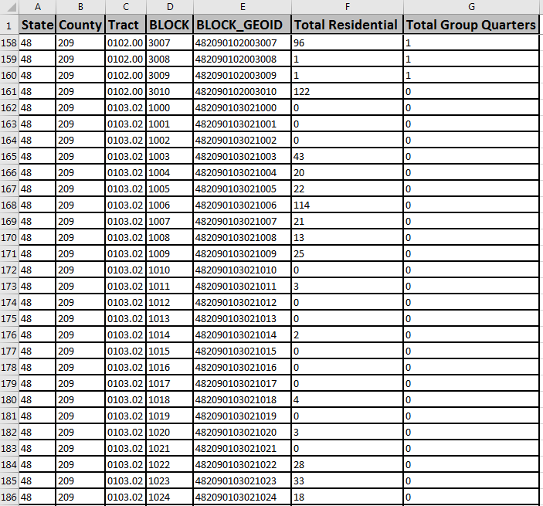
Early tools
Provide 2020 Census LUCA Address Block Count files.
Provide Census Geocoder to geocode jurisdiction’s address list: <https://geocoding.geo.census.gov/geocoder/>
TIGERweb: <https://tigerweb.geo.census.gov/tigerweb/>
Notes:
After navigating to the 2020 LUCA Web site, use the “How Can I Review the Address Block Counts for My Entity” section to search and download the Address Block Count file for your government. The download is in pipe-delimited text format, but easily converts into Excel (.xlsx).
To prepare for LUCA, potential participants can compare the Census Bureau’s address count data to their local data. Potential participants can join the address block count lists to 2010 tabulation block geography using a geographic information system to create an overlay for analysis prior to receiving actual LUCA materials. Discrepancies between the census and local counts may be a result of incorrect geocoding or missing information from the census address list.
The Census Geocoder takes individual addresses, or file of addresses, and obtains census geography and approximate coordinates. It can process files up to 10,000 records at a time. Governments with over 10,000 addresses can upload their addresses to the LUCA Geocoding Service using SWIM.
Geocoding a local address list using Census Geocoder is another way to begin early preparations for LUCA because it standardizes local data into the format the Census Bureau needs for LUCA processing and provides the census block geocode for the records submitted in the local address list file. Participants may use the geocode information to generate their own local block count tallies for comparison to the Census Bureau’s block count file discussed on the previous slide. Participants can also generate geocodes using their own GIS, but this tool may help smaller entities or entities that do not have access to their own GIS.
Find the TIGERweb web service at the URL listed on the slide, <https://tigerweb.geo.census.gov/tigerweb/>. Documentation is located within the same URL.

Slide 22
Product Preference Combinations
Geographic Update Partnership Software (GUPS).
Paper Address List & Large Format Paper Maps (Paper/Paper).
Paper Address List & Large Format Paper Maps with PDF small format block maps (Paper/PaperPDF).
Paper Address List & Digital Map (Paper/Digital).
Digital Address List & Large Format Paper Maps (Digital/Paper).
Digital Address List & Large Format Paper Maps with PDF small format block maps (Digital/PaperPDF).
Digital Address List & Digital Map (Digital/Digital).
Notes:
There are three mediums of materials available for 2020 LUCA; the Geographic Update Partnership Software, known as GUPS, paper formatted materials, and digitally formatted materials. From these three mediums, seven product preference combinations evolve.
The SEVEN product preference combinations are:
Geographic Update Partnership Software (GUPS) – Participants choosing this product preference receive a digital address list and digital map as part of the GUPS package. By doing so, they have all the components necessary to complete their work in GUPS or using their own GIS. GUPS has Title 13 protections programmed into the software, taking much of the guesswork out of Title 13 security concerns.
Paper Address List and Large Format Paper Maps – This product preference requires Title 13 protection for the paper address list. The large format paper maps do not display any Title 13 information. There are no small format block maps provided with this material combination.
Paper Address List and Large Format Paper Maps with PDF small format block maps – In addition to protecting the paper address list, the DVD requires digital Title 13 protection because the PDF small format maps on the DVD contain map spots. Any printed small format block maps also need protection.
Paper Address List and Digital Map – This product preference requires Title 13 protection for the paper address list. The “digital map” is a TIGER Partnership shapefile. The shapefiles do not contain structure points; therefore, no digital Title 13 security measures are required for the DVD containing the shapefiles.
Digital Address List and Large Format Paper Maps – This product preference requires digital Title 13 protection for the address list and if printed, requires Title 13 protection for printed copies of the address list. The large format paper maps do not display any Title 13 information. There are no small format block maps provided with this material combination.
Digital Address List and Large Format Paper Maps with PDF small format block maps – This product preference requires digital Title 13 protection for the address list and if printed, requires Title 13 protection for printed copies of the address list. The large format paper maps do not display any Title 13 information. The DVD requires digital Title 13 protection because the PDF small format maps on the DVD contain map spots. Any printed small format block maps also need protection.
Digital Address List with Digital Map – This product preference requires digital Title 13 protection for the address list and if printed, requires Title 13 protection for printed copies of the address list. The “digital map” is a TIGER Partnership shapefile. The shapefiles do not contain structure points; however, using GIS, the latitude/longitude coordinates in the digital address list can generate structure points. Participants must protect the structure points they generate using the census address list coordinates under the rules of Title 13. Participants choosing this option will also receive GUPS.
The words in parenthesis on this slide represent labels describing the various product preference combinations. Expect usage of these labels during other presentations related to LUCA. Each product preference has its own detailed “Acceptable Updates” presentation tailored specifically for participants who have chosen that product preference. This organization tactic ensures a totally paper participant is not distracted by digital discussions or vice versa.
Many governments will choose digital format for both their address list and maps to leverage their own GIS. Governments with computer expertise, but without a GIS, may prefer to use GUPS or may choose digital address list and paper maps. Governments without a local address list in digital format, and with 6,000 or fewer addresses, may prefer all paper products. Choosing a paper address list and digital maps would not allow for full use of GIS capabilities, but the format combination is available.

Slide 23
Review and Update Strategies
Notes:
Welcome to the 2020 Census LUCA operation training that discusses review and update strategies. This presentation serves to prepare participants for their LUCA review. It does not provide instructions for making updates or for submitting the updated materials. Separate presentations cover those two topics.
The Census Bureau expects to post this presentation on the LUCA web site, so participants can review them again prior to materials receipt in early 2018.

Slide 24
Agenda
Strategies for LUCA review and update.
  Things to consider.
  Potential address sources.
  Identify priorities.
  Beginning your review.
Notes:
This presentation discusses strategies for your LUCA review and potential updates. It identifies things to consider, potential address sources available to your jurisdiction to conduct your review, encourages the identification of priority areas of review, and discusses how to begin your review.
For more detailed information and instruction, refer to the Respondent Guide that accompanies the materials and to upcoming presentations that discuss review, update and submission details.

Slide 25
Things To Consider
How much time can we devote to LUCA review?
  Only 120 calendar days to conduct review upon receipt of materials.
Does your jurisdiction have an address list or access to an address list?
Does the address list include multiunit structure identifiers (e.g., Apt 1, Unit A2, #4, etc.)?
Does the address list include both residential and commercial addresses or include records that are not structures? If yes, are the residential records distinguishable?
Notes:
When preparing for your LUCA review, consider your time and staff resources. The 2020 LUCA operation allows 120 calendar days to review and provide the Census Bureau with your submission. The review time begins upon receipt of materials. If your entity decides to switch product preferences, the 120 days does not reset after receipt of new materials, nor does it pause while waiting for new materials. Time does not reset if you experience technical issues, so please contact the Census Bureau immediately if you experience problems with the materials (digital or otherwise).
Consider the availability of an address list or other source of address information. If an address list exists, does it include multiunit structure identifiers, such as Apt 1, Unit A2, #4? This information is required for 2020 LUCA submissions when adding new records to the address list or updating the address list. Does the address list include both residential and commercial addresses; and if so, are the residential addresses distinguishable? The Census Bureau only wants residential addresses for LUCA, so additional work may be necessary to prepare the local address list for use in 2020 LUCA review.

Slide 26
Potential Address Sources
E-911 address files.
New housing construction or building permits.
  Include only if final roof, doors, and windows will be in place on Census Day, April 1, 2020.
Housing inspection records or occupancy permits.
Planning and zoning records.
Local utility records.
School enrollment records.
Driver’s license files.
Annexation records.
Assessment or tax files (residential units).
Voter registration files.
Notes:
There are many possible sources of local address information. Some of these sources may not match the Census Bureau’s address list exactly, but they are a good indication of where change is taking place and can help you identify addresses that you need to add to the address list.
Presenters, read some/all of these on the slide.

Slide 27
Identify Priorities
Apartment buildings and/or areas of concentrated multi-unit housing.
Areas along governmental boundaries and/or newly annexed land.
Areas of new residential construction.
Blocks with the greatest differences between the Census Bureau’s address block count and your address block count.
E-911 address conversion areas.
Group Quarters (e.g., housing such as college dorms and nursing homes).
Mobile home parks or new, scattered mobile homes.
Single-family homes converted to multifamily homes, and vice versa.
Warehouses converted to residential lofts.
Notes:
When deciding how to conduct the LUCA review, consider your time, staff, and available local address information. If a complete review is not possible, focus your review on these areas (listed in alphabetical order, not order of Census priority).
Presenters, read some/all of these on the slide.

Slide 28
Beginning Your Review
Assemble local sources.
Read the 2020 LUCA Respondent Guide.
Review the Census Bureau’s online training presentations.
Familiarize yourself with LUCA materials.
  Address List.
  Address Count List.
  Paper Maps/Digital Shapefiles.
  Block to Map Sheet Relationship List (use with Large Format paper maps).
Organize LUCA materials based on priority areas.
Organized approach for review yields a successful LUCA submission.
Notes:
As you begin your review, assemble all of your local sources of information (local address sources and local map sources). Take time to read the LUCA Respondent Guide that accompanies the materials. Review the online presentations when they become available.
Familiarize yourself with your specific LUCA materials. For paper participants, check the paper address list for the sort option noted at the top of each page. Check to see that all the pages (e.g., 1 of 345 through 345 of 345) are included and that none are missing. If pages are missing or the sort option is not what you need/expect, contact the Census Bureau immediately for a replacement. As stated on the previous slide, your 120 days does not pause or reset when you receive your new materials. The Census Bureau suggests you move forward with your review while you await your new materials. For digital participants, check your address list to ensure it imported properly (e.g., leading zeros are present and data is in the appropriate fields). To check the connection between address list and the address count list, scroll to the bottom of your address list. If you subtract one (for the presence of the header row) from the last row number, you will have the tally of addresses (housing unit and group quarters) for your jurisdiction. This number should match the “Total” information at the end of your digital address count list. These are all checks that participants can perform upon receipt of materials to ensure your materials are complete and correct. Review the Address Count List to ensure it includes all of its pages (for paper) and blocks (for digital). Review your paper maps to ensure all are included and legible. Setup your shapefile material for potential updates to the edges shapefile. For paper map participants, check a few blocks on the Block to Map Sheet Relationship list by locating them on the respective large format map(s).
Organize your LUCA materials based on the priority areas your jurisdiction established and focus on those areas. Do not become distracted by the additional materials for other areas or other addresses. If you complete the priority areas, you can always choose additional addresses to review.
An organized approach to conducting your LUCA review will yield a successful LUCA submission for your jurisdiction.

Slide 29
Digital Address List and Digital Map Product Preference
Notes:
Welcome to the 2020 Census LUCA operation training to introduce the digital map materials. This presentation serves as an introduction to the digital map materials and prepares participants for this specific product preference selection. It does not provide instructions for making updates to the digital maps or for submitting the updated materials. Those two topics are discussed in separate presentations.
The Census Bureau expects to post this presentation on LUCA web site, so participants can review it again prior to materials receipt in early 2018.

Slide 30
Agenda
Digital Product DVD Overview & Product Preferences.
DVD Layout and Content by Product Preference
Digital Address materials.
  Address List – Title 13.
  Address Count List – not Title 13.
Digital Map Materials
  TIGER Partnership shapefiles
  Edits to the TIGER Partnership shapefiles
Notes:
This presentation identifies the specific product preference choices that are eligible to receive digital address materials. It discusses delivery of the LUCA digital materials; Title 13 as it relates to materials that fall under Title 13 protection, describes the digital address materials, and shows examples to provide an introductory visual. It reinforces the ways to receive support and assistance during the LUCA operation and mentions ways to stay connected to the Census Bureau through several social media sources as well as Census Bureau subscriptions.
For more detailed information and instruction, refer to the Respondent Guide that accompanies the materials and to upcoming presentations that discuss review, update and submission details.

Slide 31
Digital Product DVD Overview
Product Preferences
Paper Address List and Paper/PDF (1 DVD).
Paper Address List and Digital Map (1 DVD).
Digital Address List and Paper Large Format maps (1 DVD).
Digital Address List and Paper/PDF (1 DVD).
Digital Address List and Digital Map (3 DVDs).
Geographic Updates Partnership Software (GUPS) (3 DVDs).
Notes:
All active, functioning, legal governments can choose to receive digital address materials for the 2020 LUCA operation. Each of the FOUR product preferences highlighted on this slide receive digital address materials as part of their 2020 LUCA materials. Participants that selected those preferences are the intended audience for this presentation. We expect many governments will choose digital materials for both their address list and maps in order to leverage their own GIS, while some may only feel comfortable with using the digital address materials in a spreadsheet or database software.
While Geographic Updates Partnership Software (GUPS) participants technically receive their materials by DVD, they do not use the DVDs in the same manner as the other three product preference participants on this slide. They do not have to download the digital data off the DVD because the GUPS installation process details the GUPS participant’s steps for proper installation of the software and digital data. Please refer to the GUPS presentation for all of the details on this process. If GUPS participants decide to use their own GIS system, then they effectively become a Digital/Digital participant and those sections of this presentation apply to them.

Slide 32
DVD Layout and Content:
Digital Address List and Large Format Paper maps (Digital/Paper)
One DVD with one folder:
root directory of DVD.
  2020LUCA_<EntityID>_address_countlist.csv
  2020LUCA_digital_respondent_guide.pdf
  2020LUCA_header_file.txt
  LUCA20_inventory.pdf
  Readmefirst4.txt
“shape” folder.
  2020LUCA_<EntityID>_DISK1of2.exe (**Title 13 material**).
    Includes the Digital Address List
Notes:
For this product preference, participants receive one DVD with one folder – The “shape” folder.
The root directory of the DVD contains four files:
The 2020LUCA_<EntityID>_address_countlist.csv is the digital address count list. It is not Title 13 material.
The 2020LUCA_digital_respondent_guide.pdf is the pdf version of the respondent guide for digital address list participants. A paper copy is not provided.
The 2020LUCA_header_file.txt is a template participants may use to import their local address list into the Census Bureau’s address list layout.
The LUCA20_inventory.pdf is a digital inventory form to use when providing your submission to the Census Bureau. The final presentation on submission discusses how to send in this form.
The Readmefirst4.txt includes specific instructions for this product preference.
The “shape” folder contains 2020LUCA_<EntityID>_DISK1of2.exe that includes the digital version of the Title 13 Address List. Extraction of this file is described in the Digital Materials Initial Setup presentation.

Slide 33
DVD Layout and Content:
Digital Address List and Paper/PDF (Digital/PaperPDF)
One DVD with two folders:
root directory of DVD.
  2020LUCA_<EntityID>_address_countlist.csv
  2020LUCA_digital_respondent_guide.pdf
  2020LUCA_header_file.txt
  LUCA20_inventory.pdf
  Readmefirst5.txt
“maps” folder.
  About_the_maps.pdf
  LUCA20<EntType><EntCode>.pdf
  LUCA20<EntType<>EntCode>_BLK2MS.txt
  Readme.txt
  Title13_BlockMaps.exe (**Title 13 material**).
“shape” folder.
  2020LUCA_<EntityID>_DISK1of2.exe (**Title 13 material**).
    Includes the Digital Address List
Notes:
For this product preference, participants receive one DVD with two folders – The “maps” folder and the “shape” folder.
The root directory of the DVD contains five files.
The 2020LUCA_<EntityID>_address_countlist.csv
The 2020LUCA_digital_respondent_guide.pdf is the pdf version of the respondent guide for digital address list participants. A paper copy is not provided.
The 2020LUCA_header_file.txt is a template participants may use to import their local address list into the Census Bureau’s address list layout.
The LUCA20_inventory.pdf which is a digital inventory form to use when providing your submission to the Census Bureau. The final presentation on submission discusses how to send in this form.
The Readmefirst6.txt is specifically created with instructions for this product preference.
The “maps” folder contains five files:
The About_the_maps.pdf describes the “bundled” large format PDF, LUCA20<EntType><EntCode>.pdf.
The LUCA20<EntType><EntCode>.pdf is the single PDF of all large format maps. Printed large format maps are also provided, but this PDF is on the DVD for convenience. These are not Title 13 material since they do not show map spots.
The LUCA20<EntType><EntCode>_BLK2MS.txt is the block to map sheet relationship text file that identifies each census block in the entity and on what large format map each block is located. This is also provided in paper format for this product preference. This file, unlike the digital address list and digital address count list is a semi-colon delimited text file. Instructions for properly opening it are included in section 3.2.3 of the Respondent Guide.
The Readme.txt file discusses the need for Adobe software to view the pdf maps.
The Title13_BlockMaps.exe contains the Title 13 PDF small format block maps. Extraction of this file is described in the Digital Materials Initial Setup presentation. Because this file contains Title 13 materials, protect the DVD, this file and any printed PDF small format maps according to the instructions outlined in the Confidentiality and Security Guidelines. This document is included as Appendix A of the Respondent Guide and was mailed as part of the LUCA invitation materials.
The “shape” folder contains 2020LUCA_<EntityID>_DISK1of2.exe that includes the digital version of the Title 13 Address List. Extraction of this file is described in the Digital Materials Initial Setup presentation.

Slide 34
DVD Layout and Content:
Digital Address List and Digital Map (Digital/Digital)
&
GUPS
Three DVDs:
DVD with GUPS installation software.
DVD with Title 13 data.
  “shape” folder.
    Includes the Digital Address List
    2020LUCA_<EntityID>_DISK1of2.exe (**Title 13 material**).
      Includes the Digital Address List
DVD with non-Title 13 data.
  Root directory of DVD.
    2020LUCA_digital_respondent_guide.pdf
    2020LUCA_GUPS_respondent_guide.pdf
    2020LUCA_header_file.txt
    LUCA20_inventory.pdf
    Readmefirst6.txt
  “shape” folder.
    2020LUCA_<EntityID>_DISK2of2.exe
      Includes the Digital Address County List
Notes:
The GUPS product preference and the Digital/Digital product preference have identical DVD layout and content. Both options include a copy of the GUPS software on a separate DVD. The GUPS installation DVD self installs upon insertion of DVD into your computers CD/DVD drive. It prompts participants to insert the other two discs as part of its installation process. GUPS participants do not have to execute the .exe files or perform any of their own system setup. The installation process handles all of those tasks.
Digital/Digital participants can disregard the GUPS DVD unless they decide to use GUPS instead of their own GIS. Information on extraction of the Digital/Digital (only) files on both Disk 1 and Disk 2 will be described later in the Digital Materials Initial Setup presentation.
The DVD with Title 13 data contains a “shape” folder with 2020LUCA_<EntityID>_DISK1of2.exe that includes the digital version of the Title 13 Address List.
The DVD with non-Title 13 data contains information in the root directory and within a “shape” folder.
The root directory of the DVD contains five files.
The 2020LUCA_digital_respondent_guide.pdf is the pdf version of the respondent guide for digital address list participants. A paper copy is not provided.
The 2020LUCA_GUPS_respondent guide.pdf is the pdf version of the respondent guide for GUPS participants. This is the respondent guide that GUPS participants utilize for their 2020 LUCA work. It is included for BOTH GUPS and Digital/Digital participants in case Digital/Digital participants decide to switch product preferences and use GUPS for their LUCA work. A paper copy is not provided.
The 2020LUCA_header_file.txt is a template participants may use to import their local address list into the Census Bureau’s address list layout.
The LUCA20_inventory.pdf which is a digital inventory form to use when providing your submission to the Census Bureau. The final presentation on submission discusses how to send in this form.
The Readmefirst6.txt is specifically created with instructions for this product preference.
The “shape” folder contains 2020LUCA_<EntityID>_DISK2of2.exe that includes the non-Title 13 Address Count List and all the appropriate state and county TIGER Partnership shapefiles for the entity.

Slide 35
Digital Address Materials
Address List – Title 13
Census residential addresses.
  City style and non-city style.
Contain census geographic codes.
  State, county, census tract, and census block.
Comma Delimited Text (.csv) format.
  MUST import not simply open or “double-click”.
24 fields: Maximum 649 characters per record.
First row = Header row.
  Remove spaces from field names, if using Esri’s ArcGIS.
Notes:
The Census Bureau’s address list contains all of the residential (city-style and non-city style) addresses known to the Census Bureau within your jurisdiction, reservation or off reservation trust lands. It also contains census geographic codes (state, county, census tract, census block) that indicate the location of each address.
The address list is a comma delimited text file (.csv) and contains 24 fields of information. It is critical to follow the procedures that discuss “importing” the .csv rather than simply opening by using the File-Open method or double-clicking the file.
Each address record in the address list file is a maximum of 649 characters. The character length of each record may vary. The first row, or header row, of the address list file displays the field names for each data column in the file. Plan to remove spaces that exist in the header row for effective use in ArcGIS.

Slide 36
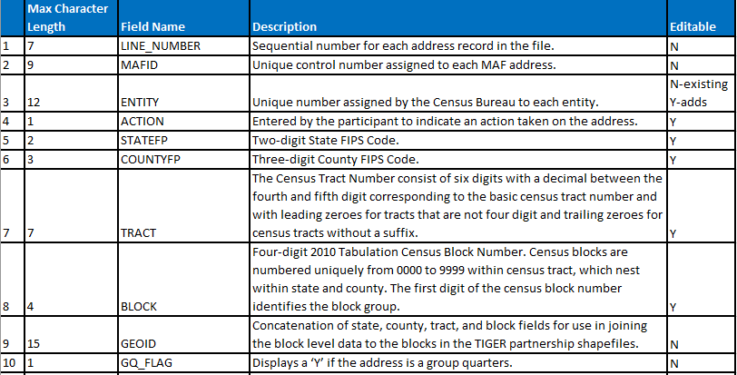
Digital Address Materials
Address List Record Layout
Refer to Table 3 located in your Respondent Guide for complete record layout.
Notes:
The slide illustrates a portion of Table 3 from the Respondent Guide. It depicts the record layout of the 2020 LUCA digital address list. As mentioned on the previous slide, there are 24 fields of information. Participants can review the Respondent Guide for a complete, clearer visual of the Address List record layout.

Slide 37
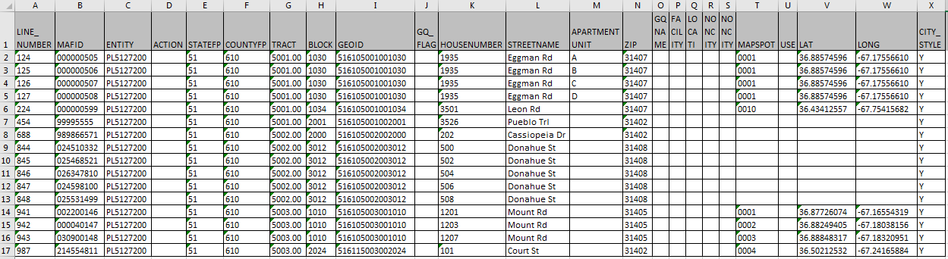
Digital Address Materials
Address List – Microsoft Excel Example
**No Title 13 Data Displayed**
Notes:
After properly importing the .csv into Microsoft Excel or other spreadsheet/database software, the 24-field address list appears similar to this example. It is important to mention this data is fictitious. It does not include any Title 13 information.

Slide 38
Digital Address Materials
Address Count List – Non-Title 13
Residential address census block tallies.
  Housing units and Group Quarters.
Reference only.
  Identify inconsistencies between census block counts and your jurisdiction’s block counts.
Comma Delimited Text (.csv) format.
  MUST import not simply open or “double-click”.
13 fields: Maximum 140 characters per record.
First row = Header row.
“Unable to Geocode” tally for state and county participants.
Notes:
The Census Bureau’s address count list contains the number of housing unit and group quarters addresses on the Census Bureau’s Address List for each census block within your jurisdiction. It is not Title 13 material.
Developed as an early tool for LUCA preparation and for use with GUPS, digital participants may use it for reference purposes only. The address count list can identify inconsistencies between the Census Bureau’s housing units and/or group quarters address counts and your housing unit and/or group quarters address counts.
Like the address list, the address count list is a comma delimited text file (.csv). It is critical to follow the procedures that discuss “importing” the .csv rather than simply opening by using the File-Open method or double-clicking the file.
The address count list contains 13 fields of information, with a maximum of 140 characters per record. The first row, or header row, of the address list file displays the field names for each data column in the file. The last row of the file is a Total row that sums all of the housing units and group quarters block counts for the jurisdiction.
The last important point to make regarding the address count list is to mention that for state and county participants the address count list includes an “unable to geocode” tally on the next to last line of the file. This row summarizes the ungeocoded address records, by housing unit and group quarters, included in the address list.

Slide 39
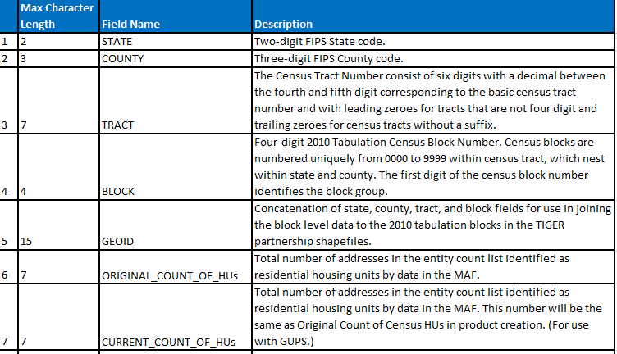
Digital Address Materials
Address Count List Record Layout
Refer to Table 4 located in your Respondent Guide for complete record layout.
Notes:
The slide illustrates a portion of Table 4 from the Respondent Guide. It depicts the record layout of the 2020 LUCA digital address count list. As mentioned on the previous slide, there are 13 fields of information. Participants can review the Respondent Guide for a complete, clearer visual of the Address Count List record layout.
The first five fields are the census geographic codes for state, county, tract and block, with the fifth field being a concatenation of the previous four fields to form the 15-character GEOID field.
Digital/Digital participants should place their focus on the two “ORIGINAL” fields; one for HUs and one for GQs. GUPS uses the six “CURRENT”, “LOCAL”, and “DIFFERENCE” fields for its processing; therefore, participants that do not use GUPS to review the LUCA materials can ignore those six fields.

Slide 40
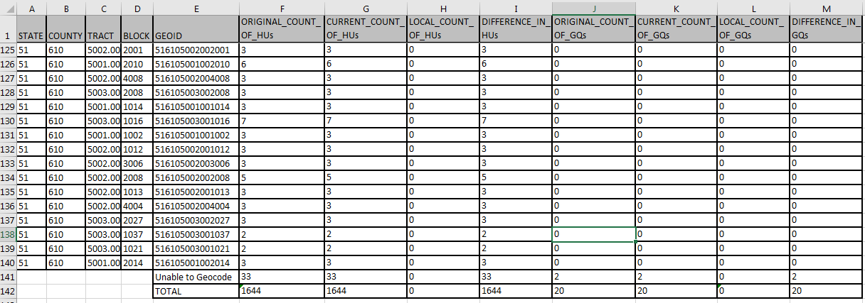
Digital Address Materials
Address Count List – Microsoft Excel Example
Notes:
After properly importing the .csv into Excel, the address count list appears similar to this example.

Slide 41
Digital Map Materials
TIGER Partnership Shapefiles
Created from Master Address File/Topologically Integrated Geographic Encoding and Referencing (MAF/TIGER) System.
Require use of a Geographic Information Software (GIS).
County based shapefiles, regardless of entity.
Do not contain structure points, so not Title 13 material.
  Generate structure points using Census Bureau’s digital address list (Title 13 material); refer to Respondent Guide Chapter 6.
Retain vintage for use in feedback products.
Notes:
The digital maps provided by the Census Bureau in support of the 2020 LUCA operation are the TIGER Partnership shapefiles. The Census Bureau’s MAF/TIGER System is the source for these shapefiles. Shapefiles require the use of a Geographic Information Software (GIS).
The Census Bureau provides county-based shapefile layers regardless of whether or not the entity is a tribal nation, state, county, or incorporated place participant. This means tribal participants receive county shapefiles that cover the extent of their reservation and off-reservations trust lands. State participants receive county shapefiles for the counties they wish to review and update. Likewise, the incorporated place participants receive county shapefiles for each county within which their jurisdiction falls within. The Census Bureau also includes state level shapefiles for reference and query purposes.
The TIGER Partnership shapefiles do not contain structure points (map spots), so they are not Title 13 material. Digital/Digital participants can generate structure points using GIS from the latitude and longitude coordinates in the Census Bureau’s address list. Upon creation, Title 13 protection is required. Participants may choose to use their local sources to generate residential address coordinate data. Refer to Chapter 6 of your Respondent Guide for instructions on this task using ArcGIS.
For 2020 LUCA, the Census Bureau intends to use the same vintage of blocks, 2010 blocks, for the feedback materials as with the initial materials. This decision helps with comparability of geography during the feedback phase in 2019.

Slide 42
Digital Map Materials
Edits to TIGER Partnership Shapefiles
Address focused operation, but updates to address list may require updates to digital maps.
Allow submission of linear feature updates electronically.
  Importing shapefiles, editing features, and exporting shapefiles.
Edges shapefile contains all linear features (road, rail, hydro).
  Used to Add Lines, Delete Lines, or Change Attribution for roads.
Tabblock2010 shapefile contains tabulation blocks used for 2020 LUCA.
  Used to geocode addresses.
More details in Respondent Guide Chapter 5.
Notes:
It is very important to note that LUCA is an address focused operation, and address list review its priority; however, some address list updates may require map updates, e.g., missing addresses from the address list may mean a missing road feature in the TIGER Partnership shapefiles.
Shapefiles allow participants to submit feature updates electronically if they follow Census Bureau requirements. In order to submit digital feature information, participants must have a GIS capable of importing Esri shapefiles, editing the features, and exporting layers back into Esri shapefile format.
All linear features in the MAF/TIGER System are contained in the edges shapefile. LUCA participants use the edges shapefile to add lines, delete lines, or change linear feature attributes for the road features impacted by an address list update. The Census Bureau does not expect, and will not process, updates to the edges shapefile for features other than roads. Participants use the tabblock2010 shapefile for geocoding addresses for inclusion or update to the address list.
For details on the contents of the shapefiles, review Chapter 5 of your Respondent Guide and the “readmefirst#.txt” file that is included on the DVD containing your shapefiles

Slide 43
Digital Materials
Initial Setup
Notes:
Welcome to the 2020 Census LUCA operation training to introduce the initial setup process for the digital materials. This presentation serves as an introduction to the digital LUCA materials and provides detailed information for each product preference that receives digital materials. It does not provide instructions for making updates or for submitting the updated materials. Separate presentations cover those two topics.
The Census Bureau expects to post this presentation on LUCA web site, so participants can review them again prior to materials receipt in early 2018.

Slide 44
Agenda
Digital Materials Initial Setup Summary
Digital Product DVD Overview
Getting Started
  DVD(s) of digital LUCA materials.
  Suggested setup of local system.
  Extracting files.
  File naming convention and examples.
Using Your LUCA Digital Materials
  Opening .csv files in Microsoft Excel
  Opening .shp files in Esri ArcGIS
Notes:
As participants begin to prepare for 2020 LUCA and receipt of digital materials, it is important to identify the product preferences that receive digital materials and discuss preparing for the delivery of the digital materials. We will describe the DVD layout and content for the six product preferences that receive digital materials and walk through getting started. We will end the presentation with discussing how to receive support and assistance from the Census Bureau as well as connect with us through social media.

Slide 45
Digital Materials Initial Setup Summary
Ensure Confidentiality and Security Guidelines followed and Title 13 security in place prior to installation of DVD material to local drive.
Review the “readmefirst#” txt file on DVD.
Review presentation again upon receipt of materials.
Use presentation in conjunction with Respondent Guide and the 2020 LUCA Quick Start Guide.
Notes:
This presentation covered a lot of detail of the digital materials that accompany six different product preference selections. Before we close, we will summarize the presentation. Ensure the implementation of the Confidentiality and Security Guidelines, Appendix A of the respondent guide. Ensure Title 13 security precautions are in place prior to installing any of the DVD materials discussed today. If your jurisdiction cannot meet the digital security requirements, please do not install the data. Contact the Census Bureau immediately to discuss alternatives.
Upon receipt of the LUCA materials, review the product preference specific “readmefirst#” text file included in the root directory of your DVD. Please plan to review this presentation again and use it in conjunction with the appropriate respondent guide as resources for getting started. Be on the lookout for a hardcopy 2020 LUCA Quick Start Guide that accompanies the materials, as it will contain tips on organizing and handling the digital materials.

Slide 46
Digital Product DVD Overview
Paper Address List and Paper/PDF (1 DVD).
Paper Address List and Digital Map (1 DVD).
Digital Address List and Paper Large Format maps (1 DVD).
Digital Address List and Paper/PDF (1 DVD).
Digital Address List and Digital Map (3 DVDs).
Geographic Updates Partnership Software (GUPS) (3 DVDs).
Notes:
All active, functioning, legal governments can choose to receive digital address materials for the 2020 LUCA operation. Each of the FOUR product preferences highlighted on this slide receive digital address materials as part of their 2020 LUCA materials. Participants that selected those preferences are the intended audience for this presentation. We expect many governments will choose digital materials for both their address list and maps in order to leverage their own GIS, while some may only feel comfortable with using the digital address materials in a spreadsheet or database software.
While Geographic Updates Partnership Software (GUPS) participants technically receive their materials by DVD, they do not use the DVDs in the same manner as the other three product preference participants on this slide. They do not have to download the digital data off the DVD because the GUPS installation process details the GUPS participant’s steps for proper installation of the software and digital data. Please refer to the GUPS presentation for all of the details on this process. If GUPS participants decide to use their own GIS system, then they effectively become a Digital/Digital participant and those sections of this presentation apply to them.

Slide 47
Getting Started
DVD(s) of LUCA Digital Materials
Digital/Paper-PDF & Paper/Digital-PDF participants.
  One DVD (contains both Title 13 and non-Title 13 materials).
    root directory.
    “maps” folder.
    “shape” folder.
Digital/Digital & GUPS participants.
  Three DVDs.
    One with Title 13 data in “shape” folder.
    One with non-Title 13 data in “shape” folder.
    One with GUPS installation software.
Notes:
For 2020 LUCA, the Census Bureau delivers the LUCA digital materials on DVD. Due to confidentiality and security requirements of Title 13 data, we cannot make the digital LUCA materials available through download (ftp or internet) or through e-mail.
For the four product preferences, besides Digital/Digital, that receive digital materials:
One DVD
Contains both the Title 13 and non-Title 13 materials
Has files stored in:
the root directory
and in either or both
a “maps” folder
a “shape” folder
Presence of these two folders is dependent on the product preference, meaning all four of the product preferences may not have both folders on their DVD.
Digital/Digital participants
receive three DVDs
one containing the Title 13 data
one containing the non-Title 13 data
one containing GUPS installation software.
The Census Bureau intends to provide the GUPS installation DVD to Digital/Digital participants in case they decide to use GUPS instead of their own GIS. The three DVDs have similar layout and content as described for the single DVD participants. More details on the DVD layout and content of each product preference are included in forthcoming slides.
For reference, the digital Title 13 data includes:
Census Bureau’s Address List
PDF small format block maps that contain structure points depicted as map spots.
Requires a password to access
Participants must use the Census provided password in order to gain access to these Title 13 materials. The password was prepared and shipped under a separate correspondence. Participants must ensure the confidential treatment of the DVD and contents included within the DVD in order to comply with Title 13 restrictions. Use the Confidentiality and Security Guidelines for descriptions of the necessary protections.
The digital non-Title 13 data includes the Address Count List and the TIGER Partnership shapefiles. No password is required for accessing this information, as with the Title 13 materials.

Slide 48
Getting Started
Suggested Setup of Local System
Read the installation instructions included in your materials.
Inspect your DVD(s) immediately upon receiving:
  If DVDs damaged, incomplete, or files corrupted contact Geographic Programs Support Desk at: 1-844-344-0169.
  If DVDs ok, create folder named “2020LUCA” on your hard drive.
Copy contents of DVD into your new “2020LUCA” folder.
Execute the various .exe files (if present).
Review the other files on DVD for additional instructions.
Review the 2020 LUCA Respondent Guides for instructions on use.
Notes:
Upon receipt of the DVDs containing the LUCA digital material if the DVDs are damaged, incomplete, or if the files are corrupted, contact the Geographic Programs Support Desk at 1-844-344-0169 immediately for assistance and potential replacement of DVD.
The Census Bureau recommends that you make a copy of each of the files and place them on the hard drive of a computer, only after ensuring you can adhere to the Confidentiality and Security Guidelines. Retaining a copy will preserve the original files should you need to look at an original record or require another original copy of the file.
To keep your work organized, create a new directory/new folder on your hard drive. We suggest naming it “2020LUCA”. Copy all of the contents from the DVD into the newly created folder on your local system. Execute the various .exe files, if they are present, that we will discuss in the next slides and review the other files included on the DVD that were not part of the .exe files for additional instructions.
Participants needing assistance with saving, executing, and/or opening the files, should refer to the materials specific Respondent Guide included with the materials for detailed instructions. Consider the Respondent Guide the source for answering questions regarding the LUCA operation. Call the Geographic Programs Support Desk at the number listed above or send an e-mail the LUCA staff at <GEO.2020.LUCA@census.gov> if questions still exist.

Slide 49
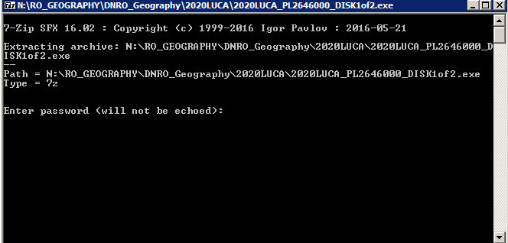
Getting Started
Extracting 2020LUCA_<EntityID>_DISK1of2.exe
Navigate to the “2020LUCA” folder you created.
If present, double click on the file named
  “2020LUCA_<EntityID>_DISK1of2.exe”.
Command prompt opens,
  requests password &
  closes upon completion.
Notes:
For training purposes, slides seven through 12 depict product preference specific examples. The Census Bureau did not include examples of extraction results for every product preference that receives digital material.
Navigate to the 2020LUCA folder on your local system. The DVD for two of the product preferences (Paper/PaperPDF and Paper/Digital) does not include this file because they receive paper address materials. For the other three product preferences (Digital/Paper, Digital/PaperPDF and Digital/Digital), double click on the file, 2020LUCA_<EntityID>_DISK1of2.exe, from your copy on the local system to execute the file and extract its encrypted contents. A command prompt opens and prompts for a password. Enter the password provided by the Census Bureau separately from your LUCA materials. The password is not visible when entering into the command prompt window. The command prompt window shows the progress of the file extraction and closes upon completion. This action has effectively unzipped and unencrypted the Title 13 address list for your jurisdiction.

Slide 50
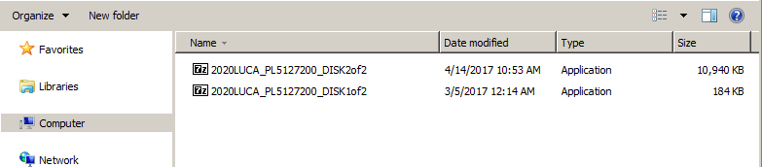
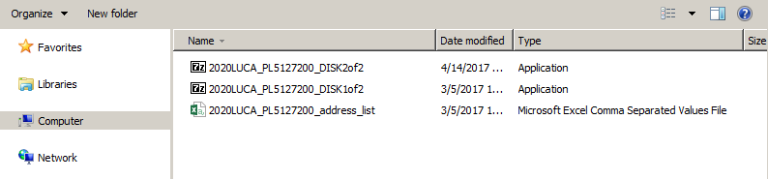
2020LUCA_<EntityID>_DISK1of2.exe – Visual
In this example for the Digital/Digital option - After executing the Disk1of2.exe file the resulting address list file appears in 2020LUCA folder.
Notes:
This visual represents how the local system would appear for Digital/Digital participants. The important point we are trying to illustrate is the presence of the resulting file, 2020LUCA_<EntityID>_address_list.csv, after the execution of the Disk1of2.exe file.
The file name varies based on the “EntityID”, which is comprised of a two character, alpha entity type (ST=state, CO=county, PL=Place, MC=minor civil division or MCD) and a variable length, numeric entity ID code. The code varies based on the type of entity. State code=2 digits, County=5 digits, Place=7 digits, MCD=10 digits. An upcoming slide discusses the file naming conventions. To properly open the Address List, see section 2.1.5, Converting Comma Delimited Files of the Respondent Guide, to ensure the field contents are preserved.

Slide 51
Getting Started
Extracting Title13_BlockMaps.exe
Navigate to the “2020LUCA” folder you created.
If present, double click on the file named
  “Title13_BlockMaps.exe”.
Command prompt opens,
  requests password &
  closes upon completion.
Notes:
Navigate to the 2020LUCA folder on your local system. Only the DVD for two of the product preferences (Paper/PaperPDF and Digital/PaperPDF) includes this file. For these two, double click on the file, Title13_BlockMaps.exe, from your copy on the local system to execute the file and extract its encrypted contents. A command prompt opens and prompts for a password. Enter the password provided by the Census Bureau separately from your LUCA materials and is the same one used to extract the digital address list. The password is not visible when entering into the command prompt window. The command prompt window shows the progress of the file extraction and closes upon completion. This action has effectively unzipped and unencrypted the Title 13 PDF small format block maps for your jurisdiction.

Slide 52
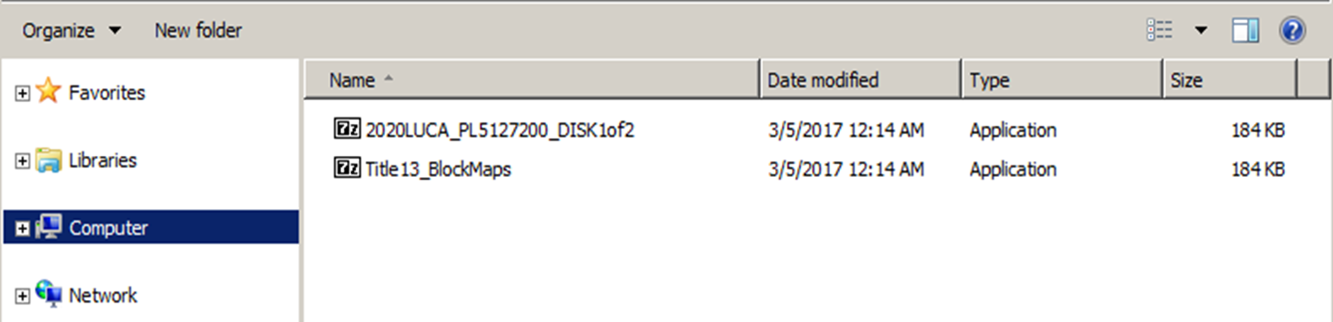
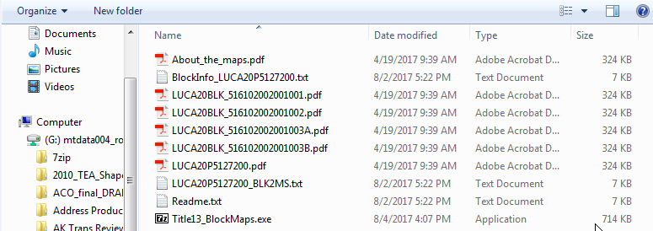
Title13_BlockMaps.exe – Visual
In this example for the Digital/PaperPDF option - After executing the Title13_BlockMaps.exe file the resulting block map PDFs appear in 2020LUCA folder.
Notes:
This visual represents how the local system would appear for Digital/PaperPDF participants. The important point we are trying to illustrate is the presence of the resulting files, beginning with “LUCA20BLK”, which appear after the execution of the Title13_BlockMaps.exe file.

Slide 53
File Naming Convention – Digital Materials
Address List.
  2020LUCA_XXyyyyyyyyyy_address_list.csv
  2020LUCA_TRxxxxTAyyyy_address_list.csv
Address Count List.
  2020LUCA_XXyyyyyyyyyy_address_countlist.csv
  2020LUCA_TRxxxxTAyyyy_address_countlist.csv
TIGER Partnership shapefiles.
  PVS_17_v2_<layername>_SSCCC.shp
  PVS_17_v2_<layername>_SS.shp
Notes:
Replace the <EntityID> mentioned on the previous slides dealing with extracting the data from the DVDs with Xxyyyyyyyyyy or TRxxxxTAyyyy in the following four slides WHERE:
XX is a 2 character, alpha entity type (ST=state, CO=county, PL=Place, MC=minor civil division or MCD)
yyyyyyyyyy is a variable length, numeric entity ID code that varies based on the type of entity (State code=2 digits, County=5 digits, Place=7 digits, MCD=10 digits).
TRxxxxTAyyy is a fixed length alphanumeric code composed of 12 character. First six (TRxxxx) represent the tribal identification code and the last six (TAyyyy) represent the code for the tribal geographic area.
The shapefiles for 2020 LUCA are TIGER Partnership shapefiles based off the official boundaries resulting from the 2017 BAS program. Their vintage is the fall of 2017. They have a standard naming convention that changes depending on the data content (“layername” shown above). The SS and CCC correspond to the state and county FIPS codes for the state and each county in which the entity exists.

Slide 54
File Naming Convention – Address List
2020LUCA_XXyyyyyyyyyy_address_list.csv
  2020LUCA_ST01_address_list.csv (State of Alabama).
  2020LUCA_CO12001_address_list.csv (Alachua County, FL).
  2020LUCA_PL1378800_address_list.csv (Valdosta city, GA).
  2020LUCA_TR0016TA1555_address_list.csv (Immokalee Reservation).
    TR0016 = Seminole Tribe of Florida .
    TA2980 = Immokalee Reservation.
Notes:
Presenters may alter the file naming convention slides to reflect audience, i.e., change from Kansas entities to Florida entities, remove tribal if no tribes present at the workshop, or remove MCDs if no functioning MCDs in the state. This slide is editable for content; just ensure the naming convention is accurate. All that should change is the <EntityID> and the description in parenthesis.
This slide explores the various naming conventions for the address list based upon the entity types, state, county, incorporated place, minor civil division and federally recognized tribes with reservation and/or off reservation trust lands.
ST20 identifies a state address list for Kansas. CO20001 identifies a county address list for Allen County KS. PL2000125 identifies an incorporated place address list for Abilene city KS. MC2000120550 identifies a minor civil division address list for Elm township KS. TR0197TA2980 identifies a tribal address list for Prairie Band of Potawatomi Nation Reservation, where TR0197 is the tribal identification code for Prairie Band Potawatomi Nation and TR2980 represents the Prairie Band of Potawatomi Nation Reservation, the geographic area associated with the Prairie Band Potawatomi Nation.

Slide 55
File Naming Convention – Address Count List
2020LUCA_XXyyyyyyyyyy_address_countlist.csv
  2020LUCA_ST22_address_countlist.csv (State of Louisiana).
  2020LUCA_CO28001_address_countlist.csv (Adams County, MS).
  2020LUCA_PL3770540_address_countlist.csv (Wake Forest town, NC).
  2020LUCA_TR0035TA0525_address_countlist.csv (Catawba Reservation).
    TR0035 = Catawba Indian Nation.
    TA0525 = Catawba Reservation.
Notes:
Presenters may alter the file naming convention slides to reflect audience, i.e., change from Kansas entities to Florida entities, remove tribal if no tribes present at the workshop, or remove MCDs if no functioning MCDs in the state. This slide is editable for content; just ensure the naming convention is accurate. All that should change is the <EntityID> and the description in parenthesis.
The address count list follows the same naming convention as for the address list, except for reference to the “countlist” in the file name.

Slide 56
File Naming Convention –
TIGER Partnership Shapefiles
PVS_17_v2_<layername>_SSCCC.shp
  PVS_17_v2_edges_20001.shp (edges for Allen County, KS).
  PVS_17_v2_tabblock2010_20001.shp (2010 Census tabulation blocks for Allen County, KS).
  PVS_17_v2_place_20001.shp (place boundaries for Allen County, KS).
  And numerous others.
PVS_17_v2_<layername>_SS.shp (for reference and query only).
  PVS_17_v2_state_20.shp (Kansas state boundary).
  PVS_17_v2_county_20.shp (county boundaries within Kansas).
  PVS_17_v2_place_20.shp (place boundaries within Kansas).
  And numerous others.
Notes:
Presenters may alter the file naming convention slides to reflect audience, i.e., change from Kansas entities to Florida entities, remove tribal if no tribes present at the workshop, or remove MCDs if no functioning MCDs in the state. This slide is editable for content; just ensure the naming convention is accurate. All that should change is the <EntityID> and the description in parenthesis.
Numerous files accompany the county-based TIGER Partnership shapefiles for LUCA, but the two of importance are the Edges and Tabblock2010 shapefiles within each of the county folder(s). The edges shapefile is the only file edited during the 2020 LUCA operation. Use it to make road feature updates resulting from address list updates. Use the tabblock2010 shapefile for geocoding purposes, as it is the block base for the 2020 LUCA operation. Make no updates to the tabblock2010 file.
Programmed to use both state level and county level shapefiles, the Census Bureau provides GUPS state level shapefiles as part of the LUCA TIGER Partnership shapefiles. These state level files are for reference only. Make no updates to any of the shapefiles located within the state folder. These files can, however, be used for reference purposes.
As an example, for an incorporated place that crosses county lines, they may wish to use the state level incorporated place shapefile (e.g., PVS_17_v2_place_20.shp) to help them identify the 2010 tabulation blocks for their entity. Since incorporated place boundaries do not cross state lines, the state level file for incorporated places shows the place boundary in its entirety, without fragmenting at the county boundary. Using the PVS_17_v2_place_20001.shp would only show the Allen County KS portion of any split boundary places.

Slide 57
Using Your LUCA Digital Materials
Opening .csv files in Microsoft Excel.
Opening .shp files in Esri ArcGIS.
Notes:
With the conclusion of the DVDs content and layout section, it is very important to review how to get started with the digital address and maps materials. Digital address materials participants must follow the exact procedures described in this presentation and in the Respondent Guide for opening the .csv files. These steps are critical. Improper opening of the .csv corrupts the data content of the digital address list. Opening the shapefiles is less complicated, but examples of opening the files using Esri’s ArcGIS software are included.

Slide 58
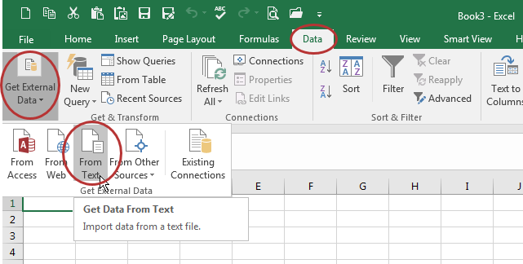
Opening .csv Files in Microsoft Excel:
Data – Get External Data – From Text
Launch Microsoft Excel and open a blank workbook.
Choose Data – Get External Data – From Text.
Notes:
It is important to open the .csv files in a particular manner so the field structure is preserved and data content is not corrupted. The next three slides of information were created using Excel 2016. Because software versions and vintages may display information differently, please keep this in mind while viewing these examples.
After launching Microsoft Excel, open a blank workbook. Choose from the Data menu to Get External Data from Text.

Slide 59
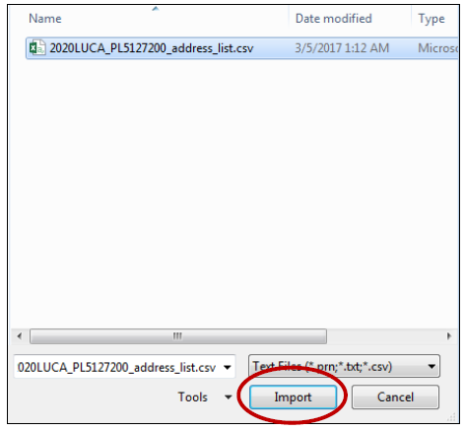
Opening .csv Files in Microsoft Excel:
Navigate – Import
Navigate to the “2020LUCA” folder, choose the .csv and then choose Import.
Notes:
Navigate to the “2020LUCA” folder on your local system, choose the .csv you wish to open, and then choose Import.

Slide 60
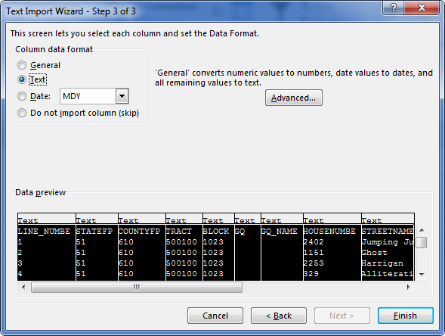
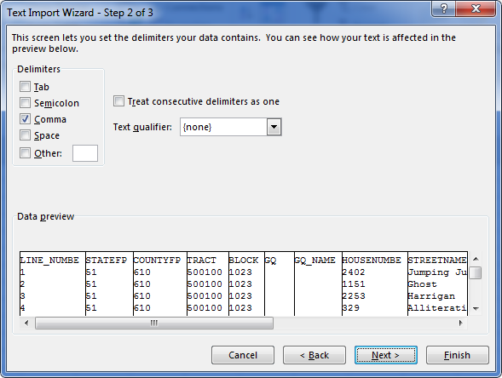
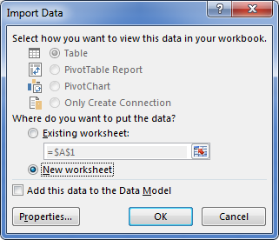
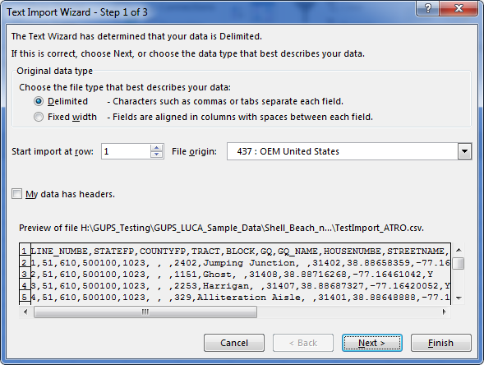
Opening .csv Files in Microsoft Excel:
Text Import Wizard
Text Import Wizard appears:
      Step 1/3 (Original data type=Delimited and choose Next).
      Step 2/3 (Change Delimiters from Tab to Comma and choose Next).
      Step 3/3 (Select all fields in Data preview, Change Column data format to Text & choose Finish).
      Import Data choose New worksheet and OK.
**No Title 13 Data Displayed**
Notes:
Follow the Import Wizard by selecting the following choices:
Original data type = Delimited and choose Next
Change Delimiter from Tab to Comma and choose Next
Select all of the fields in the Data preview window and change the data format to Text, and choose Finish (Setting the fields to Text preserves the leading zeros in the value fields)
For the Import Data window, participants may choose “New worksheet” to have the information imported into a blank new worksheet. If they choose “Existing worksheet”, make sure the field beneath is set to the upper left cell, =$A$1

Slide 61

Opening .shp Files In Esri ArcGIS:
Launch ArcGIS – ArcMap
From the Start Menu or a shortcut icon on desktop, launch ArcMap.
A “Loading Document” window appears.
Notes:
The Census Bureau uses Esri’s ArcGIS ArcMap version 10.4.1. Please note different versions of ArcGIS yield different actions and screen visuals. These screenshots provide only one method for setting up your digital map materials. This presentation does not discuss editing the shapefiles. The “Acceptable Update” presentations discuss editing the shapefiles.
Presenter read the bullets on the slide.

Slide 62
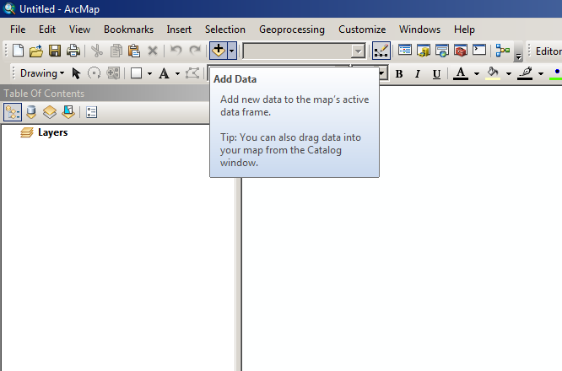
Opening .shp Files In Esri ArcGIS
Setting up .mxd
A blank Map Document (.mxd) will open.
Click the Add button to add your data to the blank .mxd.
Notes:
After the “Loading Document” window closes, a blank map document, or .mxd, will open. Click the Add button, represented as a plus sign in the ArcMap software as shown in the image on the right side of the screen.

Slide 63
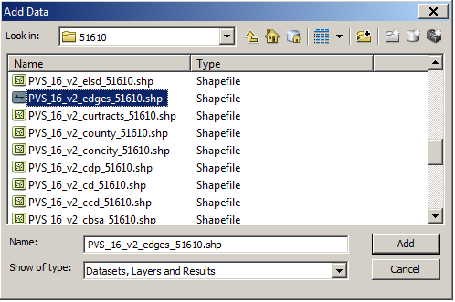
Opening .shp files in Esri ArcGIS
Browse and add data
Browse for your data.
Select the edges shapefile and the tabblock2010 shapefile and click Add.
Notes:
Browse for your shapefile data, extracted after execution of the 2020LUCA_<EntityID>_DISK2of2.exe file. Select the edges shapefile and the tabblock2010 shapefile for your jurisdiction and click Add.

Slide 64
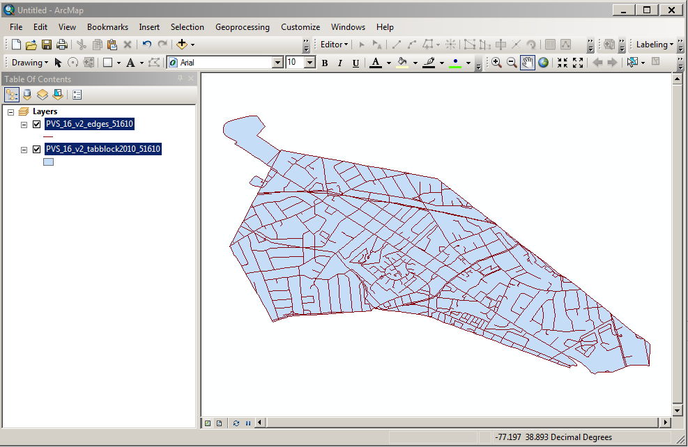
Opening .shp files in Esri ArcGIS
Add Data resulting visual
Something similar to this image appears after successfully adding the edges and tabblock2010 shapefiles.
Notes:
A visual very similar to this image appears after successfully adding the edges and tabblock2010 shapefiles to the blank map document.

Slide 65
Digital Address List
Acceptable Updates
Notes:
Welcome to the 2020 Census LUCA operation training that covers acceptable updates for digital address list and digital map participants. This presentation provides instructions and examples for making proper updates to both the digital address and digital map materials.
The Census Bureau expects to post this presentation on the LUCA web site, so participants can review them again prior to materials receipt in early 2018.

Slide 66
Agenda
Digital Address List and Digital Map Updates
Digital Address List Action Code Updates
Address List Add Updates
Digital Map Updates
Ungeocoded Addresses
Non-City Style Addresses
Notes:
This presentation identifies the intended audience for this presentation. It discusses Title 13 U.S.C. and provides a materials refresher to reintroduce the specific materials for this product preference. It defines acceptable updates, provides several examples of each, and a summary of the process. It reinforces the ways to receive support and assistance during the LUCA operation and mentions ways to stay connected to the Census Bureau through several social media sources as well as Census Bureau subscriptions.
For more detailed information and instruction, refer to the Respondent Guide that accompanies the materials and to upcoming presentations that discuss review, update and submission details.

Slide 67
Acceptable Updates and Examples
Address List action codes (ACTION):
  A – Add this address.
  C – Correct this address.
  D – Delete this address.
  J – Address is not in this jurisdiction.
  N – Address is nonresidential.
Edges shapefile change type codes (CHNG_TYPE):
  AL – Add Line.
  DL – Delete Line.
  CA – Change Attribute.
Notes:
We are entering the section of the presentation that deals with specific examples for updating the LUCA materials. Please remember, LUCA is an address-focused operation. Some map updates intertwine with some of the examples, but the focus of this section of the presentation details permissible actions that can occur to the address list.
There are five acceptable action codes used to edit the census address list, A, C, D, J, and N. Participants enter the action codes into the ACTION field. All five action codes may be used with city style addresses (e.g., 1000 Main St), non-city style addresses (e.g., RR 3 Box 34) and ungeocoded addresses. There are three acceptable change type codes used to edit the edges shapefile, AL, DL, and CA. Each updated road feature in the edges shapefile must contain one of the change type codes in the CHNG_TYPE field.
For the training examples, city style addresses are the focus, but an example of a non-city style address is included within the A action code section. As work begins on address list updates, the Census Bureau encourages participants to save their work often to preserve changes. Saving often ensures work is not lost. Keeping an original in a secure location also ensures the recreation of updates if something necessary. Lastly, please use caution when re-sorting the address list. Capture all 24 fields within the address list before re-sorting the list. Accidentally not capturing all of the fields during a sort action will jumble the records, thereby corrupting the information

Slide 68
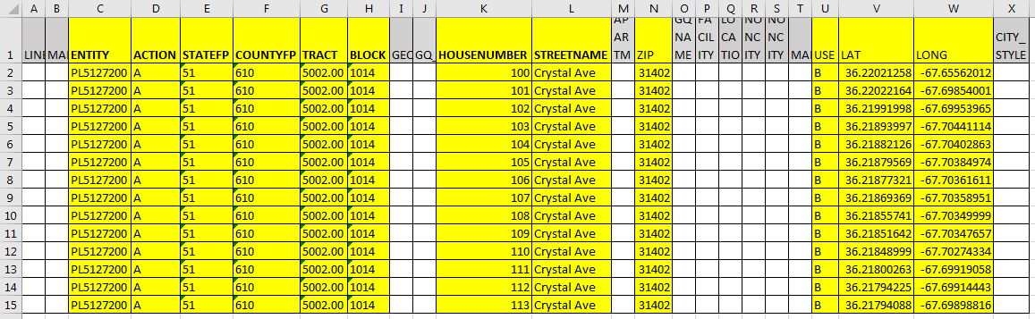
“A” Action Code – Address List:
City Style Addresses – HUs
**No Title 13 Data Displayed**
Notes:
Participants use the “A” action code to add residential addresses that are new or missing from address list. The “A” action code updates may result in updates to the edges shapefile, usually the “AL” change type.
During a participant’s review, they may find addresses missing from the census address list located on streets that are partially or entirely missing from the maps. For this example, a participant discovers addresses along Crystal Avenue, a new street, are missing from the address list. The example depicts adding the addresses to the address list and the road feature to the edges shapefile. This screen is the Excel view for adding the 14 new records on to the address list.
For all of the upcoming address list examples, the bold field headings on the slide indicate required information, while the other highlighted fields represent optional/if known information.
In the census address list, create/insert a new record/row.
Copy the ENTITY code from an existing record in the address list.
Enter an “A” in the ACTION field.
Enter/Copy the required geocode information in the appropriate fields for each new address:
State Code in the STATEFP field (51)
County Code in the COUNTYFP field (610)
Census Tract Number in the TRACT field (5002.00)
Census Block Number in the BLOCK field (1014)
Enter the complete house number in the HOUSENUMBER field.
Enter the complete street name in the STREETNAME field. (Crystal Ave)
If known, enter the ZIP (31402)
If known, enter the address use information, in the USE field: (B)
M—mailing purposes.
L—location purposes, including emergency services.
B—both mailing and location purposes.
If known, enter the structure latitude in the LAT field and the structure longitude in the LONG field.
Leave the MAPSPOT field blank because participants cannot add actual map spots to the shapefiles and because the inclusion of LAT/LONG information is effectively, the map spot coordinate information.
Leave the CITY_STYLE field blank.
Once complete, the address list for this example will contain 14 new housing unit records for Crystal Ave with all appropriate fields entered

Slide 69
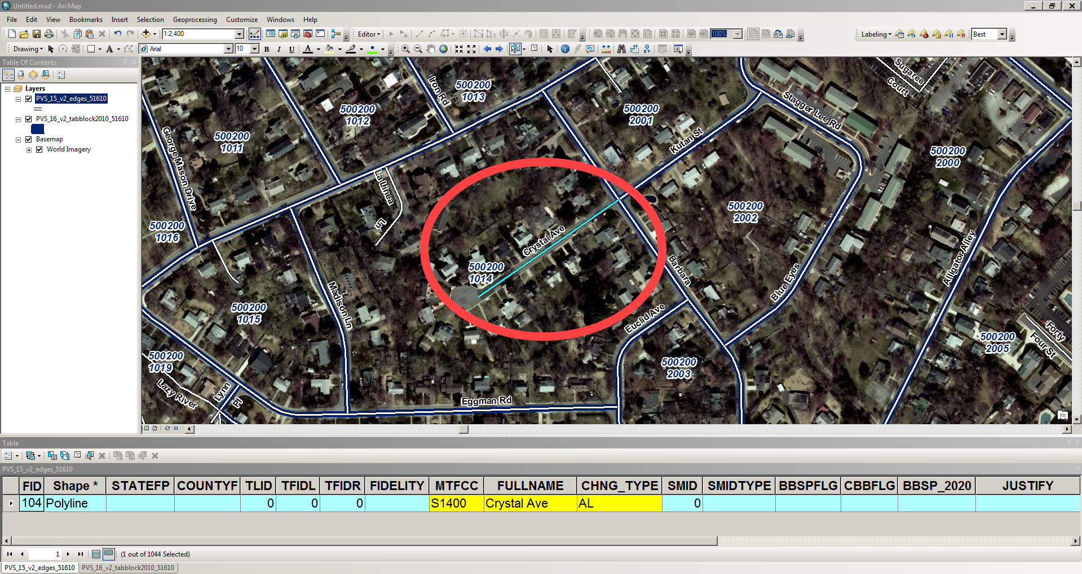
“AL” Change Type – Edges Shapefile:
Adding A Street
Notes:
In the edges shapefile, digitize the feature. In the edges attribute table, enter the MTFCC, which is “S1400”, FULLNAME, which is “Crystal Ave”, and CHNG_TYPE, which is “AL”. For this example, there will be a new road added to the attribute table from the digitization of the feature and all fields, except the MTFCC, FULLNAME, and CHNG_TYPE information remain blank.
The image illustrates the newly added street in the edges shapefile and the three fields of required information in the edges shapefile attribute table.

Slide 70
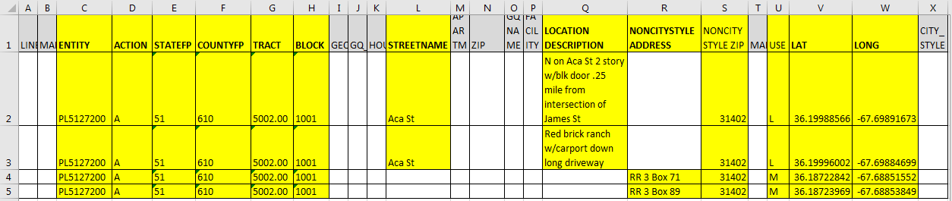
“A” Action Code – Address List:
Non-City Style Addresses – HUs
**No Title 13 Data Displayed**
Notes:
Participants may recall from the LUCA training introduction presentation, the Census Bureau classifies addresses that do not include a house number and/or street name as non-city style addresses. These may also include a complete house number or street name. In addition to the required state and county codes, and census tract and block codes, for participants to successfully add non-city style addresses in 2020 LUCA, participants must provide a well-defined description of the address location and identify the approximate location by providing the latitude and longitude information in the respective fields.
For this example, an area north of Aca Street includes four new housing units. Two records have only location description information, while the other two have rural route and box number information. The street exists correctly in the edge” shapefile, so no updates are required. This screen is the Excel view for adding four records for non-city style addresses.
In the census address list, create/insert four new records/rows.
Copy the ENTITY code from an existing record in the address list.
Enter an “A” in the ACTION field.
Enter/Copy the required geocode information in the appropriate fields for each new address:
State Code in the STATEFP field. (51)
County Code in the COUNTYFP field. (610)
Census Tract Number in the TRACT field. (5002.00)
Census Block Number in the BLOCK field. (1001)
For the records with only a location description, enter the complete street name in the STREETNAME field. (Aca St)
Enter a well-defined location description in the LOCATION DESCRIPTION field.
If known, enter the non-city style mailing ZIP Code in the NONCITYSTYLE ZIP field. (31402)
If known, enter the address use in the USE field: (L for two records and M for two records)
M—mailing purposes.
L—location purposes, including emergency services.
B—both mailing and location purposes.
Enter the structure latitude in the LAT field and the structure longitude in the LONG field.
Leave the MAPSPOT field blank because participants cannot add actual map spots to the shapefiles and because the inclusion of LAT/LONG information is effectively, the map spot coordinate information.
Leave the CITY_STYLE field blank.
For the two rural route records, follow the same instructions as above, but participants do not need to include the street name information or location description. Include the rural route address in the NONCITYSTYLE ADDRESS field. The postal services uses rural route addresses mail purposes, so notice the Use field with “M” instead of “L”.
Once complete, the address list for this example will contain four non-city style address housing unit records with all appropriate fields entered.

Slide 71
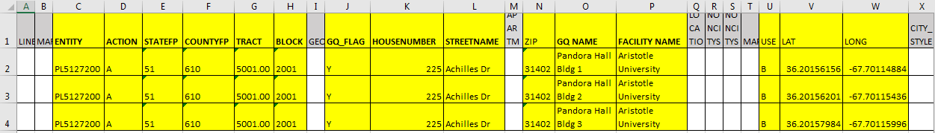
“A” Action Code – Address List:
City Style Addresses – GQs
**No Title 13 Data Displayed**
Notes:
The same process explained for adding a housing unit applies to adding group quarters, with a few additional requirements. If participants enter a “Y”, for the Group Quarters Flag (GQ_FLAG) they must provide a group quarters name and a facility name if the group quarters are associated with a facility (e.g., Group Quarters Name – Pandora Hall Bldg 1; Facility Name – Aristotle University). The Census Bureau will not process an added group quarters record without a group quarters name.
This example demonstrates how to add a group quarters address that contains three individual buildings. Aristotle University constructed three new residence halls, Pandora Hall, Buildings 1, 2, and 3 at 225 Achilles Dr. The street already exists and is correct in the TIGER Partnership shapefile, so there is no action required in the edges shapefile.
In the census address list, create/insert three new records/rows for this example for the three new buildings located at 225 Achilles Dr.
Copy the ENTITY code from an existing record in the address list.
Enter an “A” in the ACTION field.
Enter the required geocode information in the appropriate fields for each new address:
State Code in the STATEFP field. (51)
County Code in the COUNTYFP field. (610)
Census Tract Number in the TRACT field. (5001.00)
Census Block Number in the BLOCK field. (1001)
Enter a “Y” in the GQ_FLAG field for each unit added.
Enter the complete house number in the HOUSENUMBER field. (225)
Enter the complete street name in the STREETNAME field. (Achilles Dr)
If known, enter the city style mailing ZIP Code in the ZIP field. (31402)
Enter the Group Quarters name in the GQ Name field. (Pandora Hall Bldg 1)
Enter the Facility Name, if the GQ is associated with a facility. (Aristotle University)
If known, enter the address use in the USE field: (B)
M—mailing purposes.
L—location purposes, including emergency services.
B—both mailing and location purposes.
If known, enter the structure latitude in the LAT field and the structure longitude in the LONG field. For this example, each of buildings will have a unique latitude/longitude value.
Leave the MAPSPOT field blank because participants cannot add actual map spots to the shapefiles and because the inclusion of LAT/LONG information is effectively, the map spot coordinate information.
Leave the CITY_STYLE field blank.
Once complete, the address list for this example will contain three new GQ records Aristotle University with all appropriate fields entered.

Slide 72
“C” – Action Code
Use a “C” action code for the following situations:
  Incorrect state code.
  Incorrect county code.
  Incorrect census tract number.
  Incorrect census block number.
  Incorrect street name (including street directional and street type information).
  Incorrect ZIP code.
  Incorrect latitude and/or longitude values.
  Include tract and block numbers for ungeocoded address records*.
*Ungeocoded address records are missing the tract and block geocode information. These records exist for state and county participants.
Notes:
Participants use the “C” action code to update the census address list in the following situations: to correct incorrect state codes, county codes, census tract numbers, census block numbers, street names (including directional and street type information), ZIP codes, latitude and longitude values. The 2020 LUCA operation allows for update to only these eight fields. The fields corresponding to these bullets are THE ONLY eight fields 2020 LUCA allows for update.
The presentation includes three examples of using the “C” action code, shown in bold on the slide.
Correction of an incorrect census block number.
Correction of an incorrect street name.
Correction to tract and block geocodes for ungeocoded address records.
*Ungeocoded records are missing the tract and block geocode information. These records exist for state and county participants. Though ungeocoded address records can use all action codes, the most informative update for the Census Bureau is inclusion of the tract and block information that provides the necessary geocode information to distribute a questionnaire. This edit corresponds to a “C” action code.

Slide 73
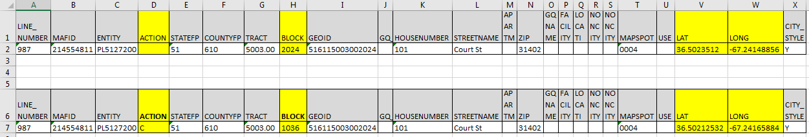
“C” Action Code – Address List:
City Style Address – Correcting Block Number
**No Title 13 Data Displayed**
Notes:
In this before and after example, the digital address list and edges shapefile incorrectly show Court Street located in block 2024 of census tract 5003.00. According to local sources, Court Street is located in the same tract, but across the Brass Alley in block 1036. Participants need to update both the address list and edges shapefile to correct this error.
In the census address list, enter a “C” in the ACTION field for one address located on Court St.
In the BLOCK field for the incorrect record, enter the correct block number, 1036. Do not update the GEOID field; leave it with the original information.
Though shown as updated in this example, it is optional to update the LAT and LONG fields based on the movement of the address from one block to the other. Do not update the MAPSPOT field or remove its information.
Once complete, the address list for this example depicts the “C” ACTION, a change to the BLOCK field, and updated LAT/LONG coordinates.

Slide 74
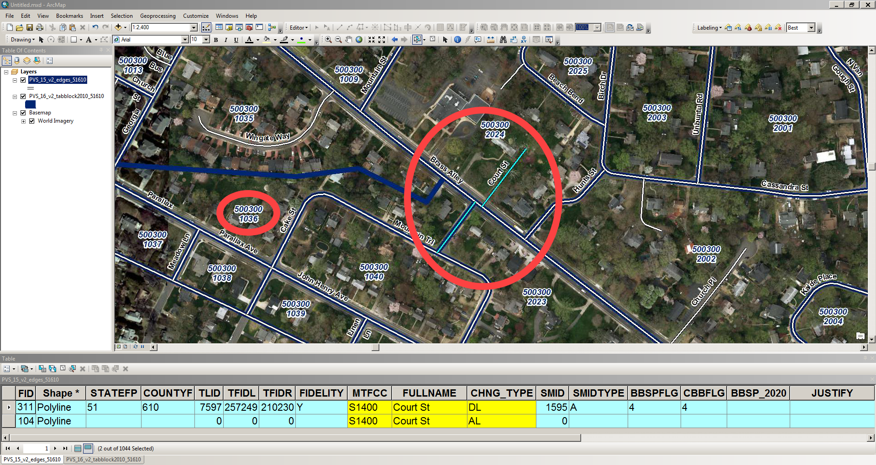
“DL” and “AL” Change Type - Edges Shapefile:
Correcting Block Number
Notes:
In the edges shapefile, select the incorrectly placed Court Street in tract 5003.00 block 2024.
In the attribute table for the incorrectly placed feature, enter “DL” in the CHNG_TYPE field to show the feature marked for deletion. Do not perform the actual deletion of the feature because that would also delete the attribute record needed to identify all changes to the edges shapefile.
In the edges shapefile, digitize Court Street in its correct location in block 1036, south of Brass Alley.
In the attribute table for the newly digitized record, enter the MTFCC, FULLNAME, and CHNG_TYPE fields, “S1400”, “Court St”, and “AL” respectively.
The image illustrates the correctly placed street in block 1036, the incorrectly placed street in block 2024, and the three fields of required information in the edges shapefile attribute table.

Slide 75
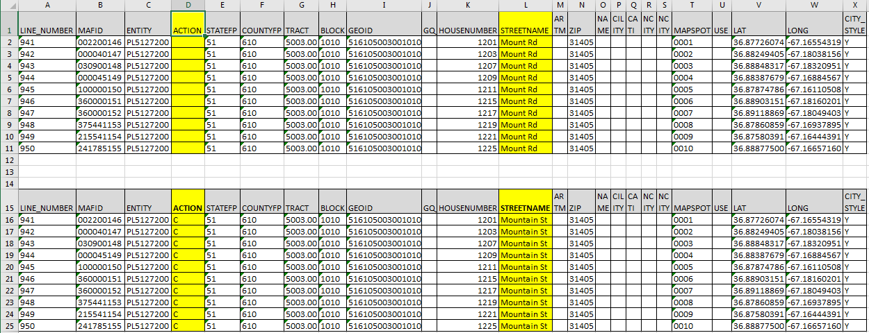
“C” Action Code – Address List:
City Style Addresses – Correcting Street Name
**No Title 13 Data Displayed**
Notes:
In this before and after example, the census address list and edges shapefile incorrectly show Mount Road instead of Mountain Street, the correct street name. Please note, not all of the addresses on Mountain Street are included in this example, just those in block 1010. There are additional corrections for this street in two different blocks (1009 and 2024) based on the imagery in the next slide.
In the census address list, enter a “C” in the ACTION field for all addresses located on Mount Rd.
In the STREETNAME field for those incorrect records, enter the correct name, Mountain St.
Do not make any edits to the other fields.
Once complete, the address list for this example will depict the “C” ACTION and a change to the STREETNAME field.

Slide 76
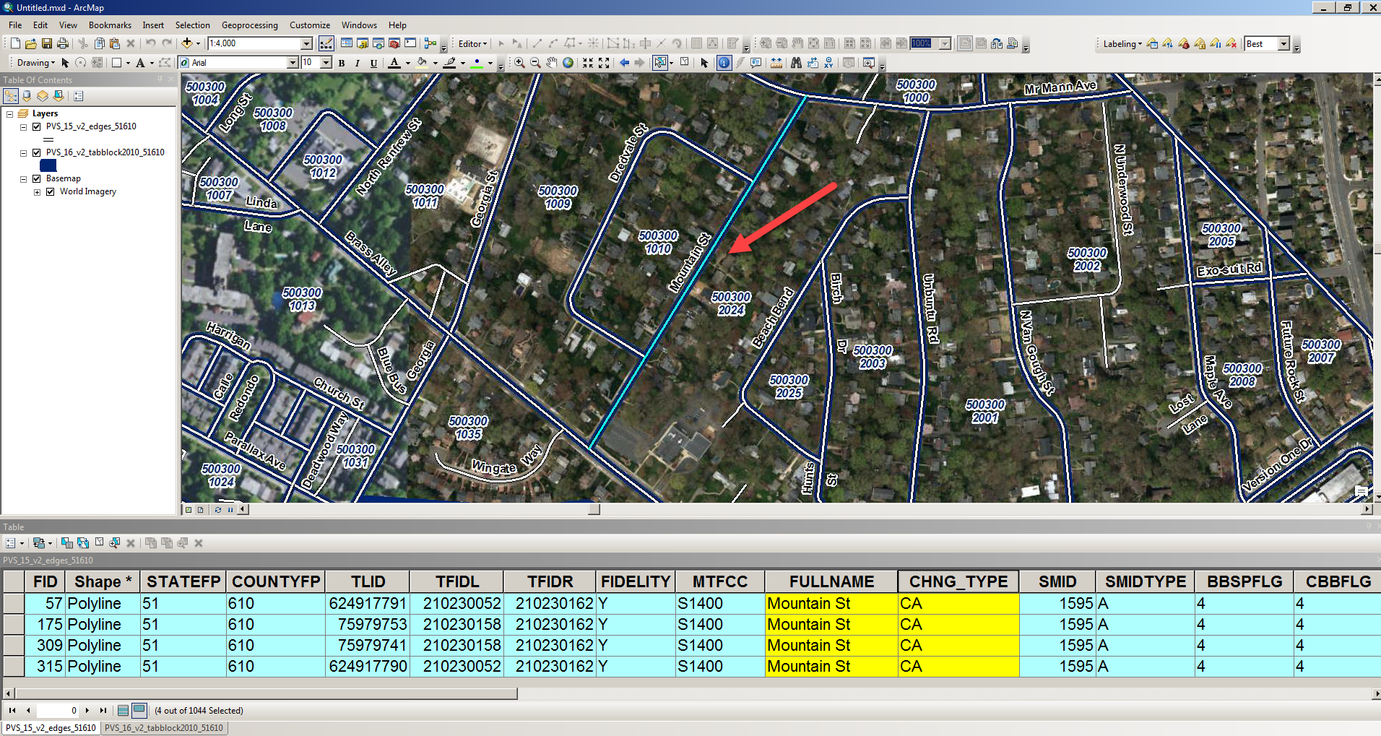
“CA” Change Type – Edges Shapefile:
Correcting Street Name
Notes:
In the edges shapefile, select all of the segments for the feature in need of correction, in this case Mount Rd.
Edit the FULLNAME field, correcting it from Mount Rd to Mountain St.
Enter “CA” in the CHNG_TYPE field to show a change to the attribution.
The image illustrates the correctly named street (Mountain St), and shows the corrected FULLNAME field and “CA” CHNG_TYPE field in the edges shapefile attribute table.

Slide 77
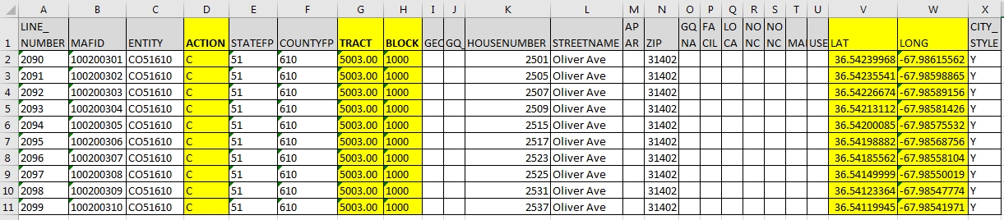
“C” Action Code – Address List:
City Style Addresses – Correcting Ungeocoded Records
**No Title 13 Data Displayed**
Notes:
The census address list for state and county participants may contain ungeocoded address records. If so, these appear at the end of the address list. Consider reviewing these addresses to determine if they are valid residential addresses. If they are, use the “C” action code and provide the census tract and census block for these records to ensure an accurate enumeration in the correct location.
If participants determine ungeocoded records do not exist, are invalid, are out of the jurisdiction, or are nonresidential, they may mark them according to guidance in upcoming slides for the D, J and N action codes and as described in the Respondent Guide.
In this example, the county address list for Winter County, CO51610, includes several ungeocoded address records. The county participant knows the necessary information to correct the ungeocoded addresses along Oliver Avenue.
In the census address list, enter a “C” in the ACTION field for the records on Oliver Ave.
Enter a “C” in the ACTION field.
Enter the required geocode information in the appropriate fields for each ungeocoded address:
Census Tract Number in the TRACT field. (5003.00)
Census Block Number in the BLOCK field. (1000)
Participants do not have to generate the GEOID value.
If participants know the approximate location of each address, include the latitude and longitude values in the LAT and LONG fields, respectively.
Once complete, the address list for this example will depict the “C” ACTION, inclusion of TRACT and BLOCK numbers, as well as the optional LAT and LONG coordinate data.

Slide 78
“D” – Action Code
Use a “D” action code for the following situations:
  Residential address no longer exists, is uninhabitable, or is a duplicate.
  Street, or section of street, no longer exists (and addresses along street no longer exist).
  Incorrect house number or incorrect apartment/unit number.
  Housing Unit, Multiunit, or Group Quarters Conversions:
    Housing unit converted to a multiunit structure or group quarters.
    Multiunit structure converted to a housing unit or group quarters.
    Group quarters converted to a housing unit or multiunit structure.
Do not modify any other columns.
Notes:
Participants use the “D” action code on the census address list to flag residential address records that no longer exist, are uninhabitable or are duplicates. They may also use the “D” action code to flag residential addresses along streets that no longer exist, as well as to flag records with incorrect house numbers or apartment/unit numbers. In instances of address conversions (e.g., housing units converted to multiunit structure or group quarters; multiunit structure converted to a housing unit or group quarters; group quarters converted to a housing unit or multiunit structure), participants use the “D” action code to delete the converted records.
In the cases of incorrect house number, apartment numbers and conversions, participants must add the corrected addresses that correspond to the records marked for deletion. The Census Bureau terms this type of update a “delete/add” action combination.
Besides updating the “D” in the ACTION field, participants must not make any additional modifications for these records on the address list.
The presentation includes three examples of proper use of the “D” action code, shown in bold on the slide.
Deletion of address records along street that does not exist
Deletion of records with an incorrect apartment/unit number and the corresponding “Add” action
Deletion of housing unit converted to multiunit structure and the corresponding “Add” action

Slide 79
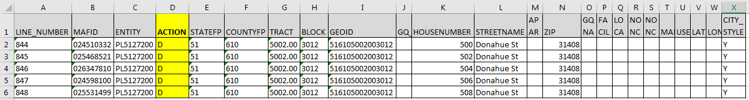
“D” Action Code – Address List:
City Style Addresses – Delete Addresses
**No Title 13 Data Displayed**
Notes:
In this example, the census address list and edges shapefile incorrectly contain Donahue Street. Though planned for creation, construction of the road and houses never occurred. Participants need to update both the address list and edges shapefile to correct this error.
In the census address list, enter a “D” in the ACTION field for the six addresses located on Donahue St. Make no other changes to these records.
Take note the absence of the MAPSPOT or LAT/LONG values. This makes sense because these structures do not exist.
Once complete, the address list for this example will depict the presence of the “D” ACTION.

Slide 80
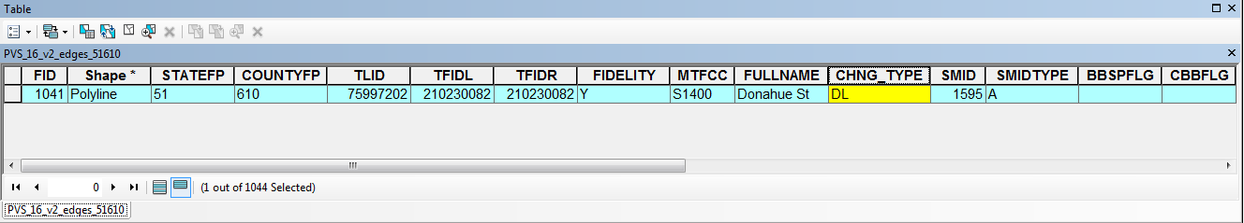
“DL” Change Type – Edges Shapefile:
Delete A Street
Notes:
In the edges shapefile, select Donahue St.
In the attribute table, enter “DL” in the CHNG_TYPE field to show the feature marked for deletion. Do not perform the actual deletion or that would also delete the attribute record needed to identify all changes to the edges shapefile.
The image illustrates the “DL” CHNG_TYPE field in the edges shapefile attribute table.

Slide 81
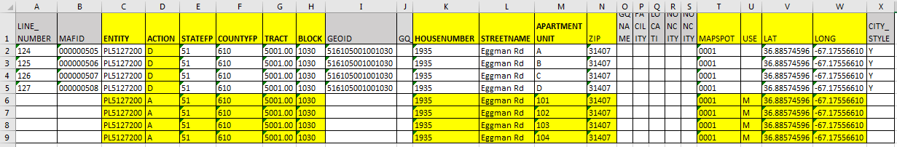
“D” and “A” Action Codes – Address List:
City Style Addresses – Incorrect Apartment Unit
**No Title 13 Data Displayed**
Notes:
In this example, the census address list shows incorrect apartment information for the apartments located at 1935 Eggman Rd. Instead of A-D, local sources indicate the apartment units are numbered 101-104. Because participants cannot edit the apartment/unit information field on the address list, they must delete the incorrect records and add the correct records. There is no action required in the shapefile for this example.
As noted earlier, the Census Bureau calls this a “delete/add” action.
In the census address list, enter a “D” in the ACTION field the four addresses on Eggman Rd with the incorrect apartment information. Take no other action on those records.
Next, in the address list, create/insert four new records/rows.
Enter an “A” in the ACTION field for the new records as well as the correct apartment information in the APARTMENT UNIT field.
Assuming no other problems exist with the deleted records, copy and paste or re-enter the information from the following fields of the deleted records: ENTITY, STATEFP, COUNTYFP, TRACT, BLOCK, HOUSENUMBER, STREETNAME, ZIP, MAPSPOT, USE, LAT, and LONG.
DO NOT copy the LINE_NUMBER, MAFID, GEOID or CITY_STYLE fields.
There is no action required in the shapefile for this example.
Once complete, the address list for this example will depict the presence of the “D” ACTION on the four incorrect Eggman Rd records and the “A” ACTION on the four newly added, correct Eggman Rd records. The added records include all of the necessary information for census processing.

Slide 82
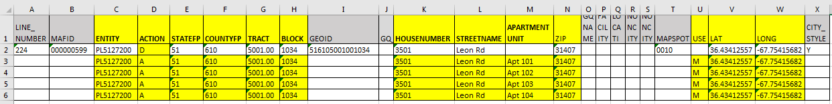
“D” and “A” Action Codes – Address List:
City Style Addresses – HU Converted to Multiunit
**No Title 13 Data Displayed**
Notes:
In this example, the census address list shows a single record for a housing unit located at 3501 Leon Road. Local sources indicate this address has converted to a multiunit structure containing four apartments. Instead of a single address for a housing unit, this address now represents a multiunit structure with four individual addresses.
In the census address list, enter a “D” in the ACTION field for the address on Leon Rd. Take no other action on the record.
Next, in the census address list, create/insert four new records/rows.
Enter an “A” in the ACTION field for the new records as well as the correct apartment information in the APARTMENT UNIT field.
Assuming no other problems exist with the deleted records, copy/paste or re-enter the information from the following fields of the deleted records: ENTITY, STATEFP, COUNTYFP, TRACT, BLOCK, HOUSENUMBER, STREETNAME, ZIP, USE, LAT, and LONG.
DO NOT copy the LINE_NUMBER, MAFID or GEOID fields.
There is no action required in the shapefile for this example.
Once complete, the census address list for this example will depict the presence of the “D” ACTION on the one incorrect Leon Rd record and the “A” ACTION on the four newly added Leon Rd records. The added records include all of the necessary information for census processing

Slide 83
“J” – Action Code
Use a “J” action code to flag residential addresses that are not in your jurisdiction.
Use for city style, non-city style, and ungeocoded address records.
Do not make modifications to any other columns.
Notes:
During the review and update strategies presentation, the Census Bureau identified blocks that span jurisdiction boundaries as potential priorities for review. Keep these “boundary” blocks in mind while conducting the LUCA review. Participants may find these errors in blocks that contain road features that split a legal boundary (reservation, county, minor civil division, or place).
Participants use the “J” action code to flag residential addresses that are not in their jurisdiction. By this, the Census Bureau means the address does not fall within the legal boundary of the jurisdiction. Participants may use the “J” action code for city style, non-city style, and ungeocoded address records. When used, participants must not make any other modifications to the address record.
In this example, two residential addresses on Pueblo Trail are not in the participant’s jurisdiction.
In the census address list, enter a “J” in the ACTION field for the two addresses in Pueblo Trail. Take no other action on the record.
Once complete, the census address list for this example will depict the presence of the “J” ACTION on the two, out of jurisdiction, Pueblo Trail addresses.

Slide 84
“N” – Action Code
Use an “N” action code to flag addresses used for purposes other than residential such as:
  Businesses.
  Schools.
  Churches.
  Government offices.
Use for city style, non-city style, and ungeocoded address records.
Do not make modifications to any other columns.
Notes:
The final action code to discuss for participants is the nonresidential, “N”. The next slide provides an example of the proper use of the “N” action code. Like the “J” action code example, there is no corresponding shapefile update for this example.
Use an “N” action code to flag addresses listed on the census address list, but used for any purpose other than residential such as businesses, schools, churches and government offices.
Before entering an “N” in the ACTION field, ensure that the structure does not contain a housing unit. Some structures can contain both residential and nonresidential units even though they have a single address such as an apartment over a store or a home with an office.
Like the other action codes, participants can use the “N” action code for city style, non-city style, and ungeocoded address records. Do not make modifications to any other fields for nonresidential addresses.
For this example, 202 Cassiopeia Drive is a business, not a housing unit or group quarters. Once complete, the census address list for this record will depict the “N” ACTION for the one record on Cassiopeia Drive.

Slide 85
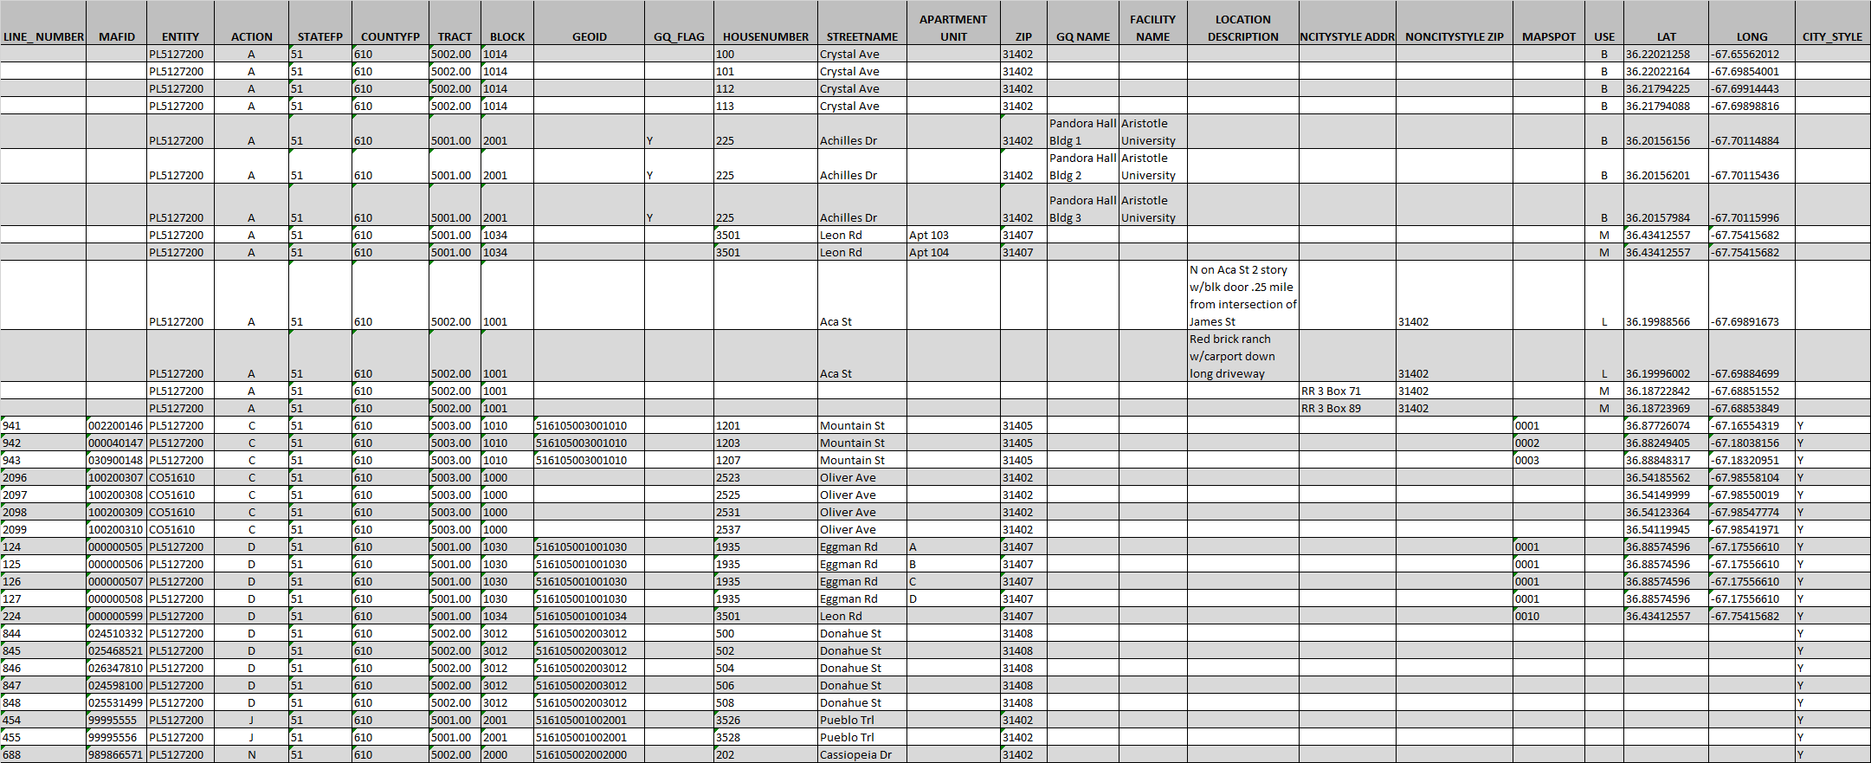
Summary of Address List Updates
Notes:
Only a sample of the updates performed in the previous slides are included in this visual due to readability concerns within PowerPoint. The important point of this partial image and summary is to emphasize the presence of codes in the ACTION field, which leads right into the last presentation regarding preparing the updated file for submission. To prepare for submitting the updated address list records, participants should re-sort the census address list by the ACTION field. This sorting promotes all records with an ACTION present to the top of the census address list for ease of selection and saving into the jurisdiction’s address list submission.

Slide 86
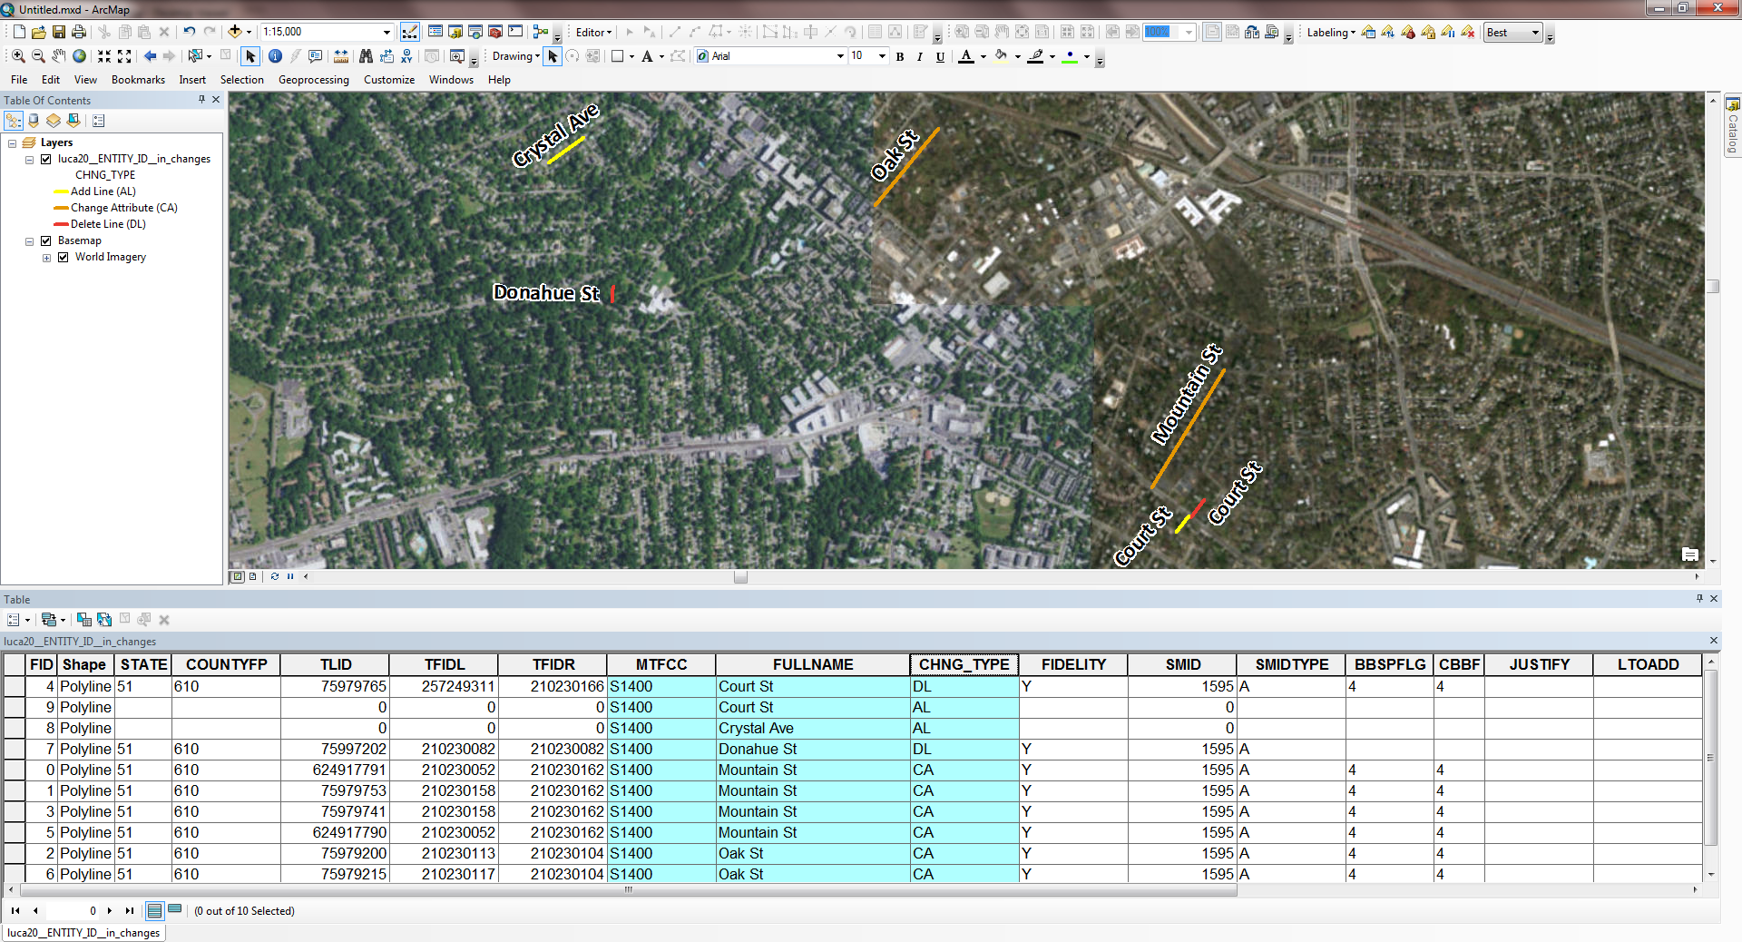
Summary of Edges Shapefile Updates
Notes:
The important point of this slide is to provide a summary visual of the edges shapefile updates. The yellow features represent road features to add, flagged with “AL”. The orange features represented road features with changed attribution, flagged with “CA”. The red features represent road features flagged for deletion, shown in the attribute table as “DL”.

Slide 87

LUCA Update Submissions
Digital Materials
Notes:
Welcome to the 2020 Census LUCA operation training that discusses submitting updated materials. This is the final presentation in the 2002 LUCA Training series. This presentation focuses on the digital address list, while covering the submission of both the paper and digital map materials.
The Census Bureau expects to post this presentation on LUCA web site, so participants can review them again prior to materials receipt in early 2018.

Slide 88
Agenda
Preparing Updated Materials for Submission.
  Address Materials
  Map Materials
  Accompanying paperwork.
Submitting updated materials.
  Shipping Instructions
  Secure Web Incoming Module (SWIM).
Notes:
This presentation covers preparing updated materials, both address and map, for submission to the Census Bureau. It touches briefly on the Next Steps after the successful submission of your updates. Lastly, it reinforces the ways to receive support and assistance during the LUCA operation and mentions ways to stay connected to the Census Bureau through several social media sources as well as Census Bureau subscriptions.
For more detailed information and instruction, refer to the Respondent Guide that accompanies the materials.

Slide 89
Address Materials
Digital
    Keeping secure.
    Assembling and organizing.
Notes:
This next portion of the presentation discusses preparing the map materials for submission. Specifically related to the paper map participants, upcoming slides discuss sorting, saving, and keeping the materials secure as well as assembling, and organizing materials in preparation for submission. For digital map participants, upcoming slides in this section discuss exporting and saving the updated edges as their own shapefile, provide examples of these steps, and discuss assembling and organizing materials in preparation for submission.

Slide 90
Digital Address Materials – Sorting and Saving
Ensure complete with all updates.
Re-sort address list by ACTION field.
Save only records with entry in ACTION field to new file.
Name the new file “luca20_<EntityID>_changes_addresses.xxx” (where EntityID is entity identification code from LUCA materials and xxx is the file extension .csv, .txt, .xls, or .xlsx).
Save to location for easy retrieval for submission and next steps.
Notes:
Ensure you have completed your review and all of the updates you wish to submit. Re-sort the address list by the ACTION field. This promotes all of the address records in the digital address list with an action code to the top of the address list. These are your updated address records. The Census Bureau only wants the updated records returned for processing. Select and save the address records with an entry in the ACTION field. Name the file “luca20_<EntityID>_changes_addresses.xxx”, where EntityID is the entity identification code from the LUCA materials and the xxx represents the file extension. It could be .csv, .txt, .xls, or .xlsx. Save this newly created file to a location for easy retrieval for submitting.

Slide 91
Digital Address List – Keeping Secure
Make copy of new file for use during the feedback phase.
All address list materials (original and copy) are Title 13.
Keep secure according to Confidentiality and Security Guidelines (D-2004), Appendix A in LUCA Respondent Guide.
Notes:
Make a copy of the new file for your records and for use during the feedback phase, scheduled for summer of 2019. Title 13 protects this copy and the original address list provided by the Census Bureau. Participants are required to keep these materials secure throughout the duration of the 2020 LUCA operation by following the instructions in the Confidentiality and Security Guidelines. The LUCA invitation letter included a copy of these guidelines. In addition, these guidelines are in the Respondent Guide that accompanied the materials as Appendix A.

Slide 92
Digital Address List– Assembling and Organizing
Navigate to directory where “luca20_<EntityID>_changes_addresses.xxx” resides (where EntityID is entity identification code from LUCA materials and xxx is the file extension .csv, .txt, or .xls).
Zip the changes address file, name the zip file “luca20_<EntityID>_changes_addresses_return.zip”.
  Password protection required because Title 13 material.
  Use case sensitive password provided with original materials.
Copy the zip file to CD/DVD if shipping submission with paper map materials, or stage the zip file for submission via Census Bureau’s secure online web application.
Notes:
Navigate to the directory where the address list changes file, “luca20_<EntityID>_changes_addresses.xxx”, is located.
Zip the file and name it luca20_<EntityID>_changes_addresses_return.zip. It is necessary to password protect the file because it contains Title 13 information. Use the password that accompanied your original materials as the password for the file. If you have misplaced this information, please contact the Census Bureau’s Geographic Programs Support Desk at 1-844-344-0169. Note, there are many different zip software products and all are adequate for this zipping task. Follow the software instructions for proper zipping of the contents.
Copy the zip file to a CD/DVD if you intend to ship your LUCA materials. If you intend to use the Census Bureau’s secure, online web application for posting your files, stage the zip file for that task. Discussion of this online web process is forthcoming.

Slide 93
Map Materials
Digital
    Exporting updates.
    Saving updates.
    Example
    Assembling and organizing.
Notes:
This next portion of the presentation discusses preparing the map materials for submission. Specifically related to the paper map participants, upcoming slides discuss sorting, saving, and keeping the materials secure as well as assembling, and organizing materials in preparation for submission. For digital map participants, upcoming slides in this section discuss exporting and saving the updated edges as their own shapefile, provide examples of these steps, and discuss assembling and organizing materials in preparation for submission.

Slide 94
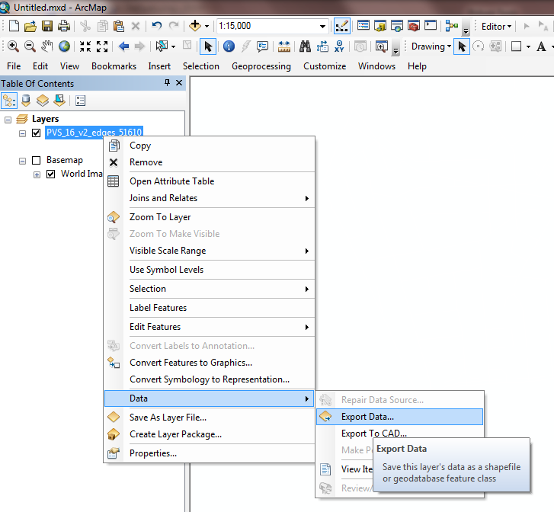
Map Materials – Digital:
Exporting Updates
Ensure complete with all updates.
Select edges with value in CHNG_TYPE field.
Export selected edges into new shapefile.
Notes:
Ensure you have completed your review and all of the updates you wish to submit. Select the edges with an entry in the CHNG_TYPE field. Export the selected edges into a new shapefile by right clicking on the edges layer in the table of contents and select Data, then Export Data as shown in the image to the right. This screenshot example depicts this action using Esri’s ArcMap software.

Slide 95
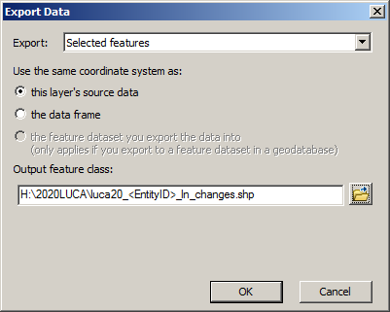
Map Materials – Digital:
Saving Updates
Ensure “Selected features” in “Export Data” window.
Name new shapefile “luca20_<EntityID>_ln_changes.shp”, where EntityID matches entity identification code in LUCA materials.
Save to location for easy retrieval for submission and next steps.
Notes:
Continuing with the Esri software example, ensure the Selected Features remains in the Export section of the Export Data window. Name the new shapefile “luca20_<EntityID>_ln_changes.shp”, where the EntityID is the entity identification code from the LUCA materials. Save this newly created shapefile to a location for easy retrieval for submission and the next steps in the 2020 LUCA operation. Because the shapefiles do not contain Title 13 information, they do not fall under the same Title 13 restrictions as the digital address materials. Please do protect the file from harm, so that is readily accessible during the feedback phase.
Presenters, please note that the “ln” is for line changes, so that “l” is an “el” and not a capital “eye”.

Slide 96
Map Materials – Digital:
Example – Updated Edges Shapefile
Notes:
The newly exported shapefile only includes the updated edges as shown in this example. This shapefile is your 2020 LUCA digital map submission that accompanies the digital address list submission.
The yellow features represent road features to add, flagged with “AL”. The orange features represented road features with changed attribution, flagged with “CA”. The red features represent road features flagged for deletion, shown in the attribute table as “DL”.

Slide 97
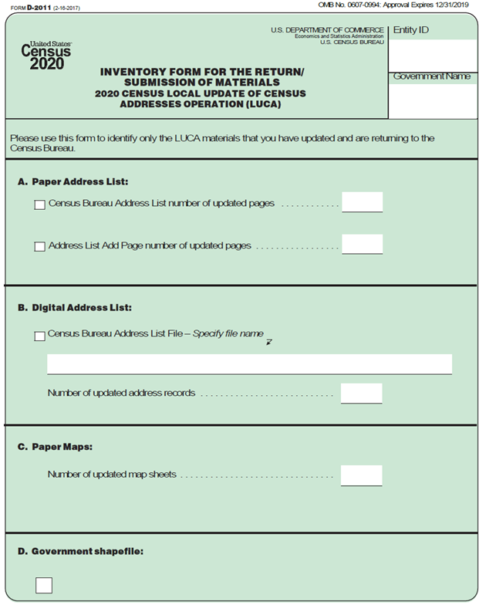
Accompanying Paperwork
D-2011 Inventory Form, paper or digital.
Provide with submission either as hardcopy or zipped on CD/DVD or with SWIM.
Keep copies for your records.
Notes:
Please include the Inventory Form (D-2011) with your submission. A paper form, similar to this image, is included with the original materials. A digital inventory form is included on DVD and available online.
Participants may choose to include the completed paper form with the CD/DVD shipping package, or they may zip the completed digital form into its own zip file, LUCA20_<EntityID>_inventory_return.zip. Include this zip file on the same CD/DVD with the other LUCA submission materials or return it using the SWIM process. More on the SWIM process later in the presentation.
Remember to keep a copy of all accompanying paperwork for your records.

Slide 98
Submitting Updated Materials
Shipping instructions.
  Title 13 details.
Secure Web Incoming Module (SWIM).
  SWIM Introduction.
  Numerous SWIM procedural screens.
Notes:
This slide serves as a transition from discussing preparation of your materials for shipment into the actual instructions for updated materials submission. This section of the presentation covers shipping instructions and instructions for using the Secure Web Incoming Module, also known as SWIM. Numerous screenshots of the SWIM process are included.

Slide 99
Shipping Instructions:
Submissions With Updated Paper Map Materials
Follow procedures for shipping Title 13 materials.
Double wrap Title 13 printed materials (paper maps) using inner/outer envelope (or box/container). Label both sides of inner envelope with “DISCLOSURE PROHIBITED BY Title 13, U.S.C.”.
Place inner envelope into the outer envelope (or box/container).
Include CD/DVD of zipped address list and completed D-2011, either hardcopy or as its own zipped file on same CD/DVD.
Use mailing label included with original materials to ship to National Processing Center in Jeffersonville, IN.
For any shipping uncertainty, consult Respondent Guide or contact Census Bureau.
Notes:
Digital address participants that do not perform any map updates can follow the shipping instructions, beginning on the fourth bullet, on this slide, and disregard reference to the updated map materials.
For digital address list participants that selected paper maps (Digital/Paper or Digital/PaperPDF) that choose to ship their LUCA submission, specific Title 13 protections are required for participants who have paper map updates. Participants must ensure they follow procedures for shipping Title 13 materials as outlined in the Confidentiality and Security Guidelines provided with the registration materials and as Appendix A of the Respondent Guide.
Double wrap the updated Title 13 paper map materials by using an inner and an outer envelope (or container), one within the other. The envelopes/containers should be durable enough to prevent someone from viewing or tampering with the enclosed material.
Label both sides of the inner envelope (or container) with the notice: “DISCLOSURE PROHIBITED BY Title 13, U.S.C.”. Place the inner envelope (or container) into the outer envelope.
Include the CD/DVD of the zipped updated address list in the shipping envelope/container. Include the D-2011 Inventory Form for the Return/Submission of LUCA Updated Materials as a hardcopy or as its own zip file on the same CD/DVD as the address list.
Use the mailing label that accompanied the original materials to return the LUCA submission to the National Processing Center. Consult the 2020 LUCA Respondent Guide for additional information and if any questions arise, please do not hesitate to contact the Census Bureau.

Slide 100
Shipping Instructions:
Submissions With Updated Digital Map Materials
Include CD/DVD of zipped updated address list and zipped updated edges shapefile.
Include completed D-2011, either hardcopy or as its own zipped file on same CD/DVD.
Use mailing label included with original materials to ship to National Processing Center in Jeffersonville, IN.
For any shipping uncertainty, consult Respondent Guide or contact Census Bureau.
Notes:
For digital address participants with digital map materials (Digital/Digital) that choose to ship their LUCA submission, include the CD/DVD of the zipped updated address list and zipped updated edges shapefile in the shipping envelope/container. Include the D-2011 Inventory Form for the Return/Submission of LUCA Updated Materials as a hardcopy or as its own zip file on the same CD/DVD.
Use the mailing label that accompanied the original materials to return the LUCA submission to the National Processing Center. Consult the 2020 LUCA Respondent Guide for additional information and if any questions arise, please do not hesitate to contact the Census Bureau.

Slide 101
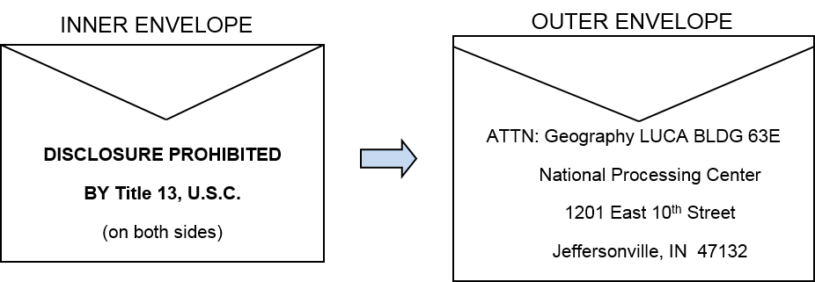
Shipping Instructions:
Title 13 Details – Double Wrap Visual
Notes:
This slide depicts an example of the envelopes used for double-wrapping the updated Title 13 LUCA materials. If you do not use the mailing label shipped with your original materials, ship your LUCA submission using a service that provides tracking information, such as U.S. Postal Service trackable delivery, FedEx, United Parcel Service (UPS), or similar service.

Slide 102
SWIM Introduction
Official web portal for uploading materials to Census Bureau.
Used for other programs besides LUCA.
Accounts are people based, not entity based.
12 digit registration token to establish account provided by Census Bureau.
Only accepts .ZIP files.
Size limitation of 250 megabytes.
Notes:
The next section discusses the SWIM process, which permits secure web method of submitting updated LUCA materials. The Census Bureau cannot accept materials by e-mail, nor navigate to your FTP site and download your submission.
Participants may submit their zipped updated materials (address list and/or shapefiles) through the SWIM, the official web portal for uploading partnership materials to the Census Bureau. The Census Bureau utilizes SWIM for other Census partnership programs, so you may already have a SWIM account. SWIM accounts are associated with individuals, not with entities.
If you do not have a SWIM account, use the 12-digit registration token provided to you by the Census Bureau in order to establish an account. SWIM accepts only .zip files and cannot accept zip files over 250 megabytes.

Slide 103
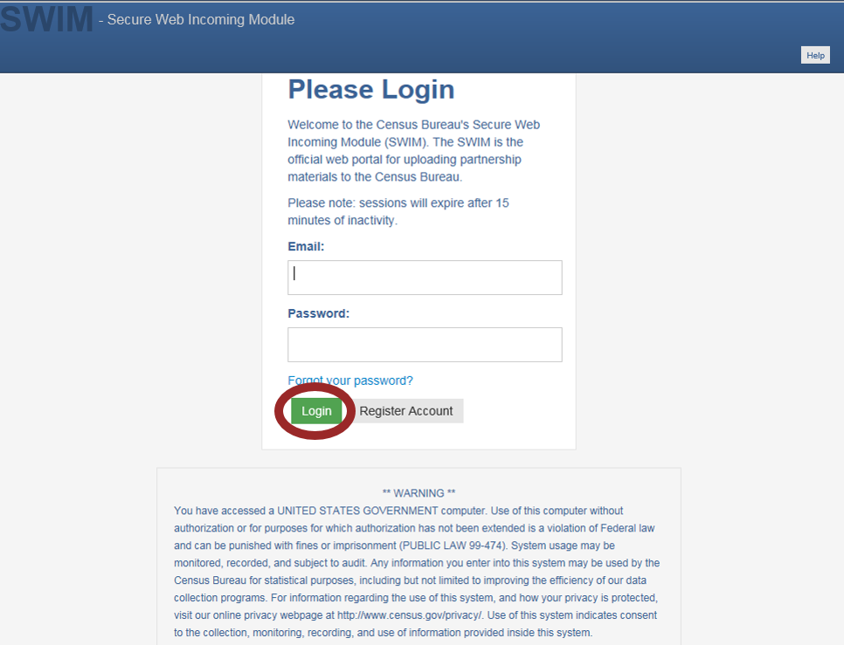
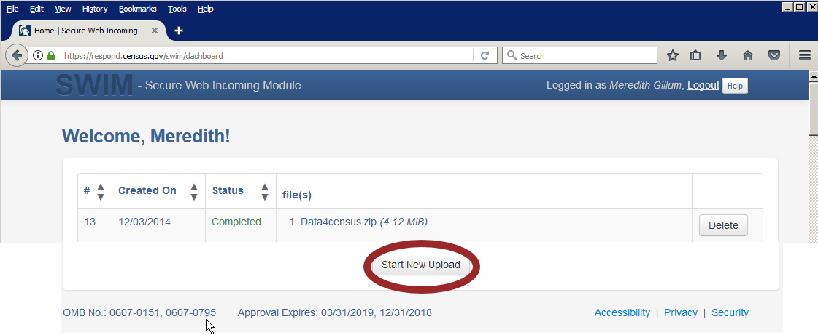
SWIM Account Login and Welcome Screens
<https://respond.census.gov/swim/>
Notes:
If you are a participant in another Census Bureau partnership program and already have a SWIM Account, access SWIM at <https://respond.census.gov/swim/> and enter your e-mail address and SWIM password. Click the Login button. The Welcome screen opens. To begin an upload, click the Start New Upload button. Advance two slides, to slide 24, the SWIM Start New Upload slide.

Slide 104
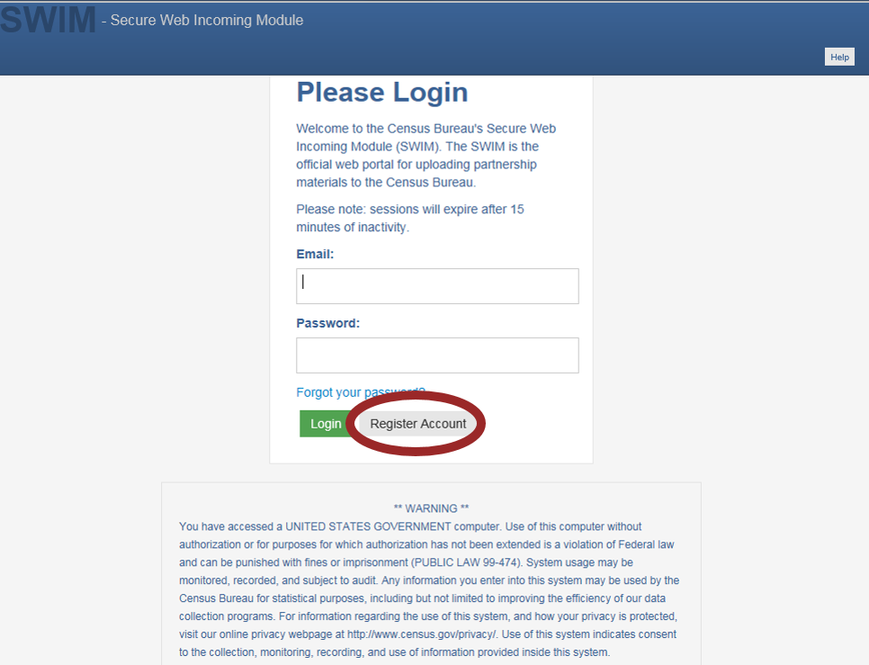
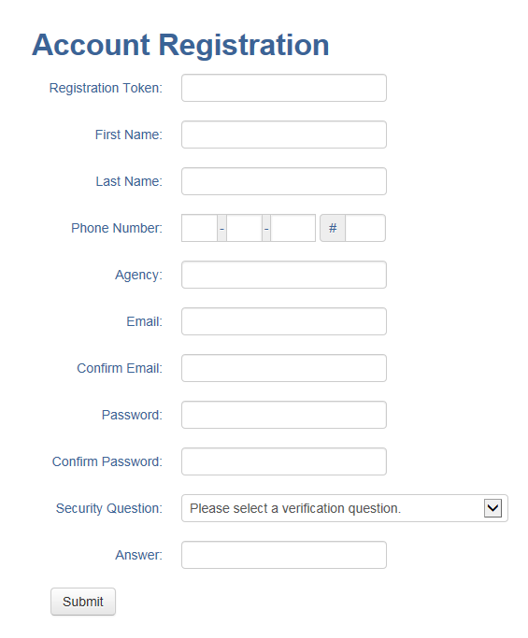
SWIM Account Registration Screens
Notes:
If you do not yet have a SWIM Account, have the 12-digit registration token provided to you by the Census Bureau ready for your account registration. You can register for a SWIM account by choosing the Register Account button on the main SWIM page. The Account Registration screen opens.
All fields on the Account Registration screen are required. Participants will not be able to move to the next screen until completing all fields. On the Account Registration screen, first, enter the 12-digit token provided by the Census Bureau. Then enter your name, agency, and e-mail in the appropriate fields. Next, create a password. Set up a security question. Click the arrow on the right of the Security Question box, select a question in the drop-down list, and enter an answer in the Answer box.
When you have finished, click the Submit button. A screen (not shown on the slide) opens to confirm that you have successfully registered. On the Confirmation screen, click ‘Login’ in the phrase ‘Go to Login’.

Slide 105
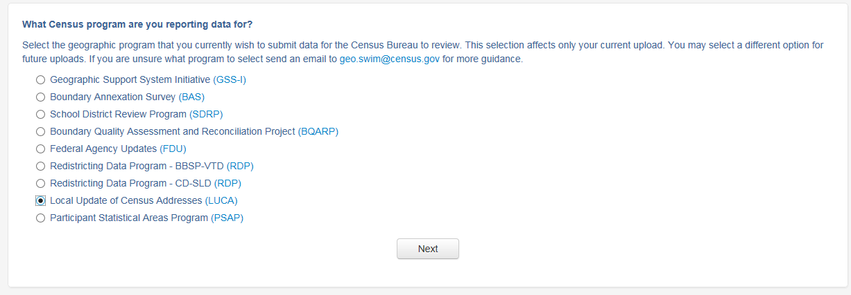
SWIM Start New Upload Screen
Notes:
The “What Census program are you reporting data for?” screen opens. On this screen, click Local Update of Census Addresses (LUCA) radio button, then click the Next button at the bottom of the screen.

Slide 106
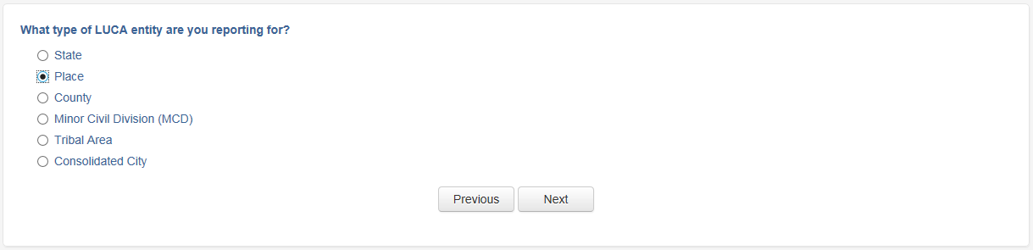
SWIM Type of LUCA Entity Screen
Notes:
The “What type of LUCA entity are you reporting for?” screen opens. Click the radio button next to the governmental entity for which you are reporting data, and then click the Next button. Use the EntityID information for your jurisdiction to help choose the proper selection (ST for state, CO for county, PL for place and consolidated city, MC for minor civil division and TR for tribal area).
This example shows selection of the Place radio button. After selecting the Next button, another window opens allowing you to choose your entity name from a group of pull-down menus. These menus differ based upon the entity type chosen. In this case, participants selecting Place must choose the State and then the Place information from that subsequent window (not shown in this example).

Slide 107
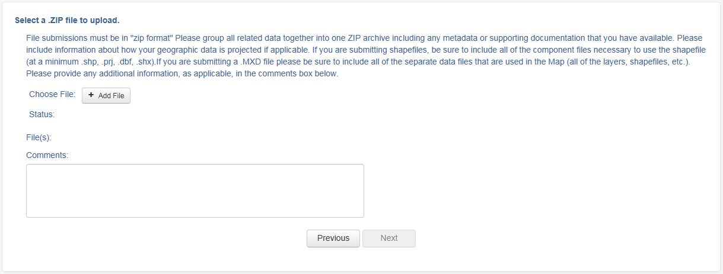
SWIM Select a .ZIP to Upload Screen
Notes:
After choosing the Next button, the “Select a .ZIP file to upload” screen opens. To upload a file, click the + Add File button on the screen and then the Next button.

Slide 108
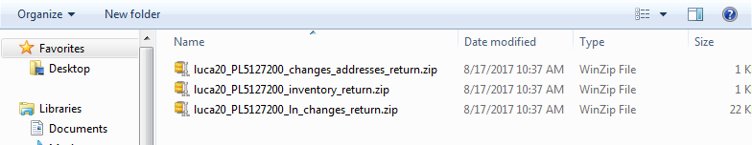
SWIM Choose .ZIP to Upload Screen
Notes:
The File Upload window opens and allows you to navigate on your computer to the .ZIP file’s location.
In this example, choose the luca20_<EntityID>_changes_addresses_return.zip, the luca20_<EntityID>_inventory_return.zip, and the luca20_<EntityID>_ln_changes_return zip to upload. Depending on your map materials, and whether or not you choose to submit the D-2011 through SWIM, the selection of .zip files to upload will vary for participants.

Slide 109
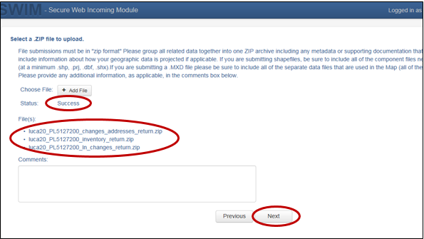
SWIM .ZIP File Upload Status Screen
Notes:
If participants do not select all of the files at once, please choose +Add File until all files you intend to SWIM into the Census Bureau appear ready for upload. It is very important to select and upload all of the files as part of one SWIM action. Once all files are added and ready for upload, the Status section reflects Success. Participants may choose to include a description in the Comments field, otherwise, choose the Next button to upload the files.

Slide 110

SWIM Thank You Confirmation Screen
Notes:
Upon successful upload completion, SWIM returns a Thank You message. Participants can choose the Log Out link to log out of the SWIM session. This completes the SWIM portion of the presentation. Are there any questions before we move into the final section of the presentation?

Slide 111
Next Steps
Notes:
Welcome to the 2020 Census LUCA operation training that discusses submitting updated materials. This is the final presentation in the 2002 LUCA Training series. This presentation focuses on the digital address list, while covering the submission of both the paper and digital map materials.
The Census Bureau expects to post this presentation on LUCA web site, so participants can review them again prior to materials receipt in early 2018.

Slide 112
Next Steps – Census Bureau
Census Bureau processes submission for validation.
Census Bureau ships feedback materials in Summer 2019.
Census Bureau begins outreach to close out LUCA operation.
  Must confirm destruction or return of all Title 13 materials, including originals and copies.
  Must receive signed Destruction or Return of Title 13 Materials Form (D-2012) that includes signatures from liaison and all reviewers.
    Appendix H of 2020 LUCA Respondent Guide.
    Confidentiality and Security Guidelines (D-2004), Appendix A of 2020 LUCA Respondent Guide, outlines approved destruction methods and process for return of materials.
Notes:
Now that we have discussed preparing and submitting your LUCA materials, we should discuss the next steps in the LUCA operation process.
Once the Census Bureau receives your submission, they will process it for validation. After validation concludes in the summer of 2019, the Census Bureau prepares the LUCA feedback materials for shipment soon after.
The Census Bureau begins outreach to close out the LUCA operation and confirm the destruction (preferred method) or return of all Title 13 materials for participants that did not provide a 2020 LUCA submission or for those that indicate they do not wish to receive feedback. The Census Bureau must receive a signed Destruction or Return of Title 13 Materials Form (D-2012) which confirms destruction or return of the Title 13 materials, as required by law. This form was included with the original LUCA materials but is also included in the respondent guide as Appendix H. The Confidentiality and Security Guidelines (D-2004) in Appendix A outlines the process for both the destruction and the return of Title 13 materials.

Slide 113
Next Steps – Participant
Agree with feedback materials, then participation ends.
  Send D-2012 to confirm destruction, or if choose to return materials, do so quickly.
Notify OMB LUCA Appeals office of disagreement with feedback materials.
  Appeals Office works with participant and Census Bureau to resolve disagreement.
  Once appeals process concludes, participants must destroy or return materials and submit signed Destruction or Return of Title 13 Materials Form (D-2012) that includes signatures from liaison and all reviewers.
Filing an appeal is optional.
Notes:
If participants agree with the Census Bureau’s feedback materials, then their LUCA participation ends. Participation concludes by providing the completed D-2012, Destruction or Return of Title 13 Materials Form, discussed on the previous slide as soon as possible to eliminate your entity from Census Bureau follow-up. If the choice is to return the LUCA materials, rather than destroy them, please follow the shipping instructions outlined in the Confidentiality and Security Guidelines to ensure protection of the Title 13 materials.
Notify the LUCA Appeals Office, managed by the Office of Management and Budget (OMB), of disagreement with feedback materials. They will work with participants and the Census Bureau to resolve all disagreements. After a determination to accept or reject disputed addresses by the Appeals Office, the Census Bureau includes address accepted by the Appeals Office into the 2020 Census enumeration universe. Once the appeals process concludes, participants must destroy or return Title 13 materials to the Census Bureau and submit a signed Destruction or Return of Title 13 Materials Form (D-2012) as required by law. Filing an appeal is optional and is not a requirement of the LUCA operation.

Slide 114


Next steps – Destruction or Return of Title 13 Materials Form (D-2012)
Notes:
As mentioned on the previous slide, the D-2012 is part of the closeout process for 2020 LUCA. This form completes necessary paperwork for 2020 LUCA closure and confirms either the destruction or return of all original, and copies, of the LUCA Title 13 materials. The LUCA liaison, all reviewers, and anyone listed on the Confidentiality Agreement Form (D-2005) are required to sign and date this form. The LUCA liaison may sign-out any reviewers that are no longer employed with your jurisdiction. Contact the Census Bureau with any questions regarding the use of this form.

Slide 115
Planned New Construction Program for 2020
Non-Title 13.
Decennial program designed to capture new addresses for housing units that will be habitable on Census Day (April 1, 2020).
Address submissions will require either:
  State/County/Tract/Block Geocodes or
  Latitude/Longitude Coordinates
Available in Self-Response Type of Enumeration areas.
  New addresses in non-Self-Response areas will be captured during field operations.
Tentatively scheduled: Summer 2019.

Slide 116
Geographic Updates
Partnership Software
(GUPS)
Notes:
Welcome to the 2020 Census LUCA Training for Geographic Updates Partnership Software (GUPS) participants. The Census Bureau expects to post this presentation on the LUCA web site, so participants can review them again prior to materials receipt in early 2018.

Slide 117
Agenda
Intended audience.
Introduction to GUPS and Title 13 U.S.C. refresher.
GUPS setup and materials introduction.
GUPS acceptable updates and examples.
GUPS submission.
Notes:
This presentation identifies the intended audience for this presentation, introduces GUPS, and provides a refresher on Title 13. It provides several instructions for GUPS setup and introduces the LUCA materials, as they exist within GUPS. It provides a few examples of acceptable updates and provides instructions for submitting your updated materials. Lastly, it reinforces the ways to receive support and assistance during LUCA and mentions ways to stay connected to the Census Bureau through several social media sources as well as Census Bureau subscriptions.
For detailed information and guidance on using GUPS, please refer to the GUPS Respondent Guide. This presentation provides a high-level overview of GUPS.

Slide 118
What is GUPS
Customized geographic information system (GIS) provided by U.S. Census Bureau.
Based on open-source platform known as QGIS.
Replaces previous software known as MTPS (MAF/TIGER Partnership Software).
Used for other geography programs (i.e., Boundary and Annexation Survey-BAS).
Notes:
GUPS is a customized geographic information system (GIS) provided by the U.S. Census Bureau for use in participating in 2020 LUCA. Based on an open-source platform known as QGIS, GUPS replaces its predecessor, MTPS. It is important to note other geography programs such as the Boundary and Annexation Survey (BAS) use GUPS for their work as well.

Slide 119
Why Use GUPS for 2020 LUCA
Tailored to meet needs of those without extensive GIS experience.
Specifically designed and developed by the Census Bureau for 2020 LUCA use.
Reduces the complexity of LUCA with specific tools, including review and validation tools.
Built-in security considerations.
Standardizes submission process.
However, NOT recommended for entities with more than 300,000 residential addresses.
Notes:
Participants may wonder why they would choose GUPS over another product preference. Tailored to meet the needs of those without extensive GIS experience, GUPS is very user-friendly. The Census Bureau designed and developed this version of GUPS specifically for use with 2020 LUCA. Review and validation tools within GUPS reduce the complexity of LUCA. The built-in security considerations help relieve the concern of Title 13 protection. GUPS standardizes the submission process, making it easier for participants to provide the Census Bureau with valid, quality submissions. Even though entities with more than 300,000 residential addresses can use GUPS, the speed of processing depends upon the power of the host computer and available memory. Entities with greater than 300,000 residential addresses, may encounter difficulties with use.

Slide 120
Security Considerations
Title 13 data is automatically encrypted within GUPS.
  Need the password sent separately by the Census Bureau to the LUCA liaison to access the Title 13 data.
Updated Census Address List files are automatically encrypted by GUPS when exporting for submission.
Notes:
By using GUPS, participants are able to minimize their handling and safekeeping of Title 13 data. The Title 13 data automatically encrypts within the program. Participants use the password provided by the Census Bureau to access the Title 13 data and the updated data encrypts as part of the GUPS export process.

Slide 121

Security Considerations (cont’d):
Automatic time-out
Notes:
The GUPS software has a built-in countdown clock to provide an awareness of unattended Title 13 data. The countdown clock window appears when the user has been inactive for 10 minutes. As a Title 13 security measure, GUPS will automatically save and close if a participant is inactive for 15 minutes. Rather than automatically completing the save action without warning, GUPS includes the countdown timer as a visual to participants to reactivate their GUPS work or close GUPS. The Census Bureau recommends allowing GUPS to proceed with its automatic save and closure process if the timer is below 15 seconds. To begin again, participants restart GUPS and re-enter the encryption key password. An upcoming slide discusses the encryption key window and password requirement.

Slide 122
GUPS Demonstration Video
https://census.webex.com/census/lsr.php?RCID=805ef5d40bb6617ce189d6d10a18ab25
Notes:
At this point in the presentation, this 20-minute GUPS demonstration video allows participants the opportunity to see the software in action, prior to entering the detailed portion of this training.

Slide 123
Delivery of Materials
Three DVDs:
  GUPS installation software.
  Title 13 data.
  Non-Title 13 data.
    Root directory.
      Respondent Guide(s) – digital and GUPS.
      Header text file.
      Inventory form.
      Readmefirst6.txt file.
Notes:
For 2020 LUCA, the Census Bureau delivers the LUCA digital materials used for GUPS on DVD. Due to confidentiality and security requirements of Title 13 data, we cannot make the digital LUCA materials available through download (ftp or internet) or through e-mail.
GUPS participants receive three DVDs, one includes the GUPS installation software, one contains the Title 13 data, and one contains the non-Title 13 data. Because GUPS self installs, GUPS participants must not copy any of the information from the “shape” folders on either DVD to their local system. They must only copy and review the content in the root directory of the non-Title 13 DVD.
The root directory of the non-Title 13 DVD contains five files.
The 2020LUCA_digital_respondent_guide.pdf is the pdf version of the respondent guide for digital address list participants and is included for GUPS participants in case they decide to switch product preferences and use their own GIS for their LUCA work. A paper copy is not provided.
The 2020LUCA_GUPS_respondent guide.pdf is the pdf version of the respondent guide for GUPS participants. A paper copy is not provided.
The 2020LUCA_header_file.txt is a template participants may use to import their local address list into the Census Bureau’s address list layout.
The LUCA20_inventory.pdf is a digital inventory form to use when providing your submission to the Census Bureau. This fillable form can be printed and included with a CD/DVD or zipped into its own .ZIP file for submission on the CD/DVD or through the Census Bureau’s secure online web application. More on the submission process is at the end of this presentation.
The Readmefirst6.txt includes specific instructions for this product preference.

Slide 124

GUPS Installation: Example
(Initial Screen With Data)
**No Title 13 Data Displayed**
Notes:
After data successfully loads, the GUPS screen displays all of the data as shown within this example. There are three separate windows: one for the Map, one for the Census Address List, and one for the Address Count List. Also noted on this image are the Standard toolbar, LUCA toolbar, and User Address List tab. All three windows are moveable, so participants with dual monitors can move the elements around to suit their needs. For instance, they may want to move the Address Count List to the second monitor to make additional room on the main screen for the Census Address List and Map.

Slide 125

Reviewing Records In GUPS:
Sort By – Filter By – Selection Tool
**No Title 13 Data Displayed**
Notes:
When reviewing an address list with a large amount of addresses, it may be simpler to review it in pieces. Using the filters in the Census Address List allows you to remove extraneous addresses from the address list view, allowing you to review only the certain addresses you require for your review.
Sorting the address list view organizes the addresses that may ease viewing and review. Participants may sort by selecting the "Sort By:” button, which provides predefined multi-level sorts, or by clicking the top of a column which provides a simple one column A to Z or Z to A sort. Additionally, the sort functions only perform sorts of those addresses currently appearing in the Census Address List/User Address List window view. In other words, if a participant filters by block to only show TEN addresses, then chooses a sort choice, the sort only applies to the TEN addresses in view.
Use of the Selection Tool isolates addresses after the selection of specific map spots or geography.
All of these functions allows for faster execution of edits in GUPS because of the presence of fewer addresses in the address list view. Using the filter, sort, or selection tool in conjunction with the Address Count List, helps narrow the LUCA review to specific areas. This allows participants to focus on specific addresses or areas as described in the Review and Update Strategies presentation.
This slide provides a visual of the Census Address List window with the Sort By, Filter By, and Selection Tool sections highlighted. It also highlights the Addresses in the List View section that changes based on the sorts, filters, or selection tools applied to the Census Address List. These buttons prepare the Census Address List and User Address List for efficient review by helping to determine a focus for review and potential update.

Slide 126
Validating Records in GUPS
Includes built-in validation tools when editing/adding records.
Recommend executing throughout review and update.
Address Review Tool checks records for valid content and ensures no duplicates.
  If invalid data or duplicates discovered, listed in the Census Address Error List window.
Notes:
GUPS includes built-in validation tools to ensure participant’s LUCA updates meet established criteria for Census Bureau processing. Having validation edits incorporated into GUPS prevents the participant from submitting invalid data as part of their LUCA submission.
While the validations run as part of the submission process at the conclusion of the LUCA review and edit process, the Census Bureau suggests utilizing the validation tools to identify errors early and avoid extensive corrections during the submission process.
The Address Review Tool checks records for valid content and ensures no duplicates exist in the Census Address List. If invalid content or duplicates encountered, the Census Address Error List window lists the erroneous records to repair. The next slide shows examples of both.
Locate more information on the address list layout and validations in an appendix within the GUPS Respondent Guide.

Slide 127
Pop Quiz!
How Well Do You Know LUCA?
Notes:
Welcome to the 2020 Census LUCA Training for Geographic Updates Partnership Software (GUPS) participants. The Census Bureau expects to post this presentation on the LUCA web site, so participants can review them again prior to materials receipt in early 2018.

Slide 128
True or False
Question 1
The Census Bureau does not require individual unit identifiers for multi-unit structures.
False – Multi-unit structures such as apartments, mobile homes, condominiums, etc., DO require individual unit identifiers.
Note: Unit identifiers are not required for individual units within a group quarters, such as individual dorm rooms in a college dorm or room numbers in a nursing home. HOWEVER, you must provide a group quarters name and a facility name if the group quarters are associated with a facility (e.g. Group Quarters Name – Pandora Hall; Facility Name – Aristotle University). The Census Bureau will not process an identified group quarters address record without a group quarters name.

Slide 129
True or False
Question 2
The Census Bureau requires lat/lon or map spots for all non-city style addresses.
True – New for 2020, Participants can submit non-city style addresses as long as they are accompanied by corresponding map spots on paper maps and address lists, or lat/lon coordinates on digital address lists and GUPS.

Slide 130
True or False
Question 3
In LUCA, participant focus should be on making map updates.
False – Focus should be on updating your entity’s address list.

Slide 131
True or False
Question 4
In order to review the digital Address List, you can simply open the file in Excel.
False – It is important to following the proper steps for importing your .csv Address List into Excel. Improper opening of the .csv corrupts the data content of the digital address list.

Slide 132
True or False
Question 5
If the mayor wants to view a map with Census Map Spots or address points, you can show him or her this data.
It depends – Only if he or she has signed the confidentiality agreement.

Slide 133
True or False
Question 6
IT personnel who have access to any Title 13 materials do not need to sign the confidentiality form.
False – Anyone with access to Title 13 materials, their storage or backup must sign the Confidentiality Agreement.

Slide 134
True or False
Question 7
If the house number or apartment unit identifier is wrong on the Address List, it can be changed by using the “C” action code and correcting the house number or apartment number on the address list.
False – In order to correct an incorrect house number and/or apartment unit identifier, a reviewer must use a “Delete/Add” combination. The address must first be deleted from the Address List using a “D” action code, then added to the paper Address Add page or the digital Address List using an “A” action code.

Slide 135
True or False
Question 8
The Census Bureau wants to receive your entire address list as part of your LUCA submission.
False - LUCA is an opportunity for local governments to review and update the Census Bureau’s address list. Your LUCA submission should only include the Census address records you edited, and the additional records that you added to the Census address list.

Slide 136
True or False
Question 9
The Address List is the foundation of an accurate Census.
True - The accuracy and completeness of the Address List is critical to the success of the Census. An accurate Address List leads to an accurate Population Count.

Slide 137
True or False
Question 10
If an address is ungeocoded, it will still be included in Census 2020 enumeration.
False - Ungeocoded addresses will not be included in the address list used for the 2020 Decennial. We cannot count the residents of a living quarters if we cannot geocode the living quarters.

Slide 138
Support and assistance
Visit the 2020 LUCA Web site:
<https://www.census.gov/geo/partnerships/luca.html>
  Frequently Asked Questions document.
Contact us:
  Geographic Programs Support Desk toll-free telephone number: 1-844-344-0169.
  E-mail: <GEO.2020.LUCA@census.gov>
Notes:
As we wrap up the presentation for “Digital/Digital” participants, please be aware additional examples of working with the census address list are included in the Respondent Guide that accompanies the materials. In addition, the Census Bureau wants to ensure all participants are aware of the ways to get support and assistance for the 2020 LUCA operation. Please visit the 2020 LUCA Web site first for information and instructions. A Frequently Asked Questions document serves as a thorough resource because it contains many of the most common questions and answers. If participants cannot find the answers or information they need, they may call the Geographic Programs Support Desk, toll free, at 1-844-344-0169 or e-mail them at GEO.2020.LUCA@census.gov.

