Slide 1
WATERSHED PROTECTION IN NORTHWEST GEORGIA: KEEPING OUR STREAMS THE BEST IN THE STATE
Catherine A. Fox
FOX Environmental, LLC
April 22, 2015

Slide 2
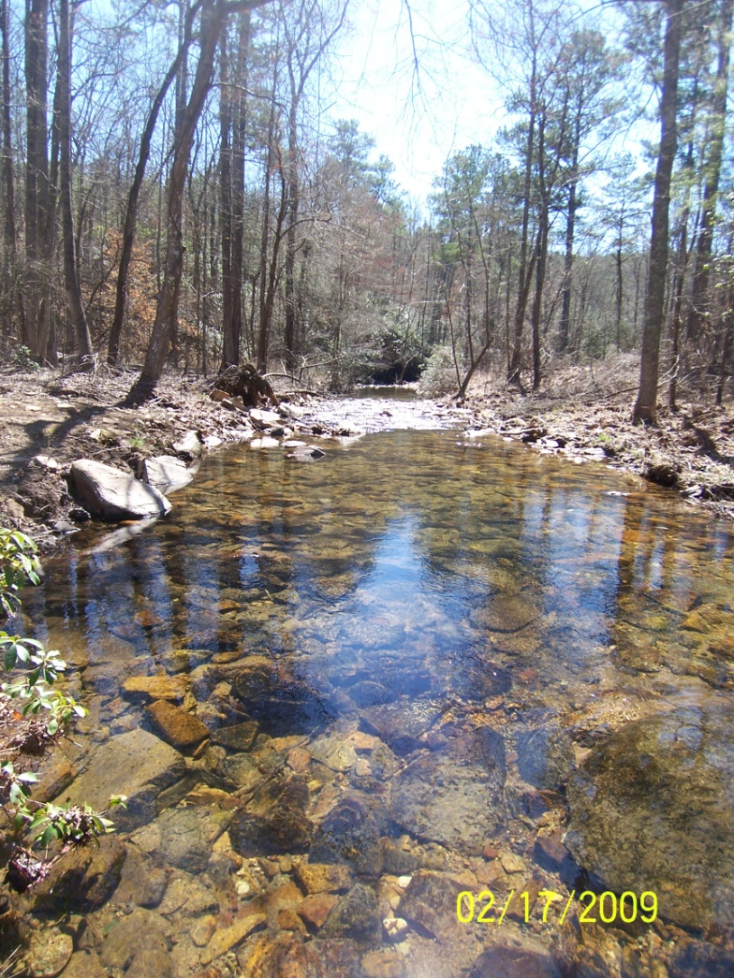
Overview of Presentation
Planning for Watershed Protection
Sharing Success Stories from Our Region
Renewing Our Commitment to Clean Streams and Lakes in NW GA

Slide 3
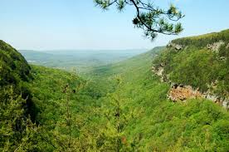
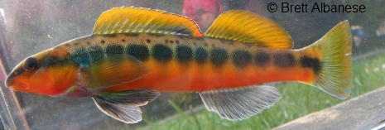
Best Streams and Lakes in the State!
“Southern Appalachian Mountains contains some of the richest biodiversity, purest waters and most important wildlife habitat on the continent” Open Space Institute, 2010.
A hot spot of biodiversity, created by the region’s long and complex geologic history.
Passage of the Weeks Act, almost a century ago, helped establish a large network of national forestland in the region.

Slide 4
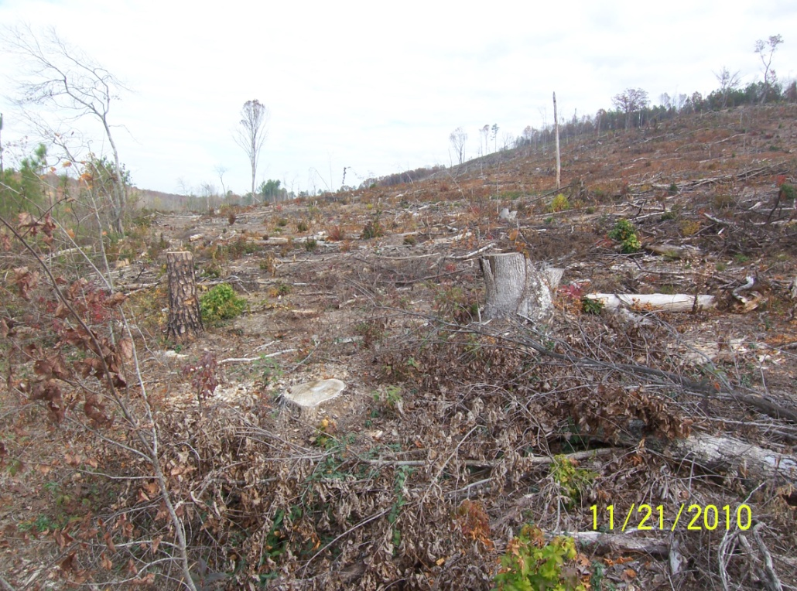
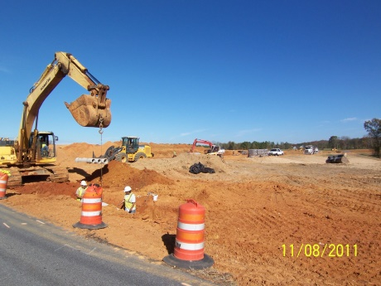
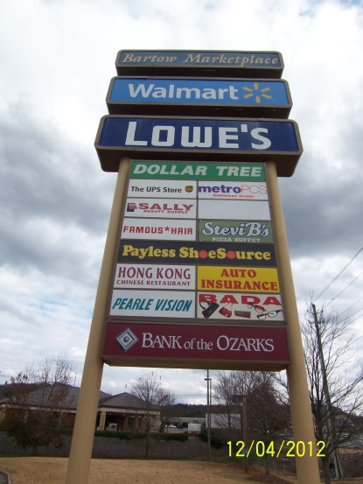
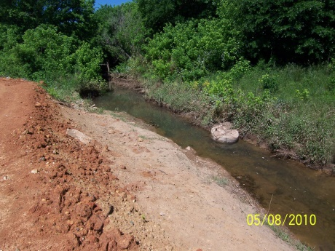
Challenges to Watershed Protection in Northwest GA
In the past, large-scale logging and mining posed the greatest threats to the region’s natural resources
Today, road building and residential/commercial real estate development are the main causes of forest fragmentation and impacts to watershed health.

Slide 5
Planning for Watershed Protection
Wastewater Permits require Watershed Assessments and Watershed Protection Plans
Approved Watershed Protection Plans Currently Being Implemented
Dalton, Bartow County, Rome, Emerson, Others?
Watershed Protection Plans Under Development
Walker County, Calhoun, Chatsworth, Cave Spring, Blue Ridge, Fairmount, Jasper, and Pickens County, Cartersville and more.

Slide 6
WPP Common Elements
Description of Watershed Health
Summary of current and proposed Best Management Practices
Wastewater Collections System Management
Fats, Oils and Grease Program
Capacity, Management, Operation, and Maintenance Program
Stormwater Management Program
Public Education/Outreach
Reducing Illicit Discharges
Improved Development Program
Municipal Pollution Prevention
Long-term Monitoring Program
Cost Estimates and Funding Sources
Implementation Schedule
Annual Reporting Requirements

Slide 7
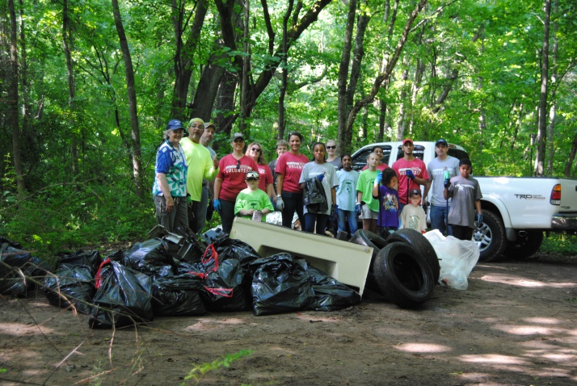
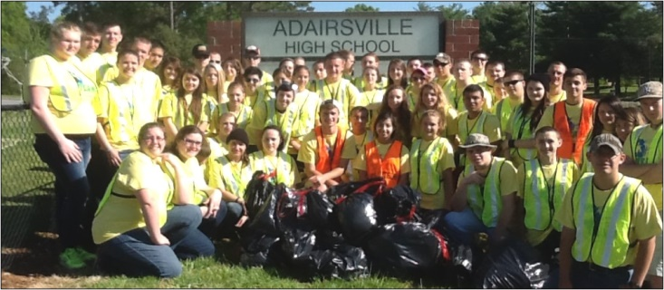
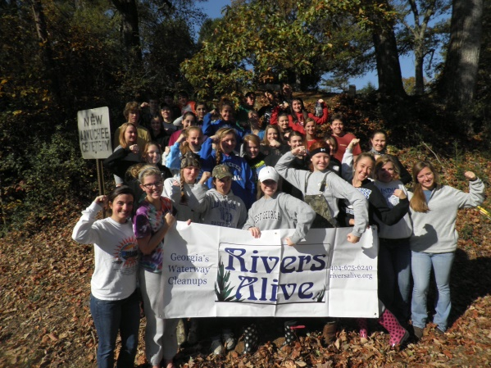
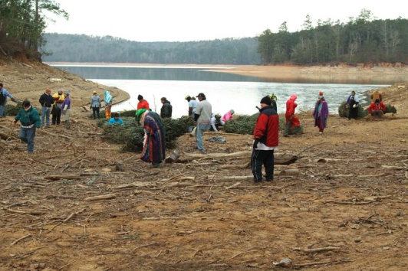
Public Outreach Program, Keep Bartow Beautiful, City of Rome and CRBI

Slide 8
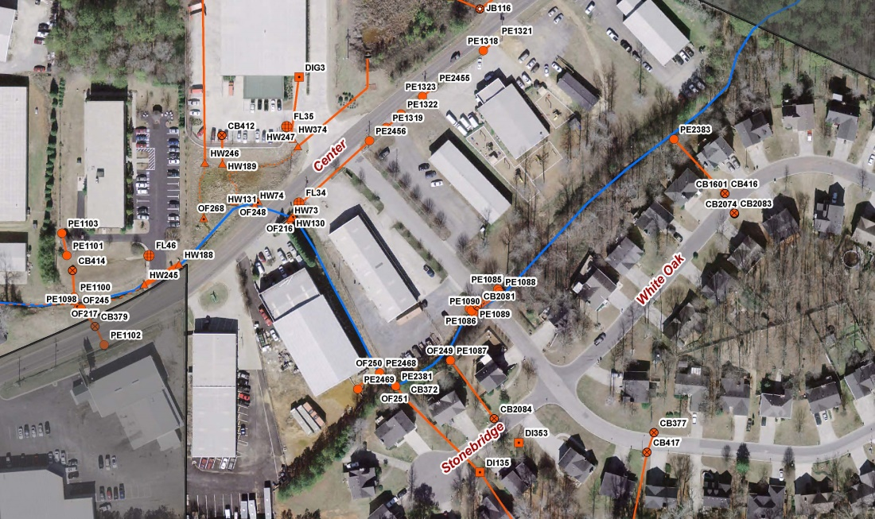
Maintaining Wastewater and Stormwater Infrastructure, City of Cartersville
Inventorying
Mapping
Inspecting
Cleaning
Repairing

Slide 9
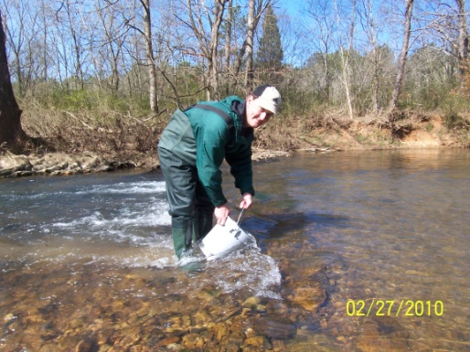
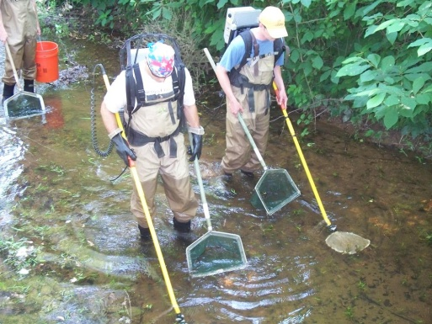
Long-term Monitoring Program, Bartow County
Water Quality Monitoring
Approximately 12 sites per year
8-10 sampling events at each site (2 dry, 1 wet and 2 geometric means)
Biological Monitoring
Habitat Assessment
Benthic Macroinvertebrate Assessment
Fish Assessment
Targeted Watershed Assessments
Land Use Study
Windshield Survey of the Watershed
Stream Walks and In-situ Monitoring
Identify Specific Pollutant Sources and Action Items to Improve Watershed Health

Slide 10
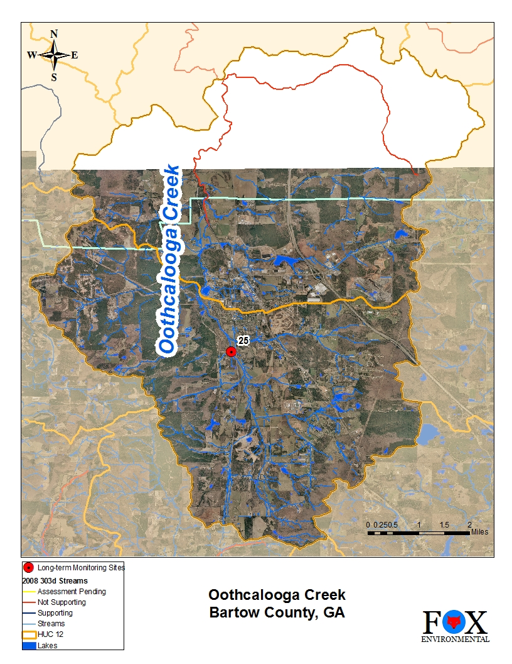
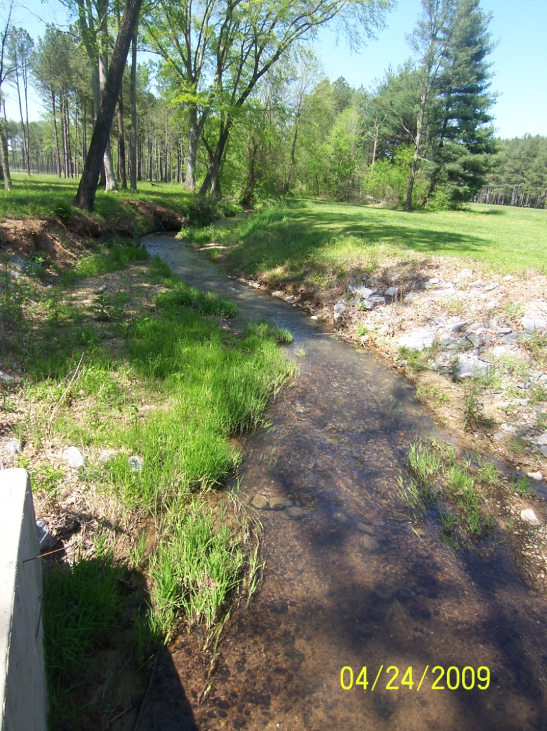
Oothcalooga Creek

Slide 11
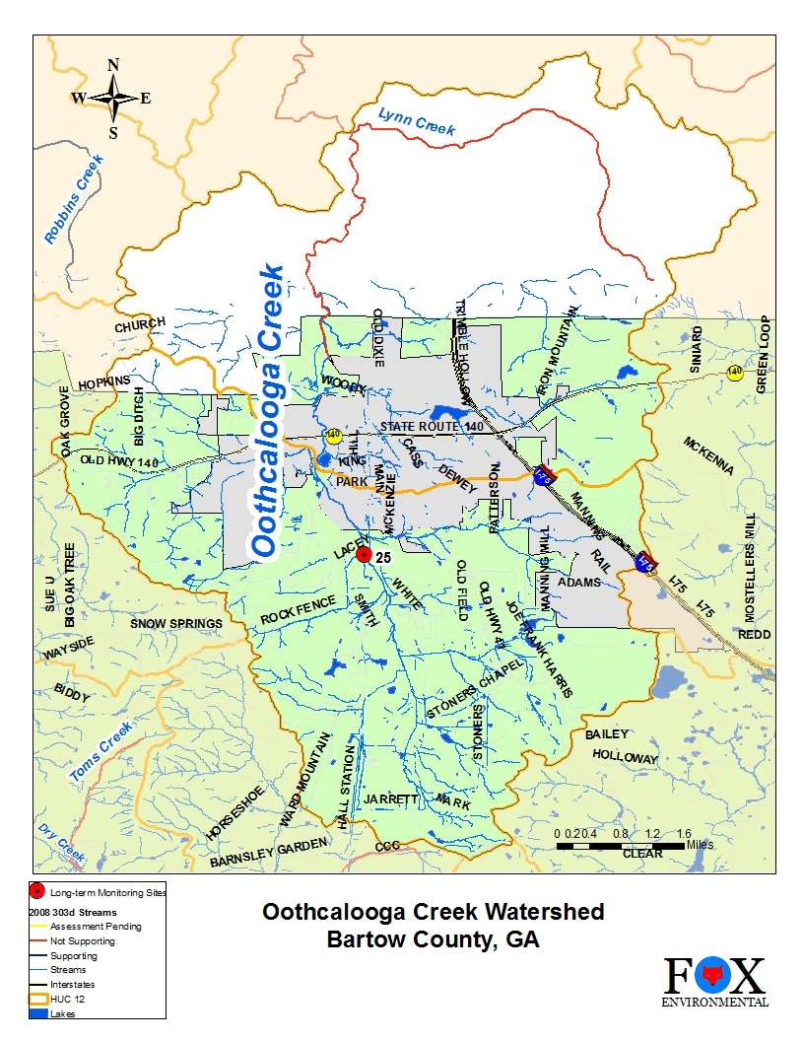
Oothcalooga Creek
Rural Watershed
13,305 Acres
City of Adairsville and Bartow County
Lower Oothcalooga Creek is listed as not meeting designated use due to fecal coliform and sediment

Slide 12
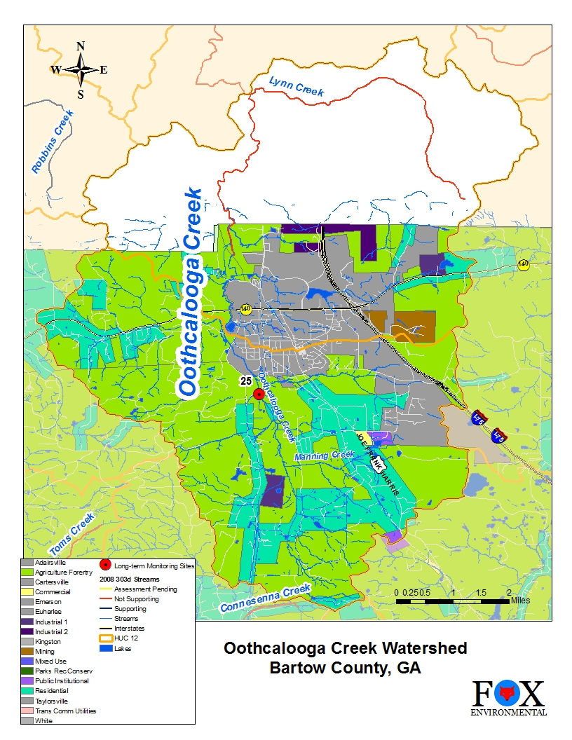
Oothcalooga Creek
Current Land Use::
Agriculture and Forestry, Residential, Small urbanized area

Slide 13
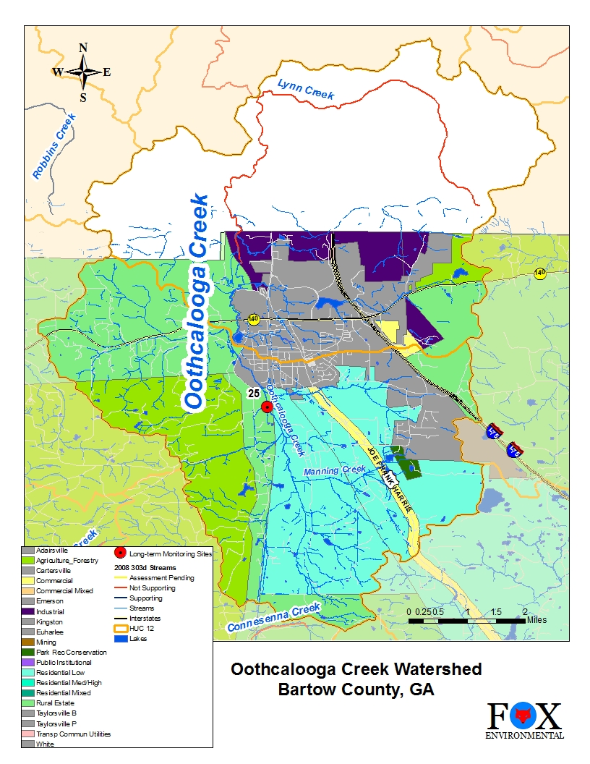
Oothcalooga Creek
Future Land Use:: Decreasing Agriculture and Forestry, Increasing Residential and Industrial

Slide 14
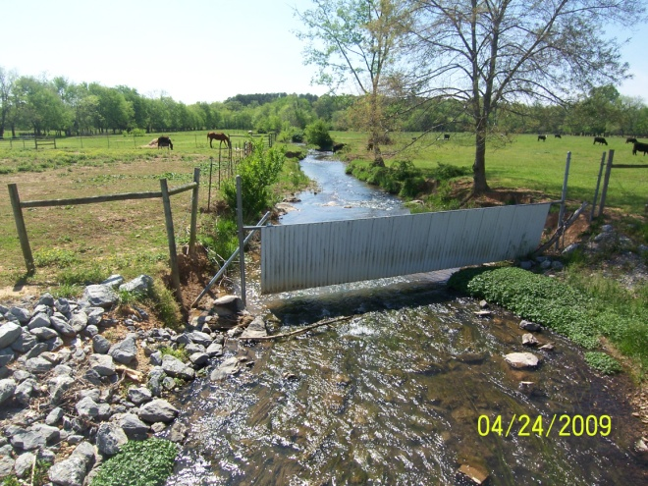
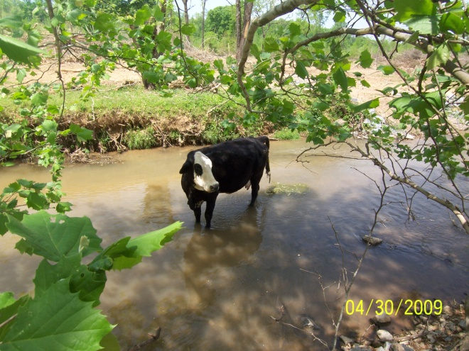
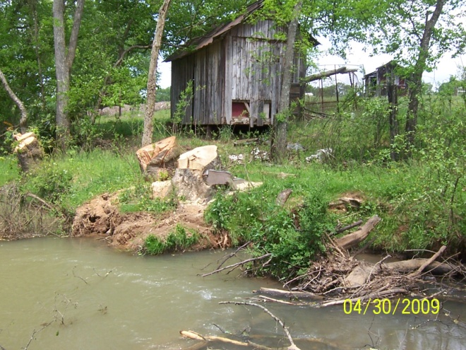
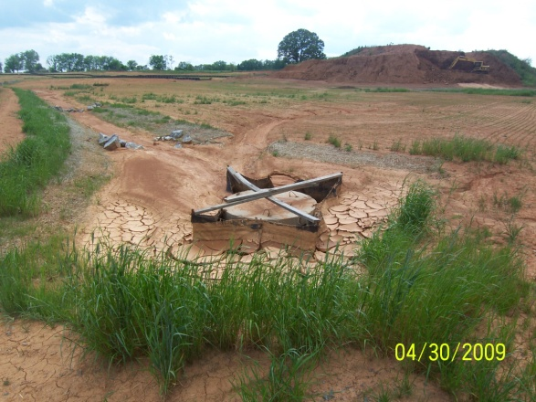
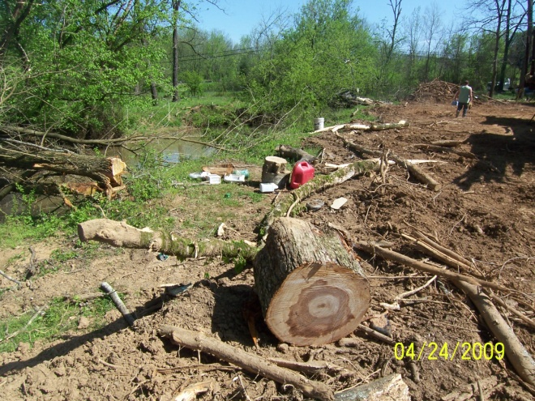
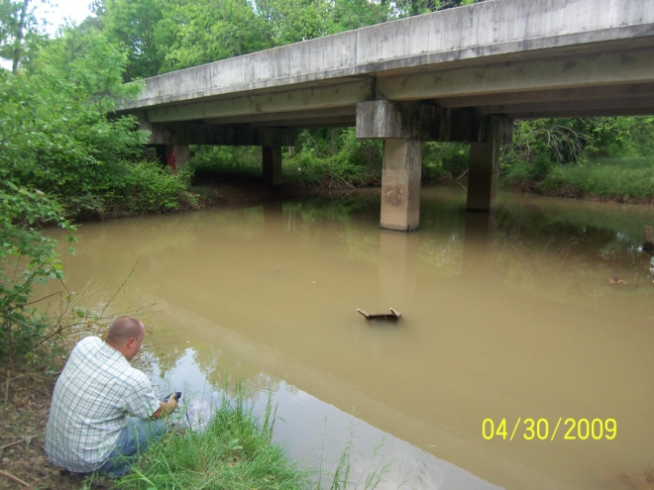
TWA - Oothcalooga Creek Watershed

Slide 15
Oothcalooga Targeted Watershed Assessment
Study Results
Numerous inputs of sediment and fecal coliform
Inadequate buffer in many locations
Timbering w/o sediment controls adjacent to stream
Some litter issues
Probable water quality and biological concerns
Action Items
Present findings to City of Adairsville and seek partnership opportunities
Work with NRSC to educate farmers about watershed protection
Identify/implement fencing and solar powered drinking stations for livestock
Increase inspections and enforcement at construction sites
Initiate and continue WQ and Bio monitoring
Others to be determined.

Slide 16
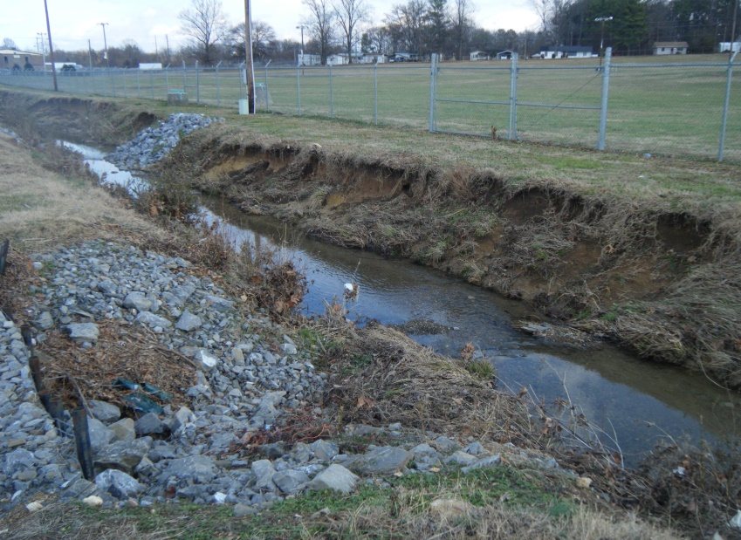
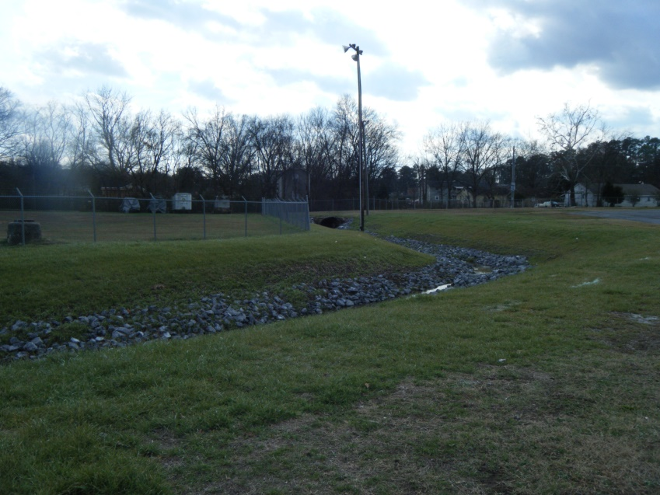
Streambank Restoration, City of Dalton
Public/Private Partnership to restore the banks of a stream located in the Fairgrounds. Dalton Utilities prepared the design and permitting and Fairgrounds Staff hired contractor to build.
Before
After

Slide 17
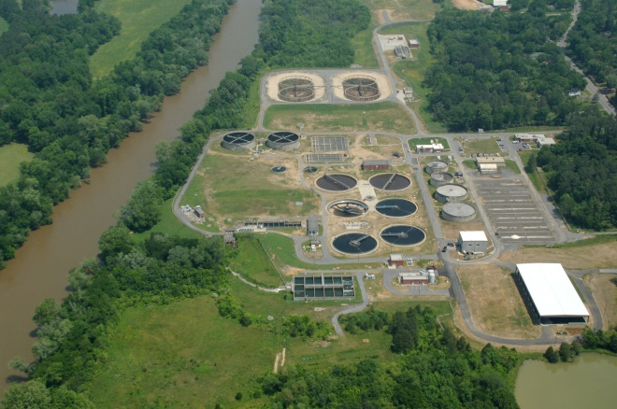
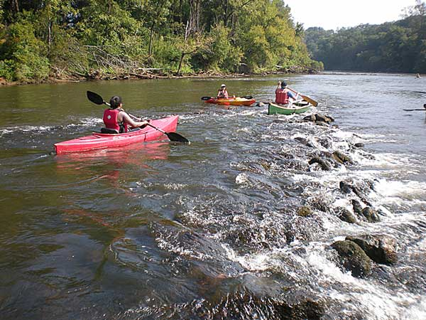
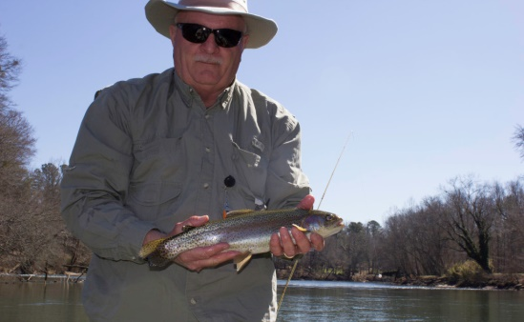
Why is Watershed Protection in NW GA Important?
Economics
Costs of Water and Wastewater Treatment
Tourism
Environment
Regulatory Compliance
Preserve Critical Habitat and Fish

Slide 18
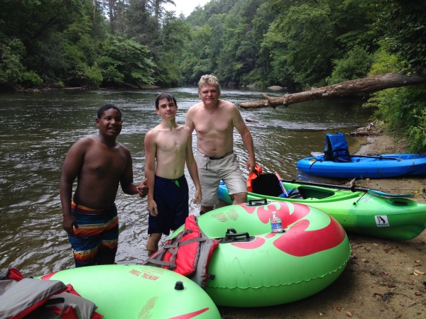
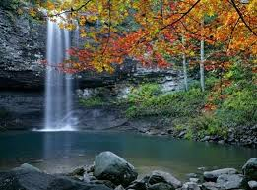
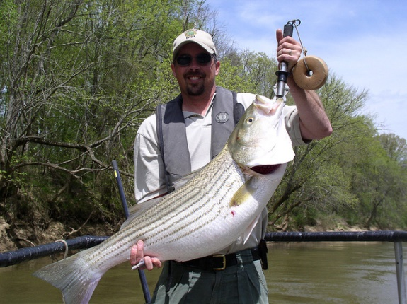
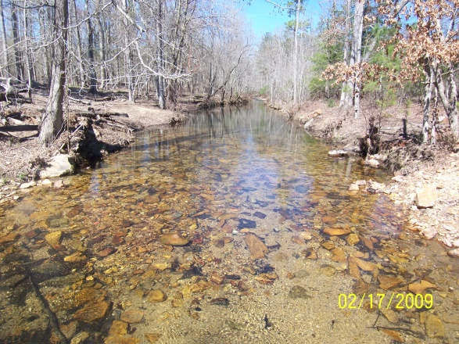
Why is Watershed Protection in NW GA Important?
Enhanced Quality of Life for Residents and Businesses
Leaving a legacy for our children and grandchildren

Slide 19
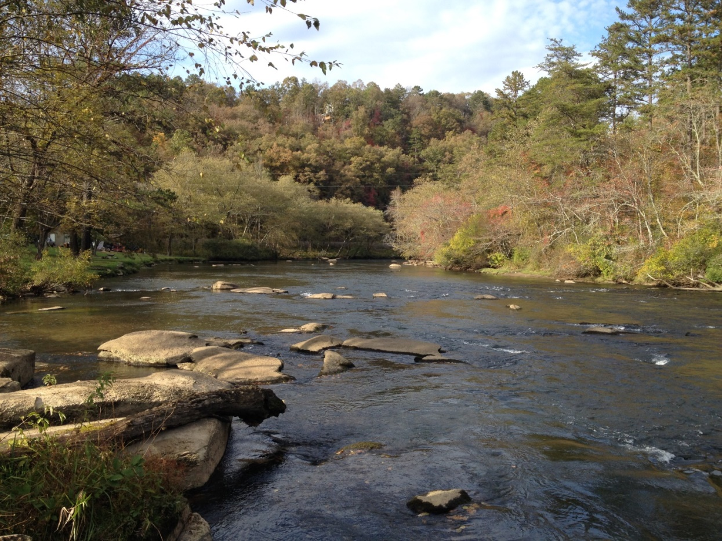
Questions & Comments?
Thank you and Happy Earth Day!

