Slide 1
Energy and Water Financing
North Georgia Water Resources Partnership
Jason Bodwell
Senior Program Manager
GEFA
April 22, 2015

Slide 2
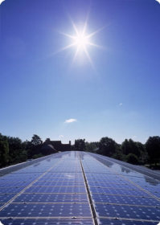
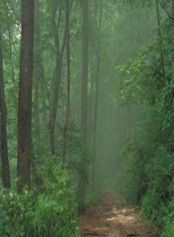

GEFA Organizational Overview
Energy Resources
  Georgia Energy Challenge
  Weatherization
  State Energy Program
  State Utilities Program
  Energy Assurance
  Performance Contracting
  State Energy Strategy
ENERGY
Land Conservation Program
  Land purchase financing
  Conservation easements
  Tax credits
Fuel Tank Program
  Remediation
  Monitoring
  Training
LAND
Water Resources
  Water and sewer financing
  Solid waste financing
  Energy Production
WATER
  Water conservation
  Water supply financing
Notes:
GEFA operates in three primary program areas: energy, land and water.
Energy Division promotes
energy efficiency
renewable energy
Land Conservation Program
provides loans and grants to local governments to conserve
helps administer a state tax credit program for land conservation
Fuel Storage Tank program helps state agencies maintain their fuel storage tanks.
Water Resources Division
works with local governments to finance wastewater, water and water supply infrastructure projects
Since its inception, GEFA has assisted local governments in financing critical infrastructure projects by committing more than $3 billion in loans to 1,500 water and sewer projects.
Check for updates (9/17/2012)

Slide 3
Conservation Initiative
Water Conservation:
Utility Water Loss
End-Use Efficiency and Conservation
Energy Conservation:
Energy Production
Energy Conservation
Energy Management Planning
Land Conservation:
Purchase of land for conservation
Qualifies for 1% interest rate reduction
Notes:
GEFA is developing a white paper that details all energy production and reduction projects that can be funded through:
GA Fund
Clean Water SRF
Drinking Water SRF
Projects at:
Landfills
Water Utilities
Wastewater Utilities
Categorizes energy projects into two main categories – energy production and reduction at water, wastewater utilities and landfills
Examines which different activities qualify for GEFA funding

Slide 4
Three Financing Programs - Energy
 | Georgia Fund | Clean Water SRF | Drinking Water SRF
Project Location/ Benefactor | Wastewater Utility Water Utility Landfills/MSW | Wastewater Utility | Water Utility
Borrowing Limits | $3,000,000 per year | $25,000,000 per year | $25,000,000 per year
Federal Requirements | N/A | Environmental approval by Georgia EPD DBE sub-contractor solicitation | Environmental approval by Georgia EPD DBE sub-contractor solicitation
20-year interest rate | 2.03% | 1.03% | 1.03%
Competitive Procurement | Design-Bid-Build Design-Build | Design-Bid-Build Design-Build | Design-Bid-Build Design-Build
Notes:
GEFA is developing a white paper that details all energy production and reduction projects that can be funded through:
GA Fund
Clean Water SRF
Drinking Water SRF
Projects at:
Landfills
Water Utilities
Wastewater Utilities
Categorizes energy projects into two main categories – energy production and reduction at water, wastewater utilities and landfills
Examines which different activities qualify for GEFA funding

Slide 5
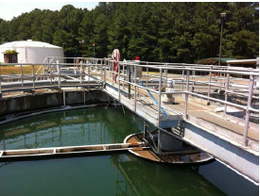
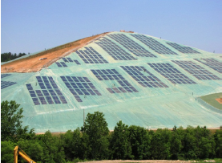
Eligible Facilities
Low-interest loans to local governments and authorities for energy production, energy conservation and projects with environmental benefits at the following locations:
          Water treatment plant
          Wastewater treatment plant
          Landfill
          Municipal Solid Waste

Slide 6
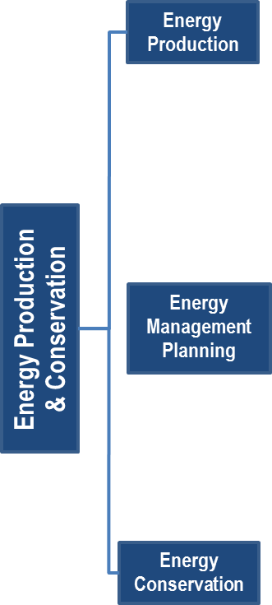
Energy Production and
Conservation Projects
Project categories
Energy Production
Energy Conservation
Energy Management Planning
Notes:
Energy Management Planning – Energy assessments, energy audits, optimization studies, and sub-metering of individual processes to determine high energy use areas, which are reasonably expected to result in a capital project, can be funded as a part of a larger project

Slide 7
Energy Conservation Projects
Notes:
Landfill Methane Gas Collection – Projects that collect methane gas from a municipal landfill to produce electricity.
Landfill Solar Power Production – Projects that install solar panels at a municipal landfill for the purpose of generating electricity.
Wind Power Production – Wind projects that provide power to the water or wastewater facility. Wind power projects can either be located onsite at the water or wastewater facility or located offsite, but provide power to the grid that the utility draws from.
Solar Power Production – Projects that provide power to the water or wastewater facility. Solar projects can either be located onsite at the water or wastewater facility or located offsite, but provide power to the grid that the utility draws from.
Geothermal Power Production – Projects that harness geothermal energy either located onsite at the water or wastewater facility or located offsite, but provide power to the grid that the utility draws from.
Micro-Hydro Power Production – Projects that involve capturing energy from pipe flow and provide power to the facility or to the grid that the utility draws from.
Biogas Combined Heat and Power Project – Biogas projects that provide power to the wastewater facility.

Slide 8
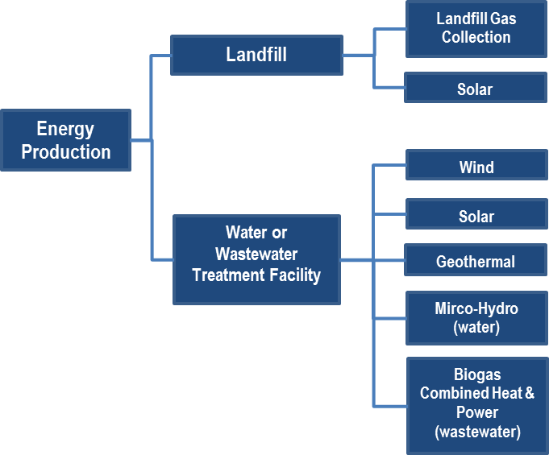
Energy Production Projects
Notes:
Landfill Methane Gas Collection – Projects that collect methane gas from a municipal landfill to produce electricity.
Landfill Solar Power Production – Projects that install solar panels at a municipal landfill for the purpose of generating electricity.
Wind Power Production – Wind projects that provide power to the water or wastewater facility. Wind power projects can either be located onsite at the water or wastewater facility or located offsite, but provide power to the grid that the utility draws from.
Solar Power Production – Projects that provide power to the water or wastewater facility. Solar projects can either be located onsite at the water or wastewater facility or located offsite, but provide power to the grid that the utility draws from.
Geothermal Power Production – Projects that harness geothermal energy either located onsite at the water or wastewater facility or located offsite, but provide power to the grid that the utility draws from.
Micro-Hydro Power Production – Projects that involve capturing energy from pipe flow and provide power to the facility or to the grid that the utility draws from.
Biogas Combined Heat and Power Project – Biogas projects that provide power to the wastewater facility.

Slide 9
Project Eligibility Requirements
 | Project Eligibility
 | On-site Project | Off-site Project
Energy production for DIRECT USE by the facility | Eligible | Eligible
Energy production SOLD TO the electrical grid or natural gas distribution system | Eligible | Ineligible
Notes:
Landfill Methane Gas Collection – Projects that collect methane gas from a municipal landfill to produce electricity.
Landfill Solar Power Production – Projects that install solar panels at a municipal landfill for the purpose of generating electricity.
Wind Power Production – Wind projects that provide power to the water or wastewater facility. Wind power projects can either be located onsite at the water or wastewater facility or located offsite, but provide power to the grid that the utility draws from.
Solar Power Production – Projects that provide power to the water or wastewater facility. Solar projects can either be located onsite at the water or wastewater facility or located offsite, but provide power to the grid that the utility draws from.
Geothermal Power Production – Projects that harness geothermal energy either located onsite at the water or wastewater facility or located offsite, but provide power to the grid that the utility draws from.
Micro-Hydro Power Production – Projects that involve capturing energy from pipe flow and provide power to the facility or to the grid that the utility draws from.
Biogas Combined Heat and Power Project – Biogas projects that provide power to the wastewater facility.

Slide 10
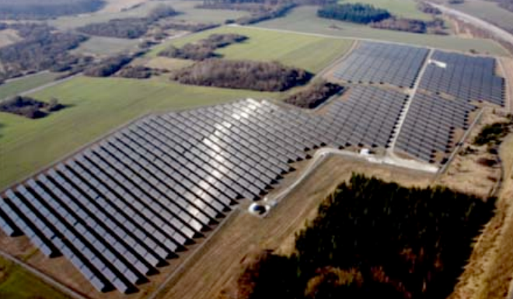
Sizing Limitations
Water and wastewater treatment facilities cannot be sized in excess of peak demand of the water or wastewater treatment facility.
Landfills and municipal solid waste facilities have no sizing limitations.
Notes:
Landfill Methane Gas Collection – Projects that collect methane gas from a municipal landfill to produce electricity.
Landfill Solar Power Production – Projects that install solar panels at a municipal landfill for the purpose of generating electricity.
Wind Power Production – Wind projects that provide power to the water or wastewater facility. Wind power projects can either be located onsite at the water or wastewater facility or located offsite, but provide power to the grid that the utility draws from.
Solar Power Production – Projects that provide power to the water or wastewater facility. Solar projects can either be located onsite at the water or wastewater facility or located offsite, but provide power to the grid that the utility draws from.
Geothermal Power Production – Projects that harness geothermal energy either located onsite at the water or wastewater facility or located offsite, but provide power to the grid that the utility draws from.
Micro-Hydro Power Production – Projects that involve capturing energy from pipe flow and provide power to the facility or to the grid that the utility draws from.
Biogas Combined Heat and Power Project – Biogas projects that provide power to the wastewater facility.

Slide 11
Jason Bodwell
Senior Program Manager
404-584-1129
jason@gefa.ga.gov
233 Peachtree St. NE
Harris Tower, Suite 900
Atlanta, Georgia 30303

