Slide 1

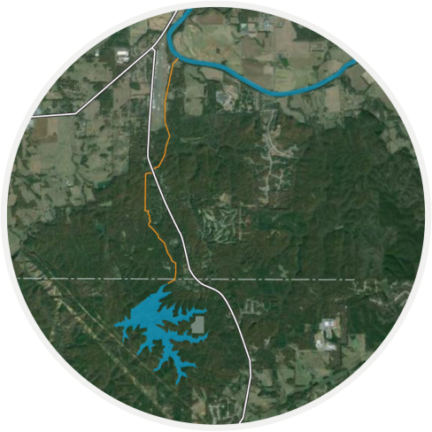

Richland Creek Water Supply Program
Briefing
Paulding County, Georgia
North Georgia Water Resources Partnership
Educational Seminar
May 3rd 2017
Notes:
Speaker: Kelly

Slide 2

Contents
Program Overview
Program Cost and Funding
Financial Model and Long-term Economic Benefits
Current Program Status

Slide 3
Program Overview
Notes:
Speaker: Kelly

Slide 4

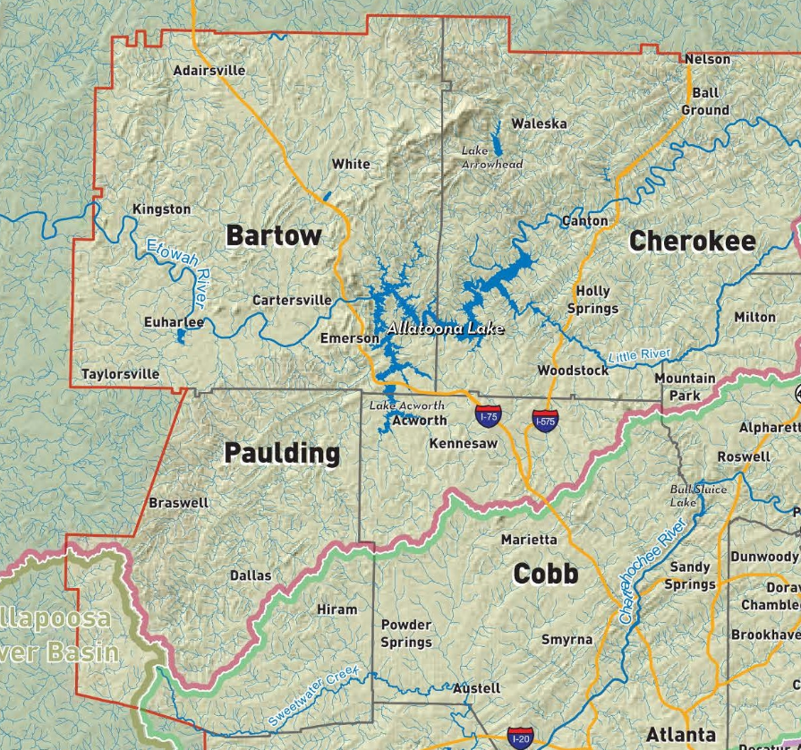


Paulding Currently Gets Water From Cobb County Marietta Water Authority
  Paulding has Approximately 43,000 customers
  Current average demand of 10 mgd
  Wholesale Customer of CCMWA – who pulls water from Lake Allatoona
CCMWA
Notes:
Speaker: Kelly

Slide 5
Richland Creek Water Supply Program
  New drinking water supply for Paulding County
  Off-Peak Pumped Storage Reservoir located downstream of the Allatoona Dam on the Etowah River
  Initiated in 1999 – Paulding County citizens voted to pursue the program and purchase the land to develop the reservoir
  Provides rate stability and a long term drinking water supply for Paulding County
Notes:
Speaker: Kelly

Slide 6
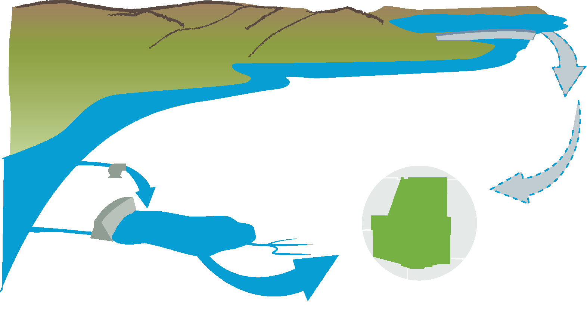
Off-Line Pumped Storage Concept
Lake Allatoona
Etowah River
CCMWA
47 mgd
36 mgd
Richland Creek Reservoir
36 mgd
Paulding County
Richland Creek
Notes:
Speaker: Kelly

Slide 7
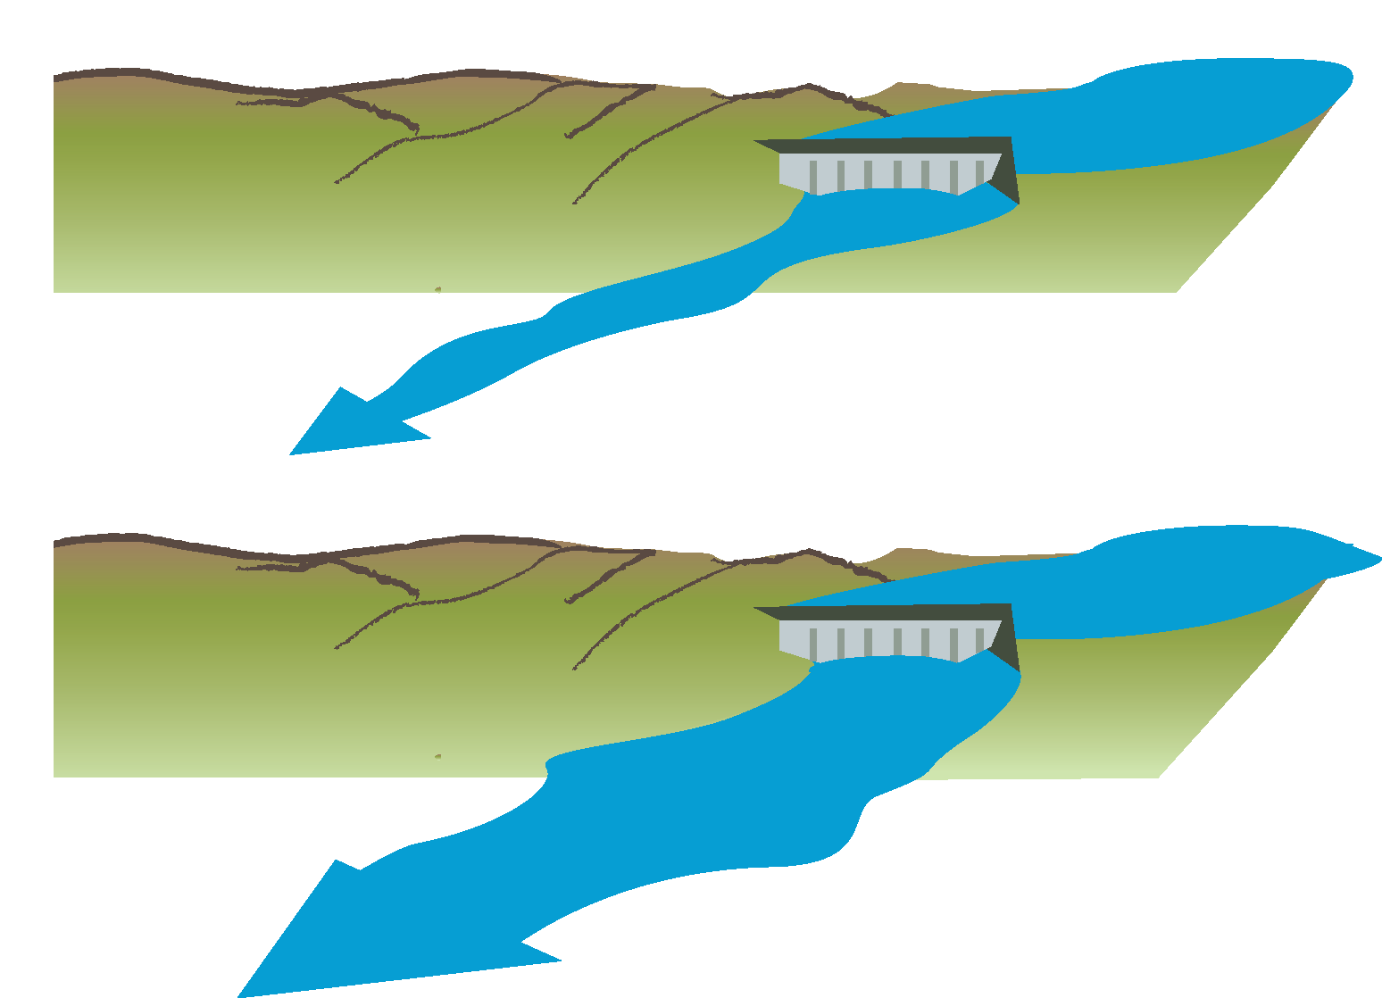
Off-Peak Pumping Scenario Minimizes Downstream Impact
Minimum Flow Conditions
290 CFS
During High Flows and Power Generation
93 CFS (60 mgd)
Up to 7000 CFS
Notes:
Speaker: Kelly

Slide 8
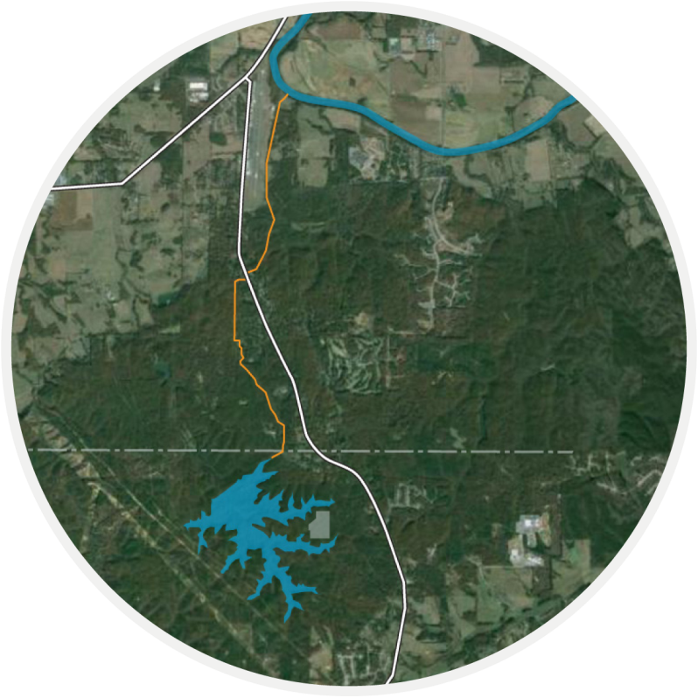
Richland Creek Water Supply Program Elements
River Intake and Pump Station
Raw Water Pipeline
Dam and Reservoir
Water Treatment Plant, Reservoir Intake and Pump Station
Distribution System Improvements
1
2
3
4
5
Notes:
Speaker: Kelly

Slide 9
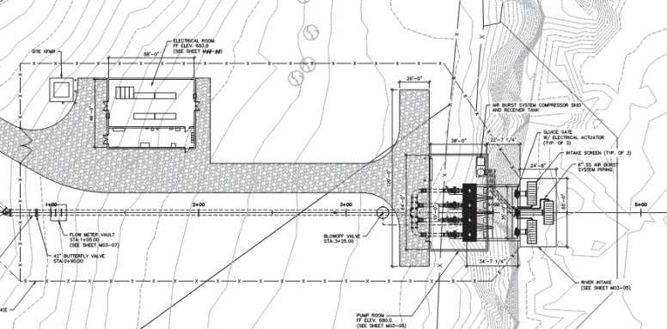
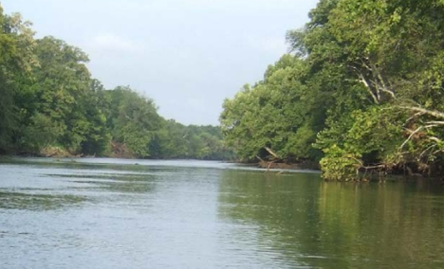
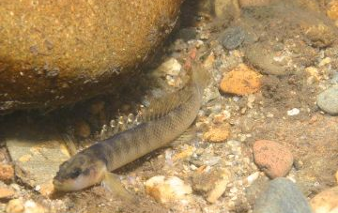
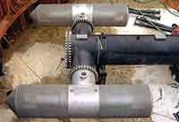
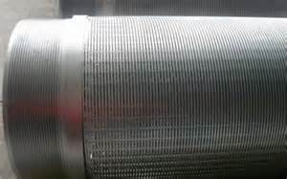
New Etowah River Intake and Pump Station
  Will pump in parallel to power releases and high flows so does not impact downstream users
  Intake screens designed to prevent impact to Cherokee Darter populations
Notes:
Speaker: Kelly

Slide 10
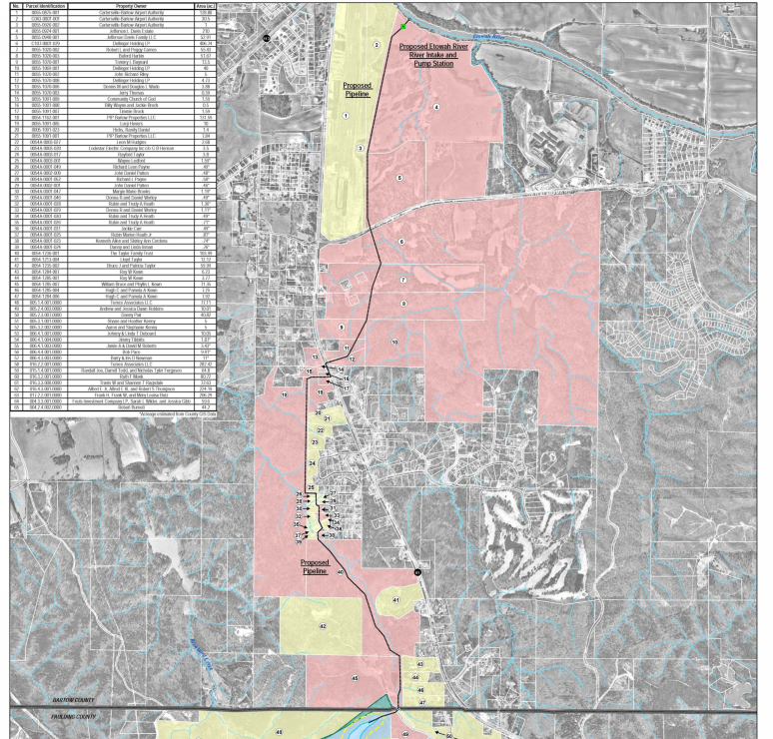
Raw Water
Pipeline
  48” Pipeline (up to 100 psi)
  Alignment chosen to minimize property impact and roadway disruption
  Accommodates airport expansion plans
Notes:
Speaker: Kelly

Slide 11
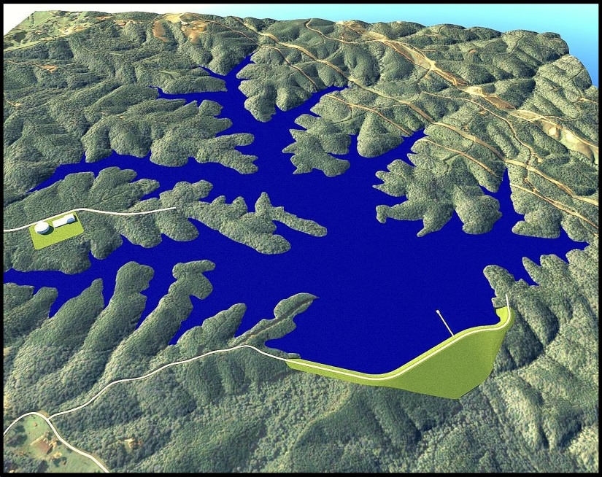
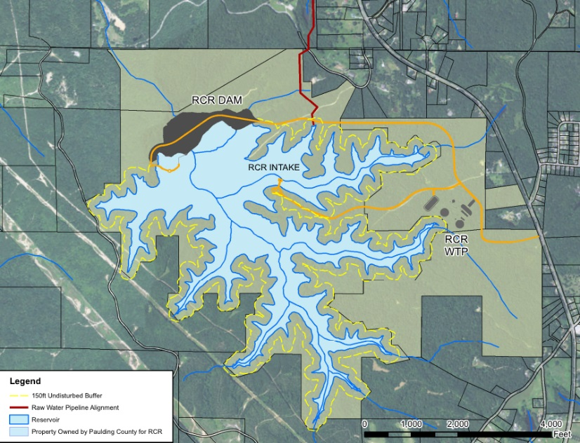
Richland Creek Reservoir
  305 acre, 3.4 BG
  Passive recreation will be allowed
  Boat ramp and dock for public access
  Adjacent park
  150 ft undisturbed buffer around reservoir
Notes:
Speaker: Kelly

Slide 12
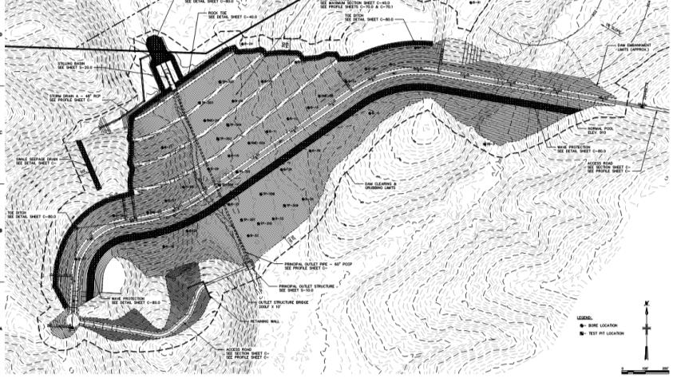
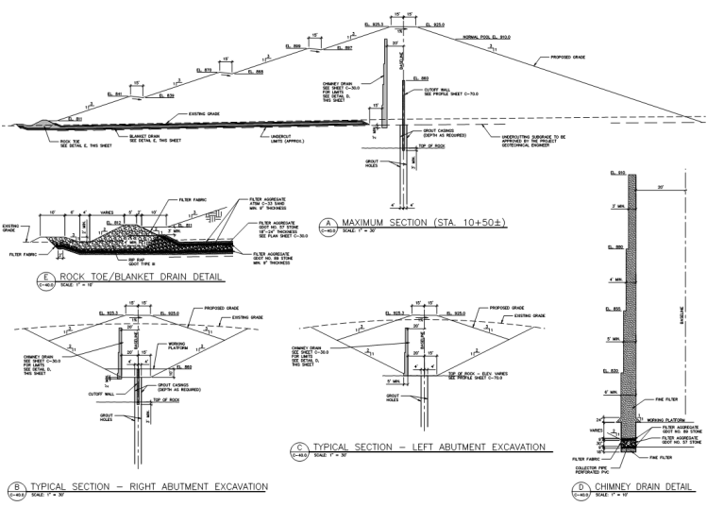
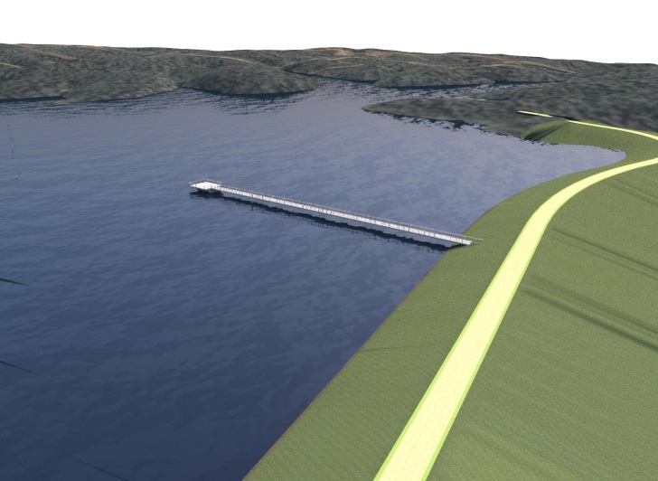
Dam Design
  115 ft high earthen dam Normal Depth 90 ft
  Grout Curtain and Concrete Cutoff Wall
  Provide release to maintain 7Q10 (0.5 CFS) in Richland Creek
Notes:
Speaker: Kelly

Slide 13
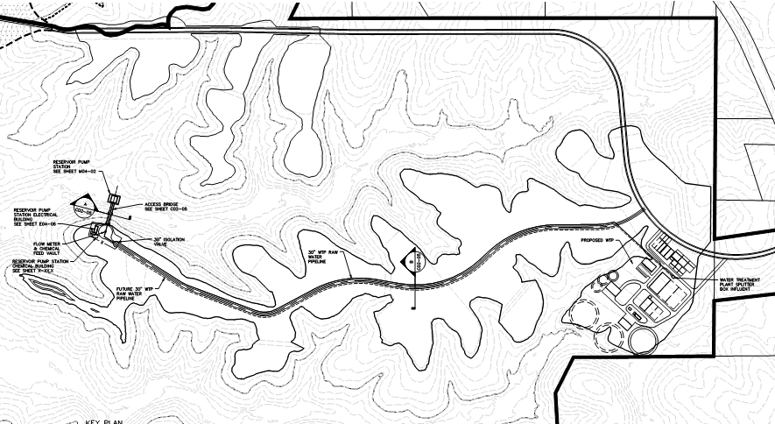
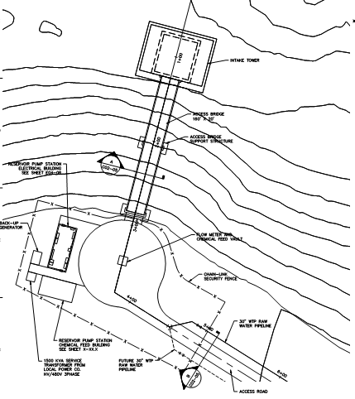
Reservoir Intake and Pump Station
  Initially 4-6.8 mgd pumps
  Space for 4 future pumps
  Ability to withdraw from the reservoir at 3 different levels within the reservoir for optimum water quality
Notes:
Speaker: Kelly

Slide 14
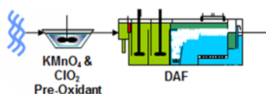

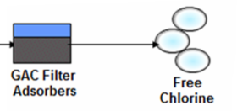
New Water Treatment Plant
  Initial Sizing of 18 mgd / Ultimately Sized for 36 mgd
  Coagulation, Dissolved Air Flotation (DAF), Filtration, Post Filter GAC Contactors
  Similar treatment process to Wyckoff WTP
CLO₂
Pre-Oxidant
Filters
GAC Contactors
Free Chlorine
DAF
Notes:
Speaker: Kelly

Slide 15
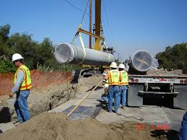
Distribution System Improvements
  RCR is located in North Paulding
  Distribution System improvements necessary to move water to South Paulding
  12 Miles of 36” water lines
  Additional distribution system storage and pumping
Notes:
Speaker: Kelly

Slide 16
Program Cost and Funding
Notes:
Speaker: Kelly

Slide 17
Program Cost Estimate
Project Element | Cost
Reservoir | $ 70,700,000
WTPs and Pump Stations | $ 99,800,000
Raw Water Pipeline | $ 9,400,000
Finished Water Pipeline and BPS | $ 35,000,000
Total Program | $ 215,000,000
        Costs shown include design /CM, construction, mitigation, and program management
Currently $ 175 Million under contract and within budget.
County went to the bond market in September of 216 and financed $156 million at a rate of 2.86%

Slide 18
Summary of GEFA Support
Georgia Environmental Finance Authority (GEFA) providing $82 million in support
$15 million in State Direct Investment
$2.8 million planning loan
$64.9 million in design / construction loans
GEFA Loan Number | Amount | Interest Rate |  |  | Term
 |  | First 3 years after initiating Drawdown | 3 years after initiating drawdown until Project Completion | After the earlier of Project Completion or 10/1/21
WS12L13WR | $ 29,100,000 | 0% | 1% | 1.82% | 40 Years
WS13L04WR | $ 21,600,000 | 0% | 1% | 1.40% | 30 Years
WS14L03WR | $ 6,000,000 | 0% | 0% | 2.03% | 40 Years
WS15L01WR | $ 8,206,250 | 0% | 0% | 2.03% | 30 Years

Slide 19
Financial Model and Long-term Economic Benefits
Notes:
Speaker: Kelly

Slide 20
Financial Plan
Conservative plan developed that assumes low growth scenario.
  Forecasting 1% growth in water use and 2.5% growth in sewer
  Last year water use increased 4.8% and sewer 5.6%
Conservative assumption in bond rates (5%) – likely will be on the order of 3%
Financial plan includes non program related costs for Water & Sewer System so additional rate increases in near term for non-RCR items should not be needed

Slide 21
Rate Increase
Needed rate increases to support Richland Creek Project Implementation
4.75% increase for 5 years above historical CCMWA Increase
After Program, plan to quickly get off of CCMWA systems so no longer will pay the CCMWA increase
Rate Increases | 2016 | 2017 | 2018 | 2019 | 2020 | 2021
Total Water | 4.0% | 8.75% | 8.75% | 8.75% | 8.75% | 8.75%
CCMWA Increase | 4.0% | 4.0% | 4.0% | 4.0% | 4.0% | 4.0%
Additional Increase | - | 4.75% | 4.75% | 4.75% | 4.75% | 4.75%
Sewer | 4.0% | 4.0% | 4.0% | 4.0% | 4.0% | 4.0%

Slide 22
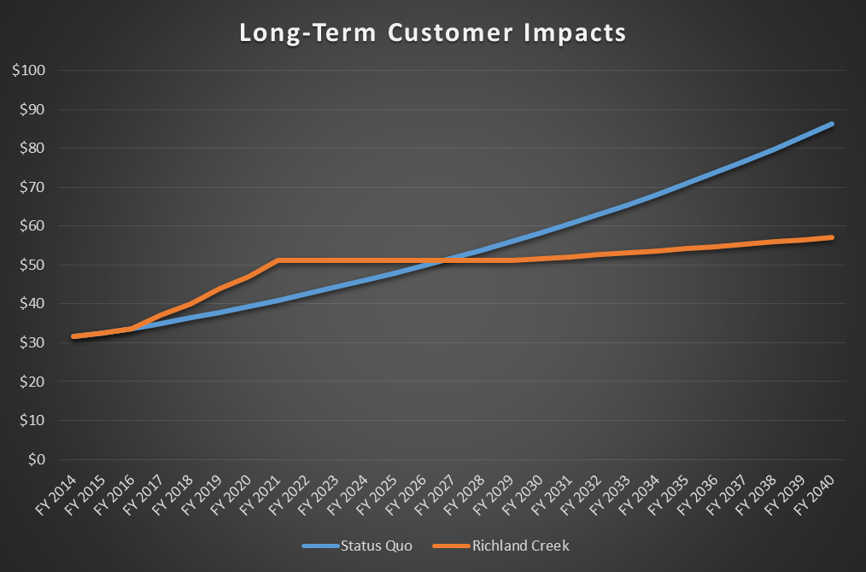
Long-Term Customer Impacts
Average monthly water bill for a customer using 4kgal per month

Slide 23
Long-Term County Savings
    Over $100 Million in long term savings for the County
    Security of having your own water supply source

Slide 24
Current Program Status
Notes:
Speaker: Kelly

Slide 25
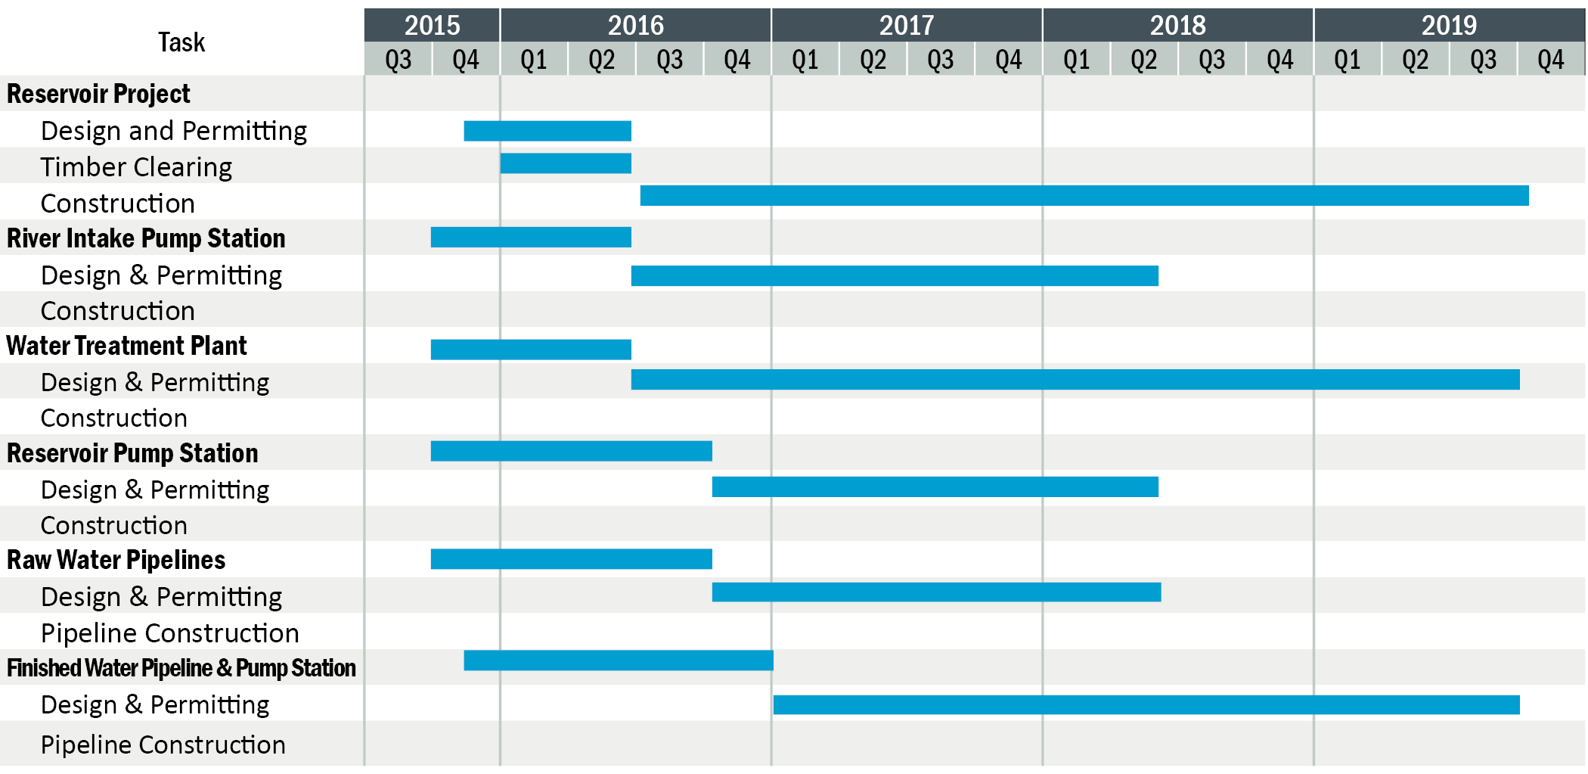
Overall Schedule
Notes:
Speaker: Kelly

Slide 26





Update on Public Outreach
        Continued involvement of RCR Stakeholder Communication Implementation Team
        Artwork and Mascot Competition were a success
        Provided Briefing to Cities
        Hiram, Dallas, Cartersville, Braswell, and Emerson
        Bill Insert / Newsletters
        Program Website – RCRWater.com
        Steady Activity – Responding to calls and questions submitted via website (Over
Notes:
Speaker: Kelly

Slide 27
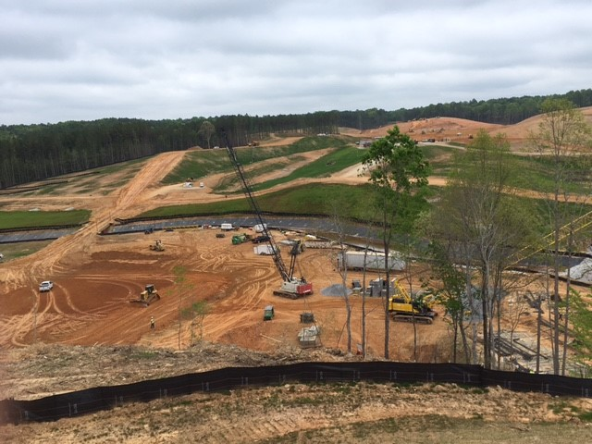
Construction Update

Slide 28
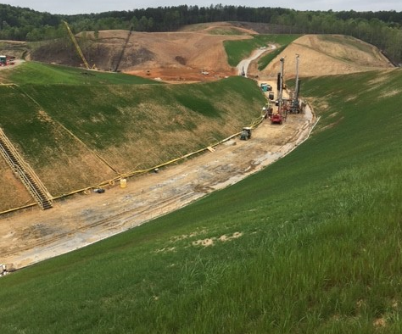
Construction Update

