Slide 1
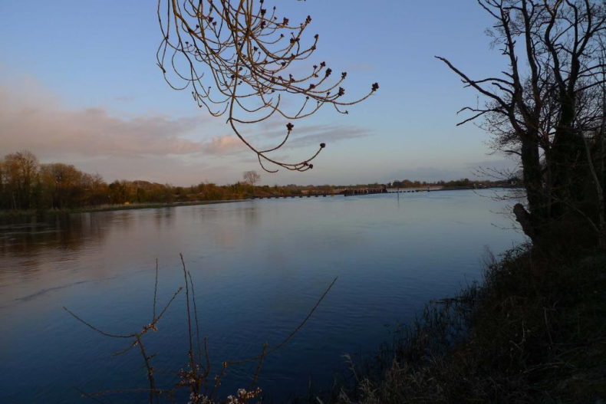
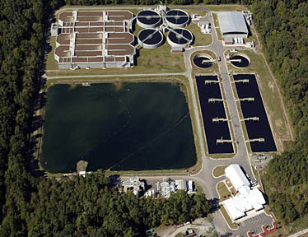
Nutrient Trading Framework in the Coosa Basin
April 22, 2015

Slide 2
Today’s Outline
Background Timeline
Nutrient Trading
Example Trade
Feasibility Study
Monitoring Plan
Questions?

Slide 3
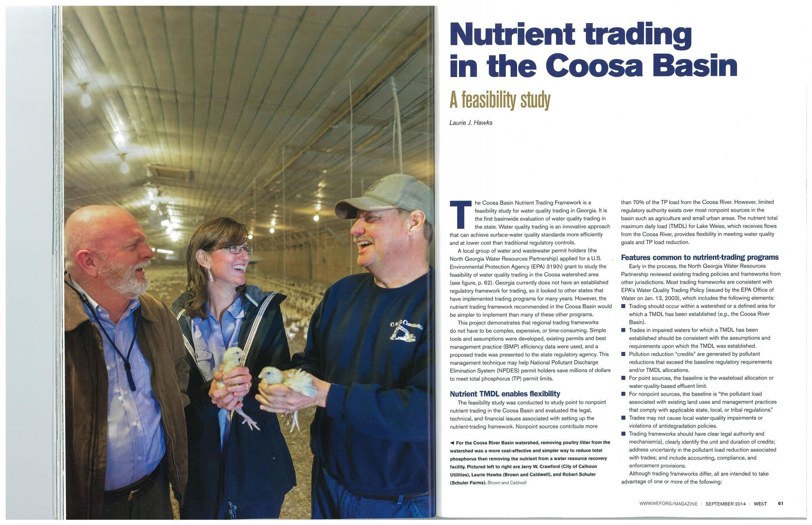
Water Environment & Technology September 2014

Slide 4
Timeline
2008 - Lake Weiss TMDL (USEPA)
2010 – 1 mg/L TP limits in NPDES permits (GAEPD)
2011- Partnership and GAEPD Correspondence
2011 - 319 Grant Awarded to Evaluate Nutrient Trading
2012-2013 – Nutrient Trading in the Coosa Basin: A Feasibility Study
Dec. 2013 – Review with GAEPD
2014 – Pilot Nutrient Trading Monitoring Plan
Oct. 2014 – Review with GAEPD
2015 – Implement Monitoring Plan

Slide 5
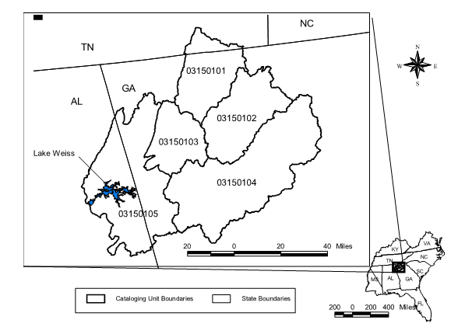
Background
Lake Weiss TMDL (USEPA 2008)
In order to meet Alabama Chlorophyll a standards, total phosphorus (TP) reduction targets set
GA required to reduce TP load by 30% at GA/AL state line
Goal can be met “any number of ways”
5,273 Square Mile Drainage Area
Source: USEPA 2008

Slide 6
Background
GAEPD issued TP permit limits for NPDES discharges of 1.0 mg/L (major) and 8.34 lbs/day (minor)
Cost of NPDES permit holder compliance estimated to be millions of dollars
Limits on Point Sources not targeting majority of the problem
Feasibility Study to look at Nutrient Trading in Coosa Basin USEPA 319(h) grant
Coosa River Basin:
Total Phosphorus Load
Non-Point Sources
> 70%
Notes:
Regulatory hook

Slide 7
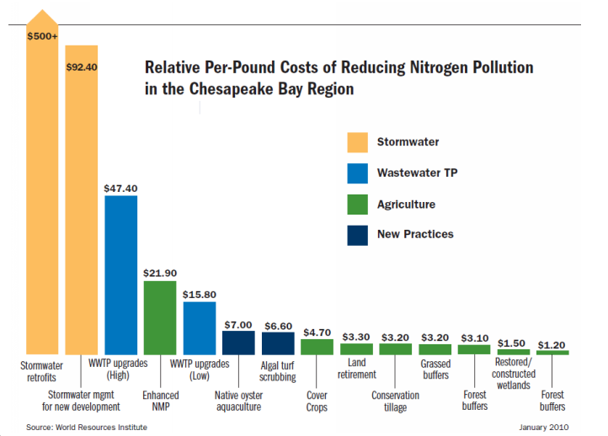
What is Nutrient Trading?
Tool to cost effectively meet pollution reduction goals
Notes:
Meet watershed goals, using most cost effective practices.

Slide 8
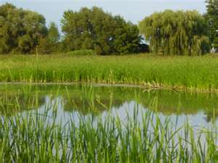
Trading Framework Examples
Neuse River, North Carolina
Point to point source trades, nitrogen
Boise, Idaho
Point to non-point source trades, phosphorus
Virginia Chesapeake Bay
Many types of trades, both nitrogen and phosphorus

Slide 9
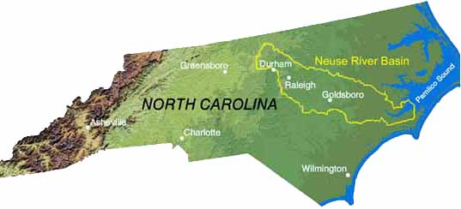
Neuse River Trading & Offset Program
Point-point trading framework
20+ Neuse River Compliance Association Members can comply by meeting:
Individual nutrient allocation; OR
Aggregate allocation
Member have reduced nutrient discharges approx 70%
If allocations exceeded, must trade or pay into Wetlands Restoration Fund
Notes:
Private watershed association

Slide 10
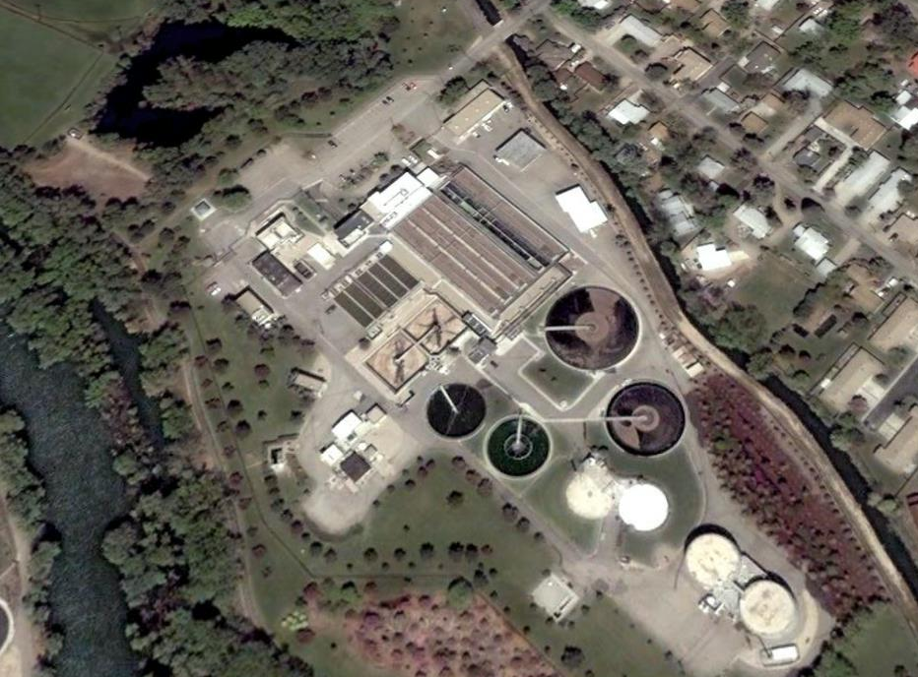
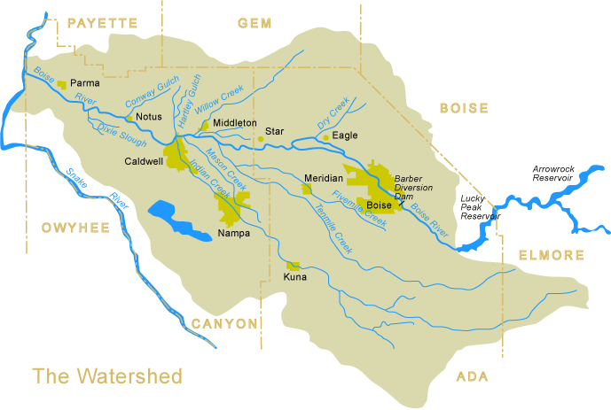
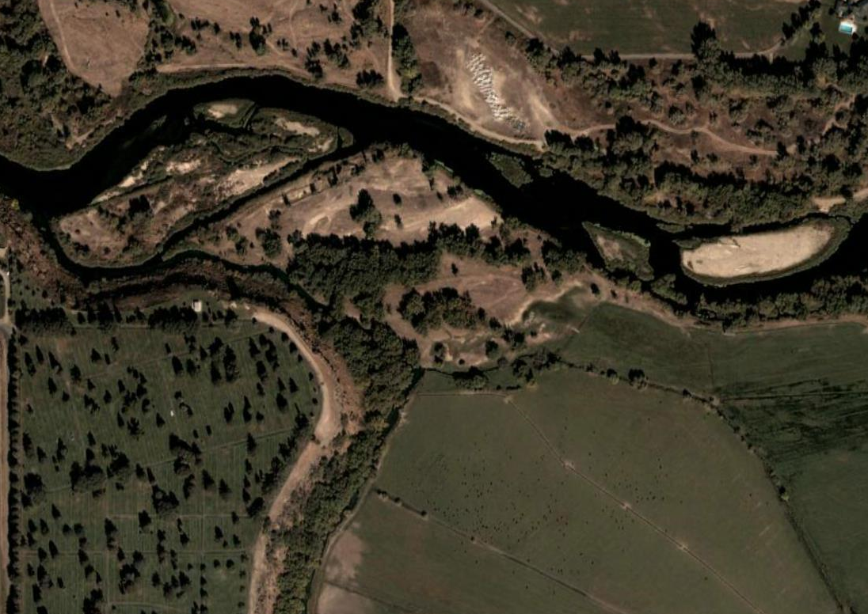
Lower Boise River

Slide 11
Benefit and Cost of Incremental P-Removal
Trading Can Offer Significant Cost Benefits
3000
300
275
250
225
2000
200
175
Lbs TP/day Removed
Lbs TP/day removed
Cost of Removal ($M)
150
Incremental Cost of
125
Removal ($M)
1000
100
75
50
25
0
0
200
70
Level of Treatment (ug TP/L)
Cost for additional 3% TP reduction = $40 million

Slide 12
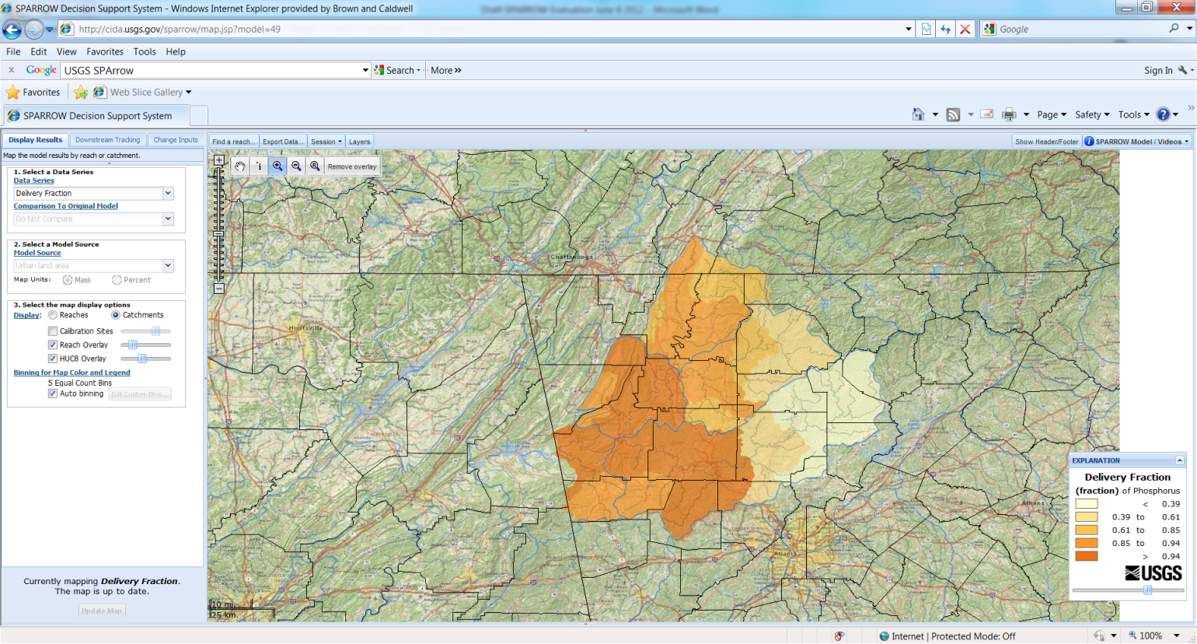
Background: Proposed Coosa Basin Trading Framework
Trades between individual parties
Trade terms and conditions incorporated into individual NPDES permits
Develop basic trading guidance
GAEPD to review/approve the trading guidance and NPDES permits
Stakeholder Meetings/Public Input
Notes:
Don’t’ ask the state to set up new program, don’t set up a new organization, use existing authority in NPDES permits

Slide 13
Nutrient Trading Overview
Non-Point Load Reduction
Point Source
Load Reduction
Trade
Trading Guidance
Permit Condition
$
Public Input
$

Slide 14
Feasibility Study
Point source costs
Nonpoint source BMPs
Point source estimating tool
BMP estimating tool
Example Trade
Final Report Issued October 2013
http://www.ngawater.org
Notes:
Demand and supply exists for a trade

Slide 15
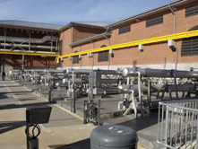
Example Trade: City of Calhoun
Adjusted goal 0.75 mg/L
Alum treatment
Limited capital costs under existing flow and limits
1.6 tons/yr additional sludge disposal
Annual O&M costs confirmed
$1.2 million capital and O&M over five years

Slide 16
Example Trade Potential BMPs
Single BMP
Enhanced Wetland/Chemical Treatment
Multiple BMPs
Georgia Soil and Water Conservation Commission Manual
Georgia Stormwater Manual
Source Reduction
Poultry litter export
Sludge land application

Slide 17
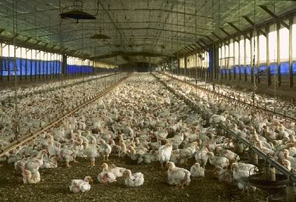
Source Reduction: Poultry Litter Export
Traditional BMPs could not meet the full load reduction
Poultry litter has volume and concentration needed (UGA literature)
Poultry production is significant in Gordon County/City of Calhoun
Current demand for litter as fertilizer
Litter applied for Nitrogen, may be over applied for Phosphorus

Slide 18
Trade Example: Point Source Data
The City of Calhoun is willing to serve as an example point source facility for a potential trade.
Current Flow – 6 MGD
Current Effluent TP Concentration – 5 mg/L
Current Annual Mass TP – 93,030 lbs/yr
Permit Limit Flow – 16 MGD
Permit Limit TP Concentration – 1 mg/L
Permit Limit Mass TP - 48,735 lbs/yr
Load reduction needed 44,295 lbs/yr
This number will increase as flow increases.
$1.2 million to meet this load reduction at the plant
using alum over a five year period.

Slide 19
Trade Example: Poultry Litter Export
A typical Broiler House produces 180 tons of litter per year, or 360,000 pounds per year.
The phosphorus content (as P₂O₅) is approximately 3% of the litter = about 4,750 pounds/yr/house.
TP Pounds Needed per year – 44,295
TP Pounds Needed per year using Litter – 3,355,682
TP Tons Needed per year – 1,678
Safety Factor (20%) – 2,013
Cost to Purchase at $25 per ton - $50,335
Cost to Purchase over Five Years - $251,676
Does not include delivery factor to stream
Conversion Factors
0.0132 3% P2O5 in litter, convert to P

Slide 20
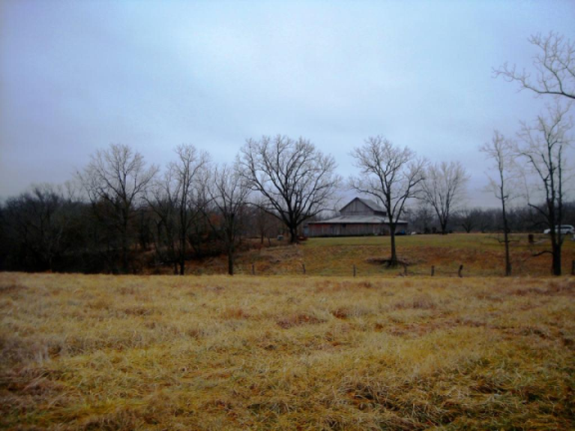
Trading Issues to Consider
Existing Poultry Litter Trade exists – how to participate in market http://www.galitter.org/
Verification of transport out of the basin
Minimum Standard for seller: Nutrient Management Plan
Permit Conditions – 5 year cycle, documentation, verification
Litter TP content confirmed
Documentation of TP reduction

Slide 21
Pilot Nutrient Trading Monitoring Plan
Goals
Defensible monitoring plan
Effectiveness of litter export
Reduce variables
Issues
Variability – watersheds, rainfall, upstream contribution
Saturated soils, may take years to see TP reduction
Sampling Scenarios Considered –
In-stream: Upstream/downstream of test fields
In-stream: Comparison watersheds
Field: Watershed sampling
Field: Plot sampling
Notes:
Robust for permit approval, UGA input, SQAP – used EPDs water quality monitoring SQAP. Time and expense considerations in accouting for variables in soils, rainfall, land use, slope, upstream water quality, etc.

Slide 22
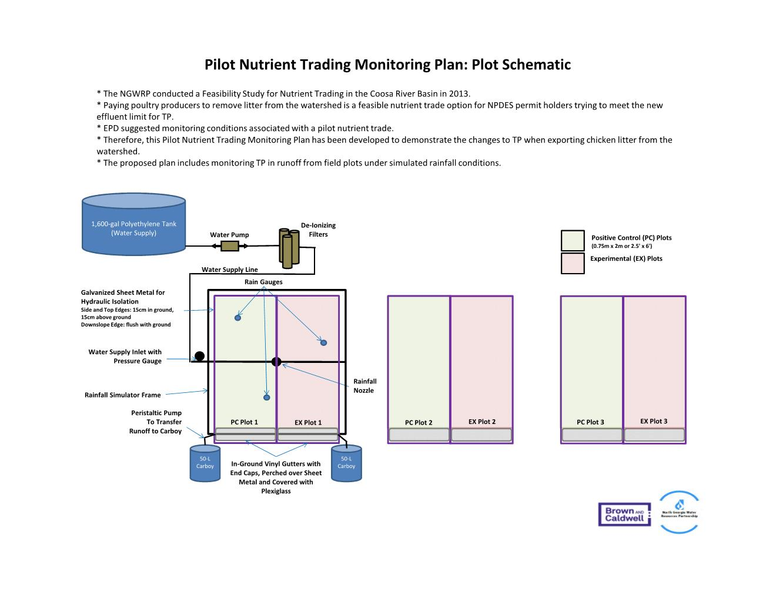

Slide 24
Next Steps
Monitoring Plan - 2014
Initiate monitoring 2015-2016
EPD Feedback – plots okay, larger field scale

Slide 25
Questions?
Contact Information
Laurie Hawks Jerry Crawford
Brown and Caldwell City of Calhoun
lhawks@brwncald.com JCrawford@calnet-ga.net
678-231-6433 706-602-6078

