Slide 1


Redundancy and Emergency Interconnectivity Plan
For the Coosa North Georgia Region
May 3, 2017
Presented by: Michelle Vincent, Jacobs Engineering

Slide 2
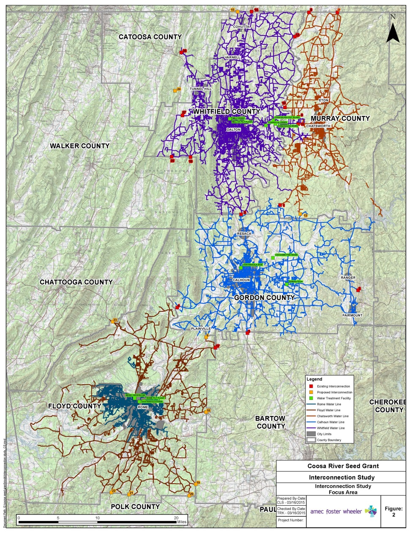

Introduction
Background
Redundancy and Emergency Interconnectivity Plan
  Service Areas
  Existing interconnections
  Emergency scenarios and reliability targets
  Potential interconnection projects and preliminary cost estimates
  Next steps and recommendations

Slide 3

Background
Studies were commissioned by the Coosa North Georgia Regional Water Planning Council (“Council”) to support Regional Water Plan implementation efforts
The Council:
  Established by Georgia's State Water Plan
  in 2008
  Sets direction, goals, and policy for water planning in the region
  Works closely with Georgia Environmental Protection Division to produce Regional Water Plans and support implementation
  Meets semi-annually to quarterly
The North Georgia Water Partnership (“Partnership”) serves as the technical advisory body for the Council, in addition to implementing goals for water planning and service for the region.
The Partnership:
  Formed in 2003
  Provides proactive regional water-based planning, technical assistance and education
  Meets monthly and assists with implementation process

Slide 4
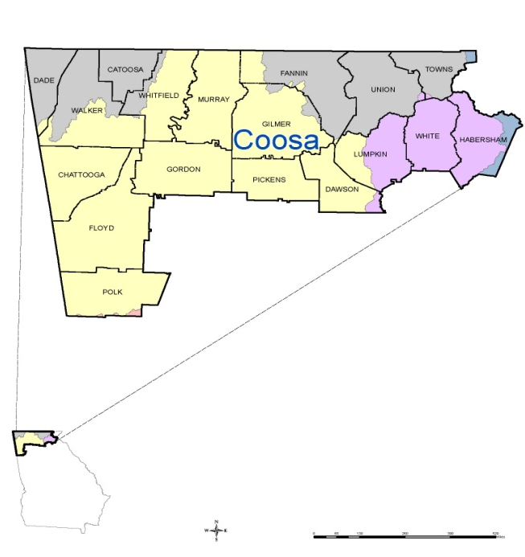
Background
Coosa North Georgia Water Planning Region
River basins: Tennessee, Coosa, Chattahoochee, Savannah

Slide 5
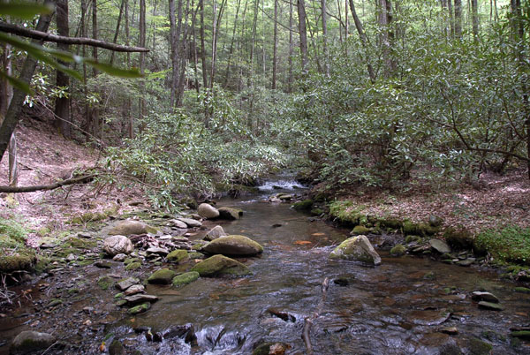
Background
Studies were modeled after a study commissioned by GEFA for the Metro Atlanta area.
Phase I and Phase II studies, combined into one “Redundancy and Emergency Interconnectivity Plan.”
Includes entirety of the Coosa-North Georgia Water Planning Region
The REI plan evaluates if communities are meeting reliability targets for water supply, in case of water – related emergency scenarios.
Plan then proposes additional projects to help communities meet reliability targets.
Proposed projects can be part of implementation of Regional Water Plan.
Conasauga River

Slide 6
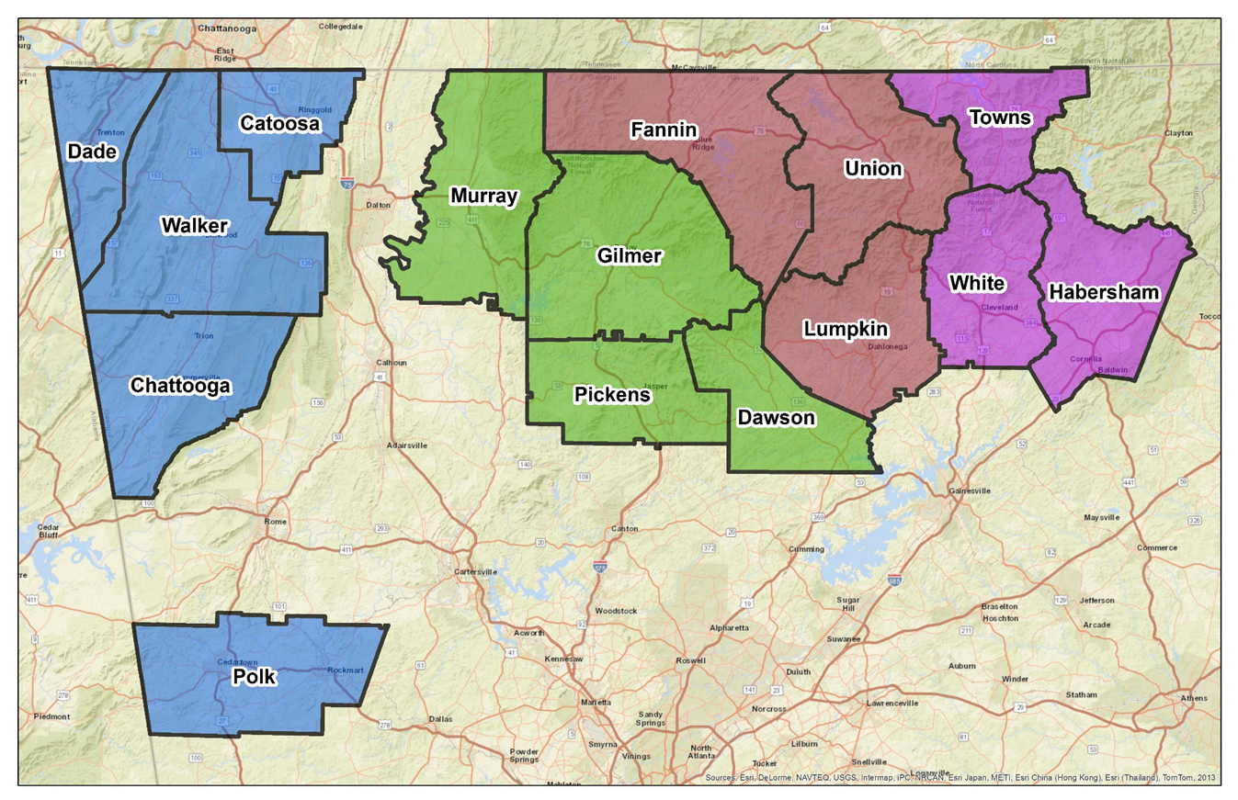
Redundancy and Emergency Interconnectivity
Phase 1 (2014-2015): Initial Focus Area - Rome/Floyd, Chatsworth, Dalton, Calhoun
Phase 2 (2016-2017): Remainder of Coosa Region: Dade, Walker, Catoosa, Chattooga, Polk, Gilmer, Murray, Pickens, Dawson, Fannin, Union, Lumpkin, Towns, White, Habersham (and connections with Tennessee, and Metro counties)

Slide 7

Redundancy and Emergency Interconnectivity
Major tasks of Study:
Data collection
Analyze and map existing systems and interconnections
Evaluate emergency scenarios and reliability targets
Propose additional interconnection projects
Next steps and recommendations
Stand up paddle boarding on Lake Blue Ridge

Slide 8
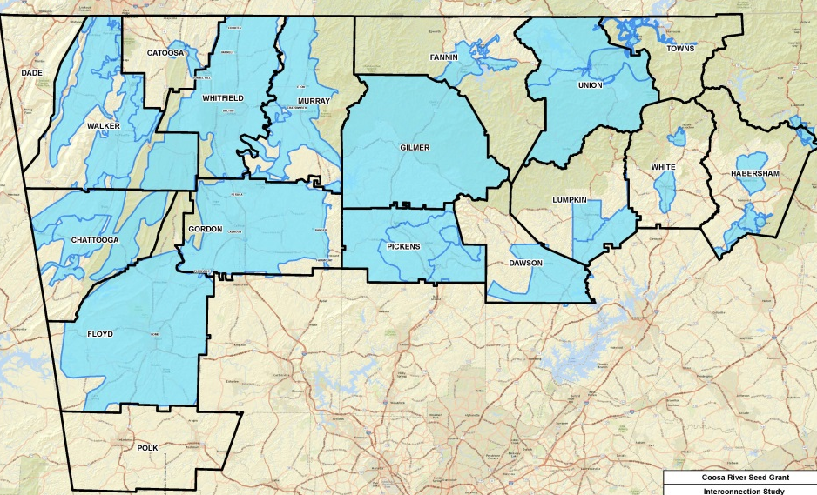
Redundancy and Emergency Interconnectivity
Public Water Service Areas
Notes:
Determined and mapped service areas for region – needs to be updated, lacking GIS in some areas. Some counties consider “Entire county” to be service area, even if they don’t have pipes there or plan to have pipes in next 20-30 yerars.

Slide 9
Redundancy and Emergency Interconnectivity
Collected GIS and Pipe Data
  GIS data not widely available across the region
  GIS data are not just the “lines on the maps”
  Important part of GIS are pipe size, when pipe was installed, when inspected, type of material, etc.
  Many communities don’t have GIS data, some don’t even paper maps, only “institutional knowledge” of where pipes are
  Real need for communities to get a handle on location of pipes, collect and collate data
  Opportunities for some future efforts and projects to work with smaller systems to get their systems tracked or mapped
Analysed and mapped existing interconnections
  Some interconnections classified “Existing, location unknown”
  Assumed 6” pipes when no GIS data available
Notes:
Collected data, pipes, water mains, water treatment plan capacities, permit limits, water availability.
We also digitized paper maps
The interconnections which are considered Existing, Location Unknown were identified from information found on gadrinkingwater.net or by talking to systems superintendents who we called.

Slide 10
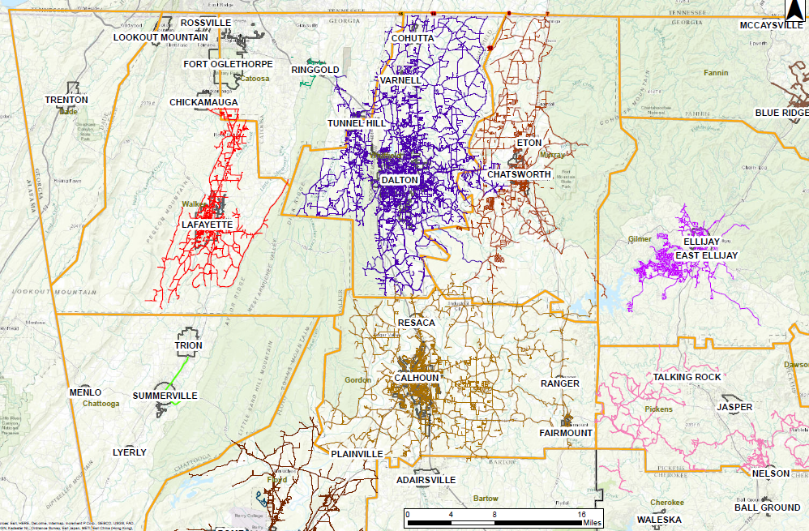
Redundancy and Emergency Interconnectivity
Notes:
Collected data, pipes, water mains, water treatment plan capacities, permit limits, water availability.
Red dots are existing; orange are proposed.

Slide 11
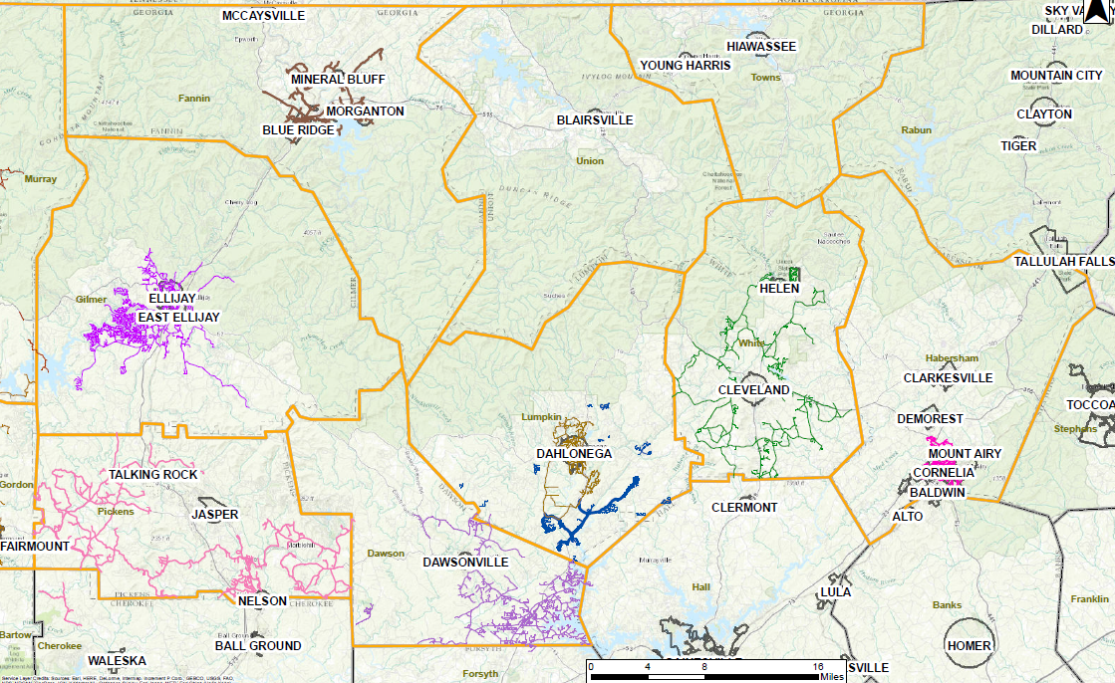
Redundancy and Emergency Interconnectivity
Notes:
Collected data, pipes, water mains, water treatment plan capacities, permit limits, water availability. Demand – current (2015) and 2050 – from Regional Water Plan
Red dots are existing; orange are proposed.

Slide 12
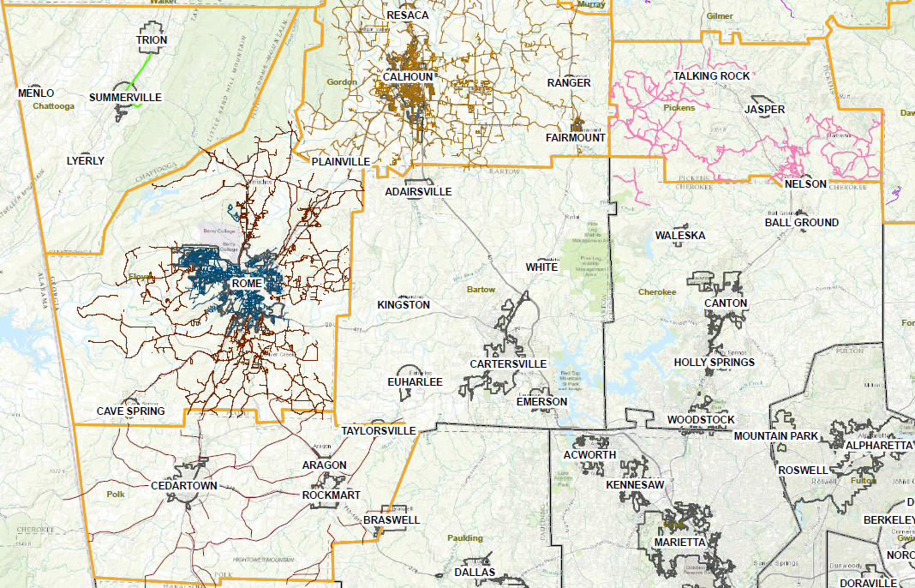

Redundancy and Emergency Interconnectivity
Fly Fishing, Fannin County
Notes:
Collected data, pipes, water mains, water treatment plan capacities, permit limits, water availability. Demand – current (2015) and 2050 – from Regional Water Plan
Red dots are existing; orange are proposed.

Slide 13
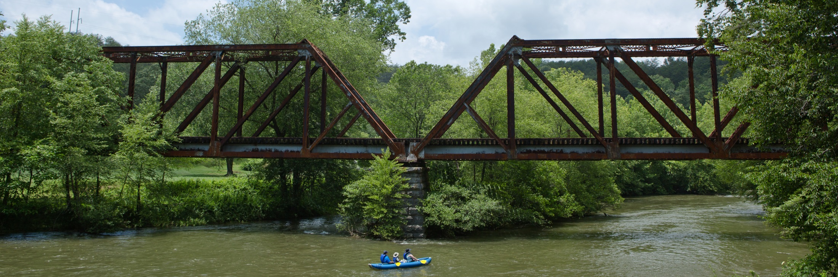
Redundancy and Emergency Interconnectivity
Next steps: Determine capacity and demand for Emergency Scenario Evaluation
Collected Water System Data
  Permitted water withdrawals, water system capacity, capacity of water treatment facilities, purchases, raw sources
  Current and Future Demand – allocated projected demand by population served. Removed self-serve customers, allocated demand through 2050
Region has nearly 250 permitted water withdrawals.
Analysed at least two* water systems per county – largest capacity systems (and any interconnected), systems of comparable size, others as appropriate.
Blue Ridge Scenic Railway
Notes:
Except Dade – only one system in Dade

Slide 14
Redundancy and Emergency Interconnectivity
Water system, water treatment plant, raw water capacity:
Fannin County:
Pickens County:
Notes:
Evaluated systems and sources for each county – capacities.

Slide 15
Redundancy and Emergency Interconnectivity
Meeting existing and future demand
Compared existing and future (2050) demand of Annual Average Day demand with water availability (MGD)
County | Annual Average Day – 2015 Demand | Annual Average Day – 2050 Demand | County | Annual Average Day – 2015 Demand | Annual Average Day – 2050 Demand
Murray County (Chatsworth) | P | P | Gilmer County | P | P
Whitfield County (Dalton) | P | P | Habersham County | P | P
Floyd County (Rome) | P | P | Lumpkin County | P | P
Gordon County (Calhoun) | P | P | Pickens County | P | P
Catoosa County | P | P | Polk County | P | P
Chattooga County | P | P | Towns County | P | (0.18)
Dade County | P | P | Union County | P | P
Dawson County | P | (1.65) | White County | P | P
Fannin County | P | P | Walker County | P | P
(Source: Coosa North Georgia Draft Regional Water Plan, 2017)
Notes:
As a first step for REI planning, we compared demand with availability (i.e., permitted capacity) for 2015 and 2050 – info from Regional Water plan.
Count aggregate. All counties but two have enough current permitted capacity to meet projected 2050 demand.

Slide 16
Redundancy and Emergency Interconnectivity
Notes:
Systems we included in this study – by county. Always included the “biggest” or primary system in a county, and at least one secondary. For some counties, included 3 or more systems.
Allocated projected demand by population served. Removed self-serve customers, and smaller systems, allocated demand through 2050.

Slide 17
Redundancy and Emergency Interconnectivity
Reliability Targets and Emergency Scenarios
Emergency Scenarios:
  Failure of largest treatment facility within a water system
  Short-term catastrophic failure of distribution system
  Short-term contamination of a water supply system
  Short-term contamination of a raw water source
Reliability Targets
  100% Annual Average Day Demand
  65% Annual Average Day Demand
  35% Annual Average Day Demand
Notes:
For all the systems listed, we then evaluated whether they could meet target reliability goals under emergency scenarios.

Slide 18
Redundancy and Emergency Interconnectivity
Reliability Targets and Emergency Scenarios
Maximum Deficit (in MGD) for evaluated emergency planning scenarios
Phase I
Emergency Scenario with Max Deficit:
Phase I: Dalton and Rome: Failure of largest Water Treatment Facility or Failure of water distribution system. [Demand not yet updated]
Dade: Failure of largest Water Treatment Facility

Slide 19
Redundancy and Emergency Interconnectivity
Reliability Targets and Emergency Scenarios
Maximum Deficit (in MGD) for evaluated emergency planning scenarios
Emergency Scenario with Max Deficit:
Gilmer, Lumpkin and Towns: Short-term catastrophic failure of a water distribution system, Failure of largest Water Treatment Facility, or contamination of major water source
Walker: Short-term catastrophic failure of a water distribution system

Slide 20
Redundancy and Emergency Interconnectivity
Potential Interconnection projects:
At least one interconnection per system
For counties with deficits meeting reliability target, may propose additional interconnections
Systems with no deficits, no additional interconnections may be necessary. A few possible projects are included where they may be easily achievable.
Notes:
Proposed projects and estimated costs
For all counties, I made sure there was at least one interconnection with a system in the Coosa region. That is why some long pipes are proposed. For example Towns has a connection with NC but a connection with Union County was proposed to identify one possible interconnection in the Coosa region. If what the shortest proposed interconnection was already an infeasible distance, I did not propose other interconnections. I proposed interconnections anywhere that it seemed easily achievable based on available GIS data. I did not propose additional interconnections for Catoosa, because they already have 9 and it makes more sense to use and maintain those. I cannot say it was driven by deficits for Phase II.

Slide 21
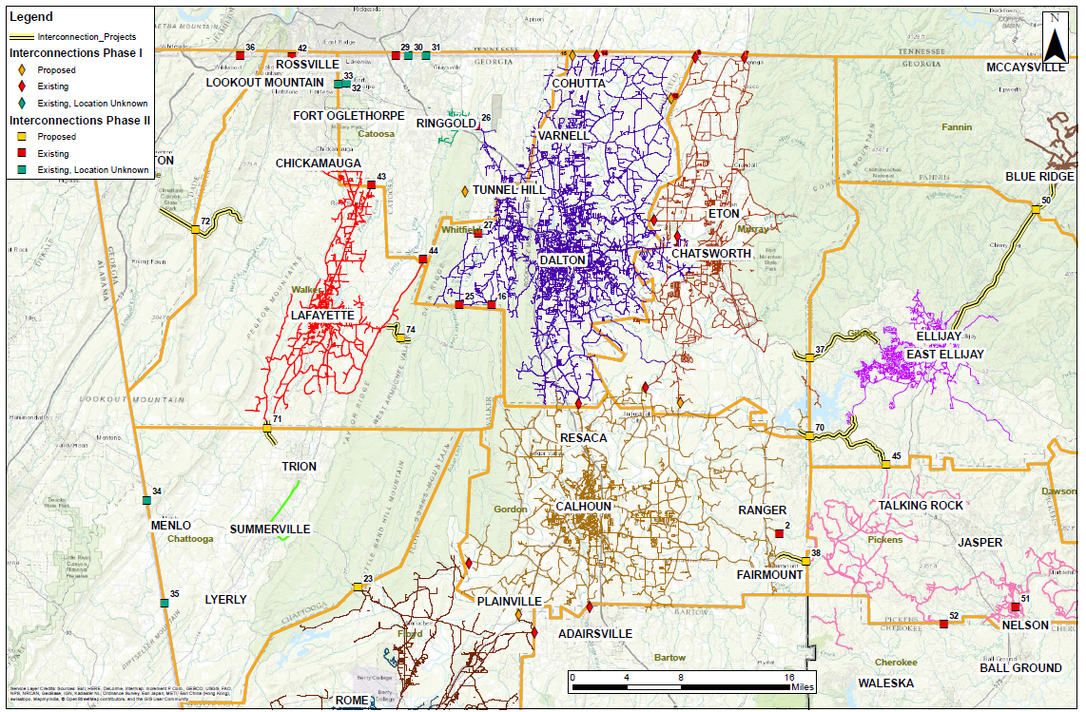
Notes:
Collected data, pipes, water mains, water treatment plan capacities, permit limits, water availability. Demand – current (2010) and 2050 – from Regional Water Plan
Red dots are existing; orange are proposed.

Slide 22
Redundancy and Emergency Interconnectivity
Potential Interconnection projects (Map 1):
Range of cost $100,000 to $6.2 million based on length
Source for Cost Estimates: Georgia State-wide Water Management Plan Water Management Practice Cost Comparison
Notes:
Proposed projects and estimated costs

Slide 23
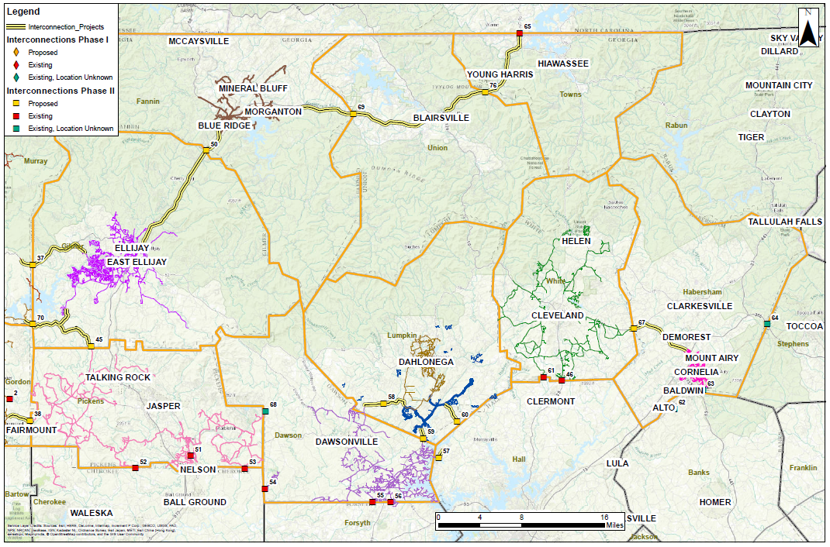
Notes:
Collected data, pipes, water mains, water treatment plan capacities, permit limits, water availability. Demand – current (2010) and 2050 – from Regional Water Plan
Red dots are existing; orange are proposed.

Slide 24
Redundancy and Emergency Interconnectivity
Potential Interconnection projects (Map 2):
Range of cost $600,000 to $18 million based on length
Source for Cost Estimates: Georgia State-wide Water Management Plan Water Management Practice Cost Comparison
Notes:
Proposed projects and estimated costs

Slide 25
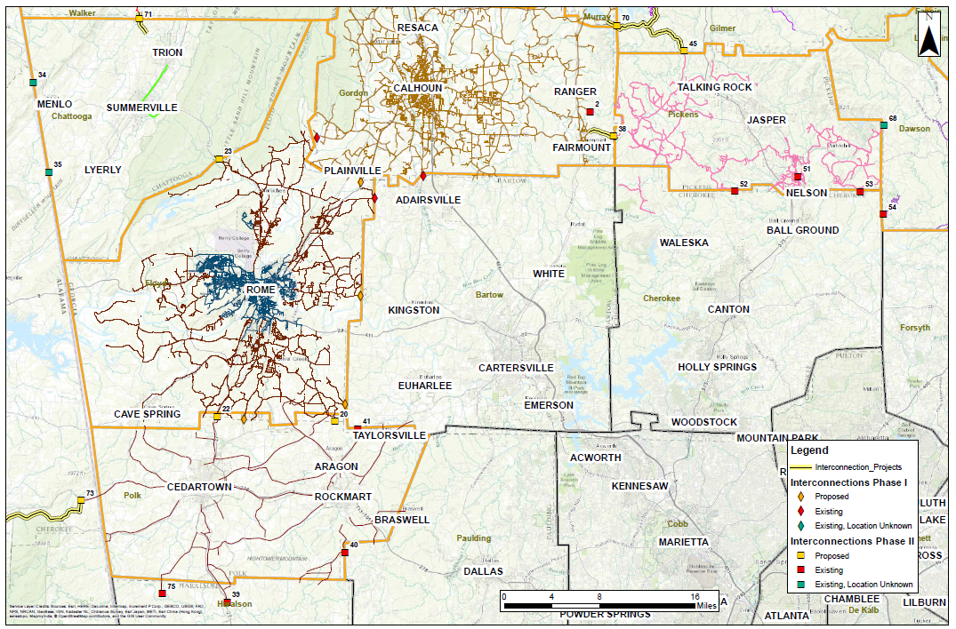
Notes:
Collected data, pipes, water mains, water treatment plan capacities, permit limits, water availability. Demand – current (2015) and 2050 – from Regional Water Plan
Red dots are existing; orange are proposed.

Slide 26
Redundancy and Emergency Interconnectivity
Potential Interconnection projects (Map 3):
Range of cost $100,000 to $5.3 million based on length
Source for Cost Estimates: Georgia State-wide Water Management Plan Water Management Practice Cost Comparison
Notes:
Proposed projects and estimated costs

Slide 27
Redundancy and Emergency Interconnectivity
Alternate potential projects:
May propose an increase in pipe size for existing connections, where we know pipe sizes, and additional need for water, and donating systems additional availability of water
May also propose additional raw water sources for isolated systems (i.e., surface water withdrawals, well systems, small reservoirs)
Notes:
Proposed projects and estimated costs

Slide 28
Redundancy and Emergency Interconnectivity
Alternate potential projects:
Redundancy evaluation for WTP:
  For areas with one WTP, or significant deficits at 35% reliability target due to failure of WTP, encourage redundancy evaluation for plant.
  Recommend determining what improvements would be necessary to provide full redundancy for each unit process, treatment train, storage tank and flow distribution structure.
Notes:
Interconnections were preferred evaluation for this REI Plan, to continue to connect Coosa systems; however, infrastructure redundancy may be more feasibly achieved by addressing redundancy at the WTP

Slide 29
Redundancy and Emergency Interconnectivity
Next steps and Future Activities:
Assist small communities with mapping their water lines and GIS data
Incorporate additional available data into REI Plan
Identify future regional water projects
Local and regional systems work to achieve emergency redundancy goals (35% and 65%)
    Implement recommended interconnections
    Implement proposed alternate projects (or similar)
Encourage communities to perform periodic maintenance of existing interconnections
Notes:
Each phase take about 6-9 months, but could be delayed due to budget concerns. Could also accelerate timeframe by combining phases.

Slide 30
Comments, Questions and Discussion
Michelle Vincent, Jacobs Engineering

