Slide 1
The Proposed WOUS Detail Definition
“A Practitioner’s View”
Presented by:
Richard W. Whiteside, PhD, CWB, CSE
Corblu Ecology Group, LLC

Slide 2
EPA Administrator Gina McCarthy - “…rural America will have to accept the fact that some ditches will be regulated. "We are talking about ditches that used to be streams and still act like streams. They may not have water running, but still act as a stream," McCarthy said. Then she added, "I never expected to say the word 'ditch' this many times in my entire life and I hope to get away from that as soon as possible."

Slide 3
WOUS What HAS NOT CHANGED
Navigable Waters
Interstate Waters/Wetlands
Territorial Seas
Impoundments of the Above

Slide 4
PROPOSED WOUS CHANGES/EXPANSION
All tributaries to:
1. Navigable Waters 2. Interstate Waters/Wetlands
3. Territorial Seas 4. Impoundments to 1-3
All Waters/Wetlands Adjacent to:
1. Navigable Waters 2. Interstate Waters/Wetlands
3. Territorial Seas 4. Impoundments to 1-3
5. Tributaries
No Significant Nexus Required

Slide 5
Definition of Tributary
Drainage features that contribute flow directly or indirectly to:
Navigable Waters
Interstate Waters/Wetlands
Territorial Seas
Impoundments to 1-3

Slide 6
Tributaries
Flow
Perennial 2. Intermittent 3. Ephemeral
Physical Attributes
Natural 2. Man-Altered 3. Man-made
Defined by
Ordinary High Water Mark 2. Bed and Bank (OHWM)

Slide 7
Definition of Adjacent waters
Adjacent - Bordering, Contiguous or Neighboring
Neighboring - Within floodplain or riparian area of:
Navigable Waters
Interstate Waters/Wetlands
Territorial Seas
Impoundments to 1-3
Tributaries

Slide 8
The net effect – expansion of wous
All tributaries are WOUS regardless of flow
All adjacent wetlands are WOUS
Probable jurisdiction of isolated wetlands as WOUS – “Other Waters”

Slide 9
Field examples of new wous
Ditches

Slide 10
Field examples of new wous
Ephemeral drains

Slide 11
Field examples of new wous
Isolated wetlands/significant nexus

Slide 12
Case study
Egypt hollow dam/lake – Humphreys county, Tn

Slide 13
EGypt hollow dam/lake
EPA alleges landowner constructed dam/lake without Section 404 permit
Landowner asserts dam/lake constructed on non-jurisdictional ephemeral drainages
Landowner has 2+ years of flow and ground water level data to support position

Slide 14
Egypt hollow dam/lake
EpA asserts that EPHEMERAL drainages
Have a significant nexus to the navigable Duck river

Slide 15
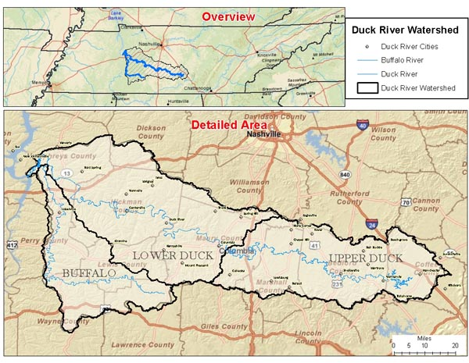
Egypt hollow dam/lake
Does a 1,100 acre watershed comprised of ephemeral drains have a significant nexus to the 1,650,000+ acre watershed of the Duck River?

Slide 16
Egypt hollow dam/lake
In 2013
EPA fails to exert jurisdictional on the ephemeral drainage system – lack of significant nexus
Case settled with NWP for dam and minor mitigation
In 2015
New WOUS definition captures ephemeral drainages by rule
Net Result – Individual Permit required/a significant violation of The Clean Water Act

Slide 17
How does this affect you?
More projects will require a USACE permit
Projects now qualifying for NWP may require an IP
Increased project costs – Consulting Fees
NWP ≥ $10,000 + Mitigation
IP ≥ $100,000 + Mitigation
4. Time Delays

Slide 18
WOUS Definition Status – as of April 2015
Over 1 Million Comments Received
20,000 “Unique Comments”
400 Public Information Meetings
87% of Comments Supportive
EPA/Corps Reviewed and Considered Comments - Slight Revisions Anticipated
Interagency Review of Final Definition – Revisions Possible
OMB 90-Day Review Initiated April 2015
Final Definition Anticipated to be Announced in Federal Register June – July 2015

